Slide 1


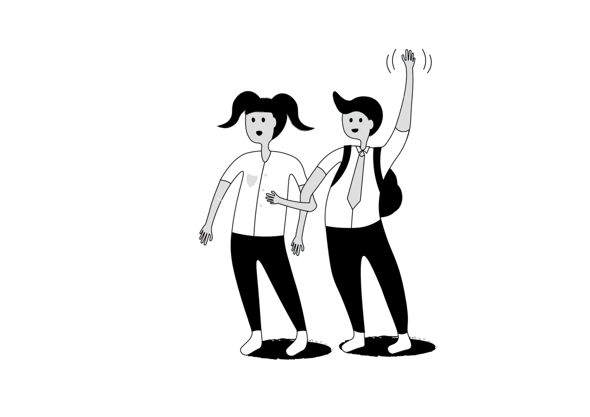

Anti-Bullying Week 2024
What is bullying?
Notes:
Slide 1: Anti-Bullying Week 2024
What is Bullying?
Refer to Learning Resource – What is Bullying Exercise 1, Part 1
Step 1:
You may wish to have the learners in your group complete this activity in small groups, in pairs or individually. Explain they are going to explore what bullying behaviour looks like and think about its impact. Learners are not required to share their own experiences of bullying during this exercise. (Slide 1)

Slide 2


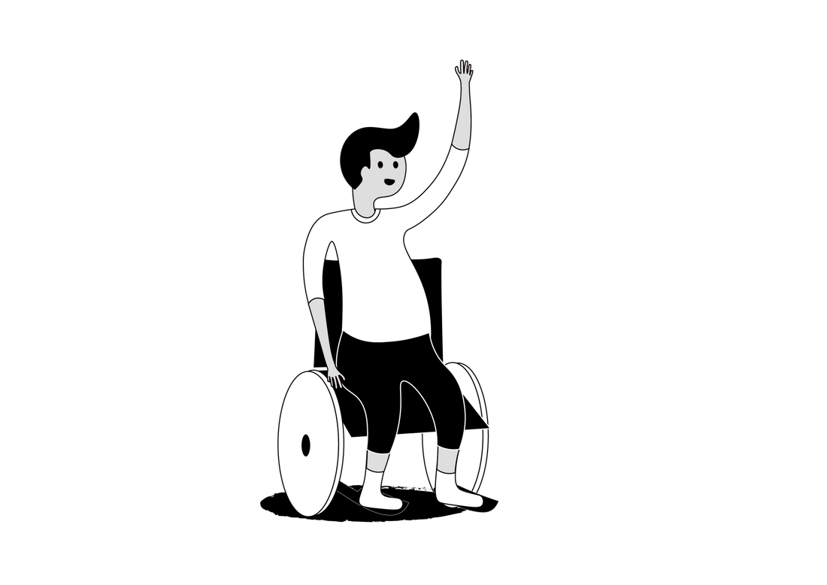
Bullying impact?
Bullying
Behaviours?
Bullying
impact?
Notes:
Slide 2: Anti-Bullying Week 2024
What is Bullying?
Step 2:
Ask each group to draw the outline of a person on a sheet of paper/whiteboard. They’ve to imagine this person is a friend who is experiencing bullying.
Step 3:
Around the outside of the person, ask them to write or draw the types of bullying behaviour that could be affecting them. They should list all the behaviours they have seen or know about. E.g. pushing, ignoring, sending messages.
Step 4:
Take some group feedback Highlight any examples given by the learners which aren’t bullying, such as friendship fall outs or disagreements or more serious/criminal behaviour such as fighting or asking for/ sending nude images.
Step 5:
Ask the learners to consider how the bullying behaviour might make the friend feel and how it could be affecting them (sad, angry, afraid, not wanting to go to school or to a club to avoid the individual(s) displaying bullying behaviours). Using a different colour marker, invite them to write their answers inside the outline of the person.

Slide 3

Behaviour and impact
Being called names, teased, put down or threatened
Being hit, tripped, pushed or kicked
Having your belongings taken or damaged
Being ignored, left out or having rumours spread about you
Receiving abusive messages
Being targeted because of who you are or who you are perceived to be
Fear of being bullied
Feeling sad, down
Attending school and school work
Avoiding people and places
Mental health
Hope for the future
Over-eating / under-eating
Self-harm
Notes:
Slide 3: Anti-Bullying Week 2024
What is Bullying?
Step 6:
Take some group feedback, exploring the examples of impacts the learners have come up with. You could use this slide to summarise.
Step 7. Explain that bullying is both what someone does (the behaviour) and how it makes you feel (impact). Bullying is always unacceptable because it can leave children feeling like they have no control or power. This makes it different from other types of behaviour like fall outs or disagreements. Be clear that no one has the right to bully someone else and we all have the right to be safe and free from bullying.

Slide 4
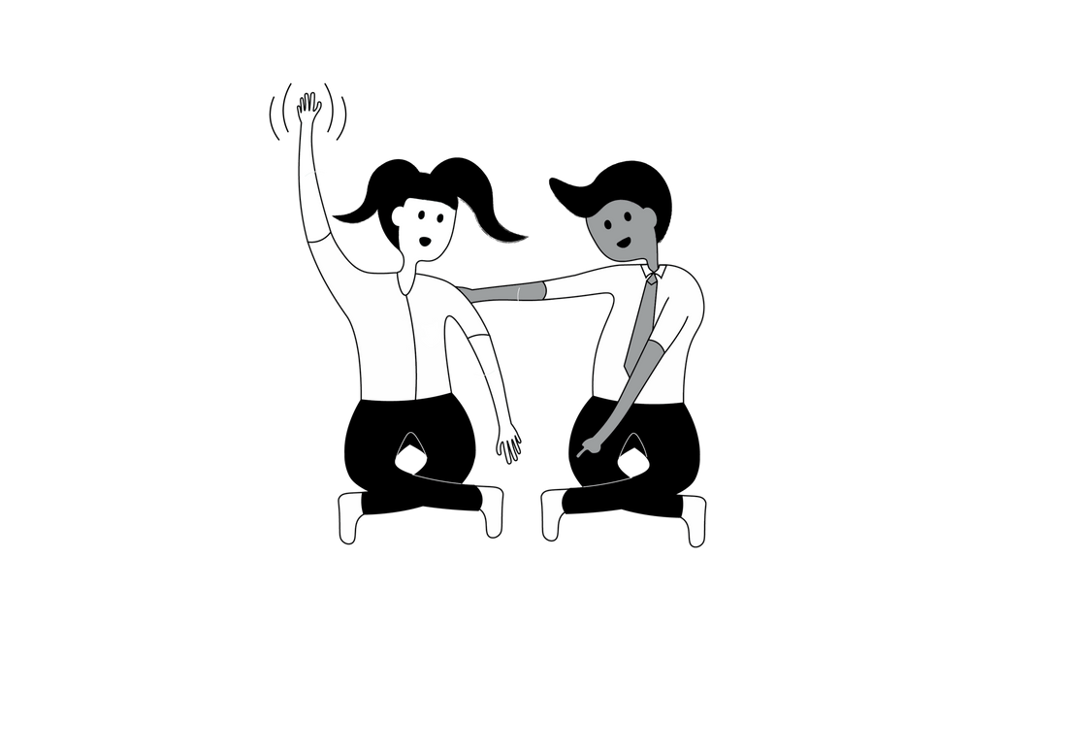



Notes:
Slide 4. Anti-Bullying Week 2024
What is Bullying?
Step 8:
You can use the bucket analogy to explore this concept further.
We all have a bucket inside our bellies, when it is full and warm it’s because we feel included, valued, respected and listened to. Our warm full buckets help us be confident and be who we are. When we don’t feel valued, included, listened to or respected – when we are bullied – our bucket tips out and so does our sense of control – we’re no longer able to confidently be ourselves. This loss of control can lead to negative thoughts and feelings.
END.

Slide 5
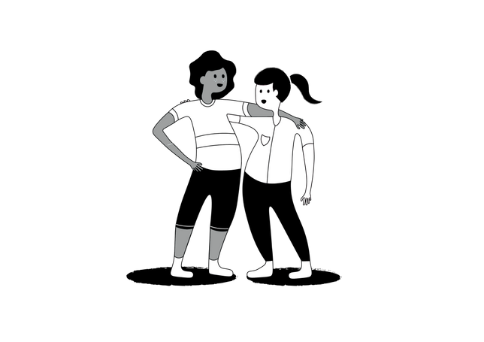
Who can help make a difference when it comes to bullying?
Notes:
Slide 5: Anti-Bullying Week 2024
Change starts with us
Refer to Learning Resource – What is Bullying, Exercise 2, Part 2 (20 minutes)
* Ideally this activity requires space for your group to move around, however it can be easily adapted if this is not available.
Step 1:
Explain that the learners are going to list all of the people they can think of who can help make a difference to bullying e.g. they might prevent it from happening in the first place, or they might do something to help someone who is being bullied.
Step 2:
Ask, who are some of the people closest to us that can make a difference?
Step 3:
On the whiteboard, for each group of people mentioned, draw concentric circles and write their name in the new circle.
Step 4:
Keep going until the group have come up with a full list, such as parents, carers, teachers, sports coaches, friends, community police officers etc.
Step 5:
Ask the group who should be at the centre of the circles – (the answer is YOU/any young person).
Step 6:
Now create these circles physically by asking for volunteers to represent each group listed and ask the young people to take position, creating concentric circles around each other by holding hands and then sitting down.
Step 7:
Once all the circles are in position, ask for volunteers to suggest small actions each group of people could take to help address bullying. The message is that no single group can make change alone, but if everyone does their bit, we have a ripple effect – the small action of stone dropping into a pond can create lots of ripples. Small actions can make a difference to someone who is being bullied. Record the actions the learners come up with on the whiteboard.
Refer to the Learning Resource for examples in a table.
Step 8:
Ask them to look around at all of the people who can help make a difference – when we all work together, we can create change. Reinforce this final message by erasing the concentric circles on the whiteboard. These lines don’t exist in the real world, all of these people can help, and importantly there are things we can do ourselves that make the world friendlier and kinder.
Step 9:
It’s important to reiterate the message that it is never a young person’s fault that they have been bullied. Revisit the idea that bullying is always unacceptable, no one has a right to bully others, and we all have a right to be safe and free from bullying.

Slide 6
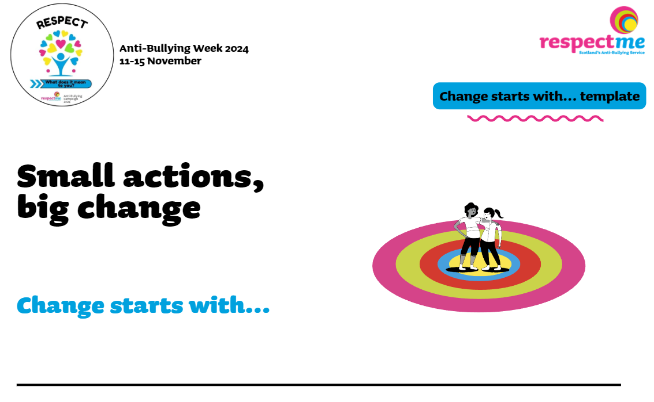
Anti-Bullying Week 2o24
Notes:
Slide 6: Anti-Bullying Week 2024
Refer to Learning Resource – What is Bullying, Exercise 2, Part 2
Cont./…Step 10:
Give each learner a “Change Starts With… ” Template (located on the respectme Anti-Bullying Week 2024 Campaign Hub online) and from the list the learners have just come up with, ask each learner to pick one they think is really important and write it on their sheet. ‘E.g. Change Starts With... my friends supporting me to seek help. Change Starts With... my parents listening to me’.
Step 11:
Get social! If your group is happy to take some pictures or videos with their ‘Change Starts With…’ Templates, and share them on Twitter or Facebook, using the hashtag #AntiBullyingWeek #RespectMeans. Don’t forget to tag respectme! Refer to our Campaign Toolkit for information.
END

