Slide 1

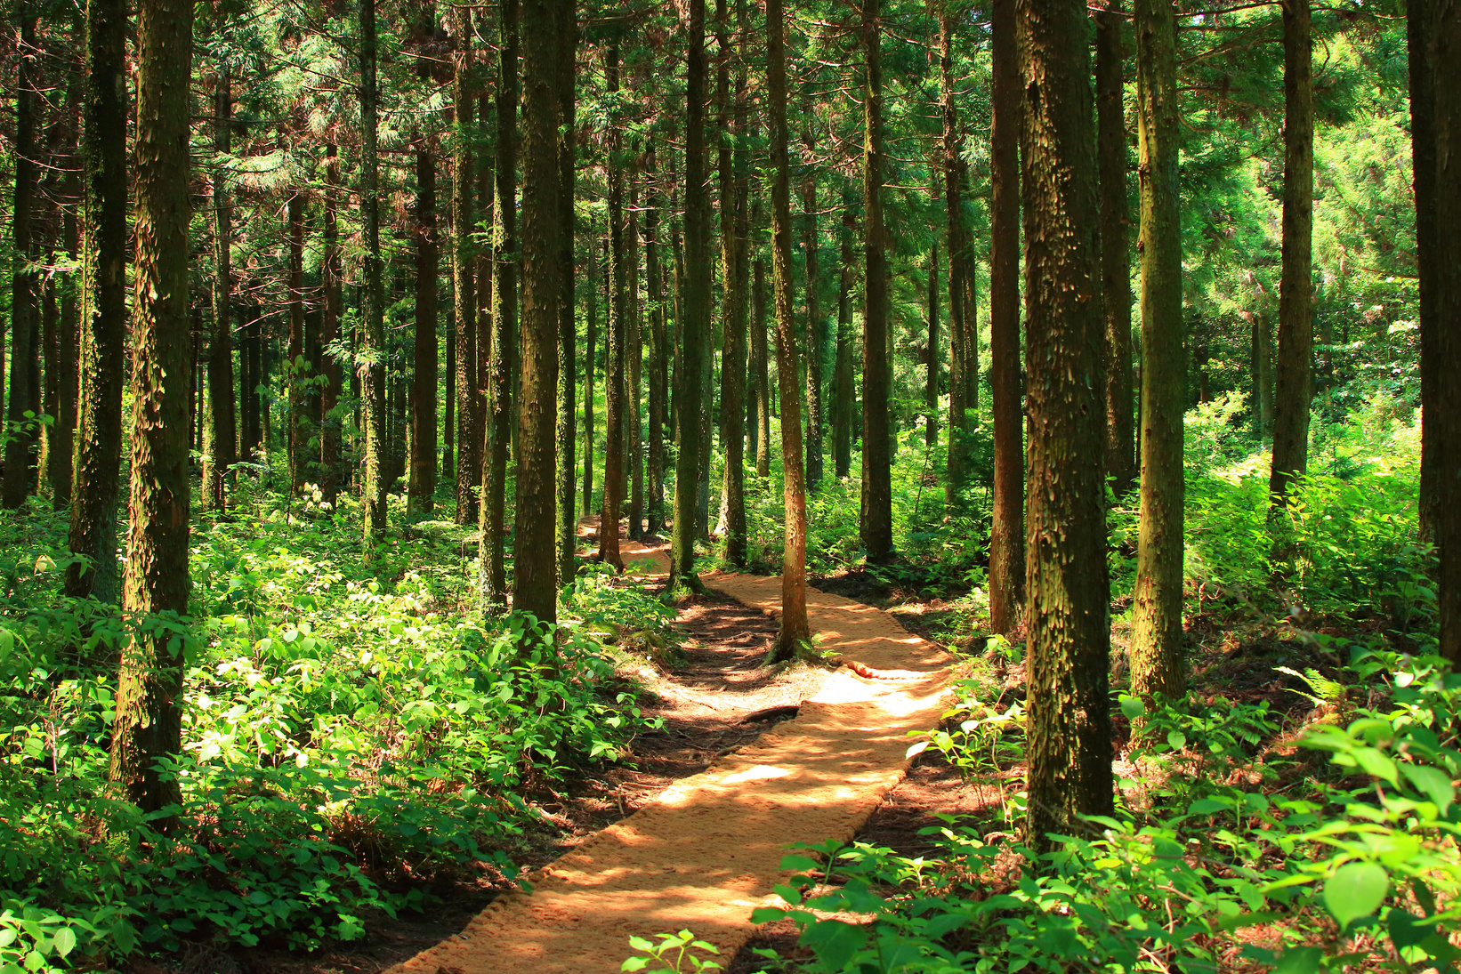

Anti-Bullying Learning Resource
Forests
Secondary Age Resource
Notes:
1

Slide 2
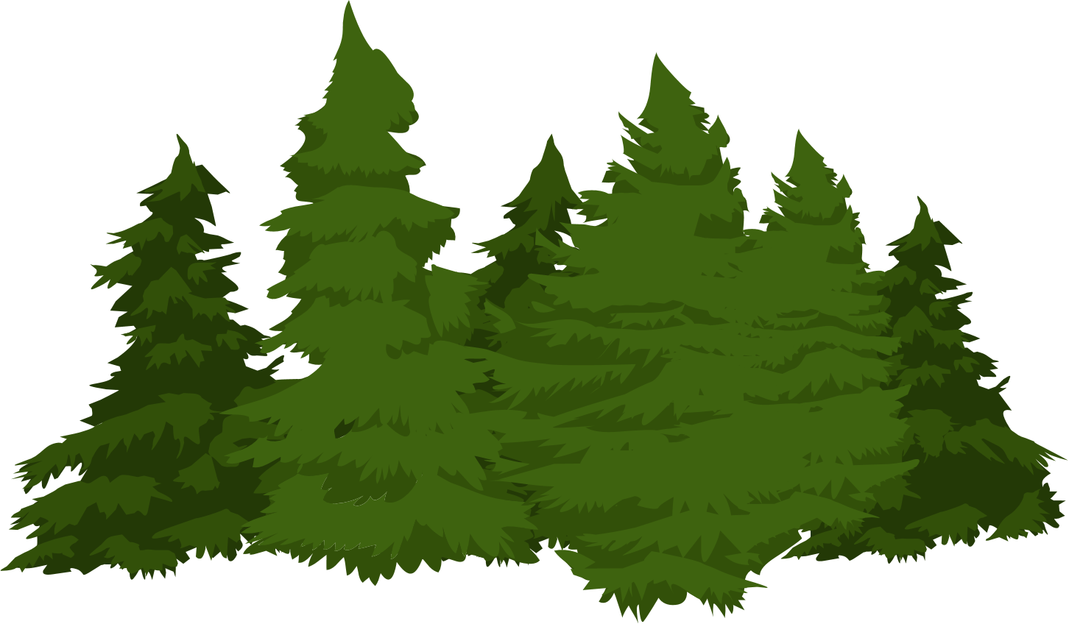
‘Forests’ was written to help us think about:
  Bullying behaviour
  How bullying can impact us
  The importance of going to trusted and responsible adults for advice and support
Notes:
Set the context by introducing the theme of the lesson and by explaining that the poem ‘Forests’ was written to help us think about:
-Bullying behaviour
-How bullying can impact us
-The importance of going to trusted and responsible adults for advice and support

Slide 3
What is bullying?
Bullying is face to face and/or online behaviour. When you are being bullied in person or online, it can make you feel hurt, scared, left out and afraid.
You might feel that things have got out of control and that you don’t know what to do to make it stop, or at least feel able to cope while it’s going on.
The bullying might be hurting you physically in your body or emotionally in your feelings, and even if it only happens once you may be worried that it’ll happen again.
Notes:
The slide features a child-friendly version of Scotland's definition of bullying for reading out to your class or group.
Here is a link to a anti-bullying guide for children which you might want to print out and hand out to your class- Anti-Bullying: A Guide to Practice
The definition as set out in the 'Respect for All' guidance is:
“Bullying is face to face and/or online behaviour which impacts on a person’s sense of physical and emotional safety, their capacity to feel in control of their life and their ability to respond effectively to the situation they are in.
The behaviour does not need to be repeated, or intended to cause harm, for it to have an impact. Bullying Behaviour can be physical, emotional or verbal and can cause people to feel hurt, threatened, frightened and left out.”
– Respect for All: The National Approach to Anti Bullying for Scotland’s Children and Young People
Explain that bullying is both what someone does (the behaviour) and how it makes you feel (impact). Bullying is always unacceptable because it can leave children feeling like they have no control or power. This makes it different from other types of behaviour like fallouts or disagreements. Be clear that no one has the right to bully someone else and we all have the right to be safe and free from bullying.
You could use the bucket analogy to explore this concept further. Invite learners to imagine they have a bucket inside their belly. When it is full and warm, it’s because we feel included, valued, respected and listened to. Our warm full buckets help us be confident and be who we are.
When we don’t feel we are valued, included, listened to or respected – such as when we are bullied – our bucket tips out and so does our sense of control. We’re no longer able to confidently be ourselves. This loss of control can lead to negative thoughts and feelings.

Slide 4
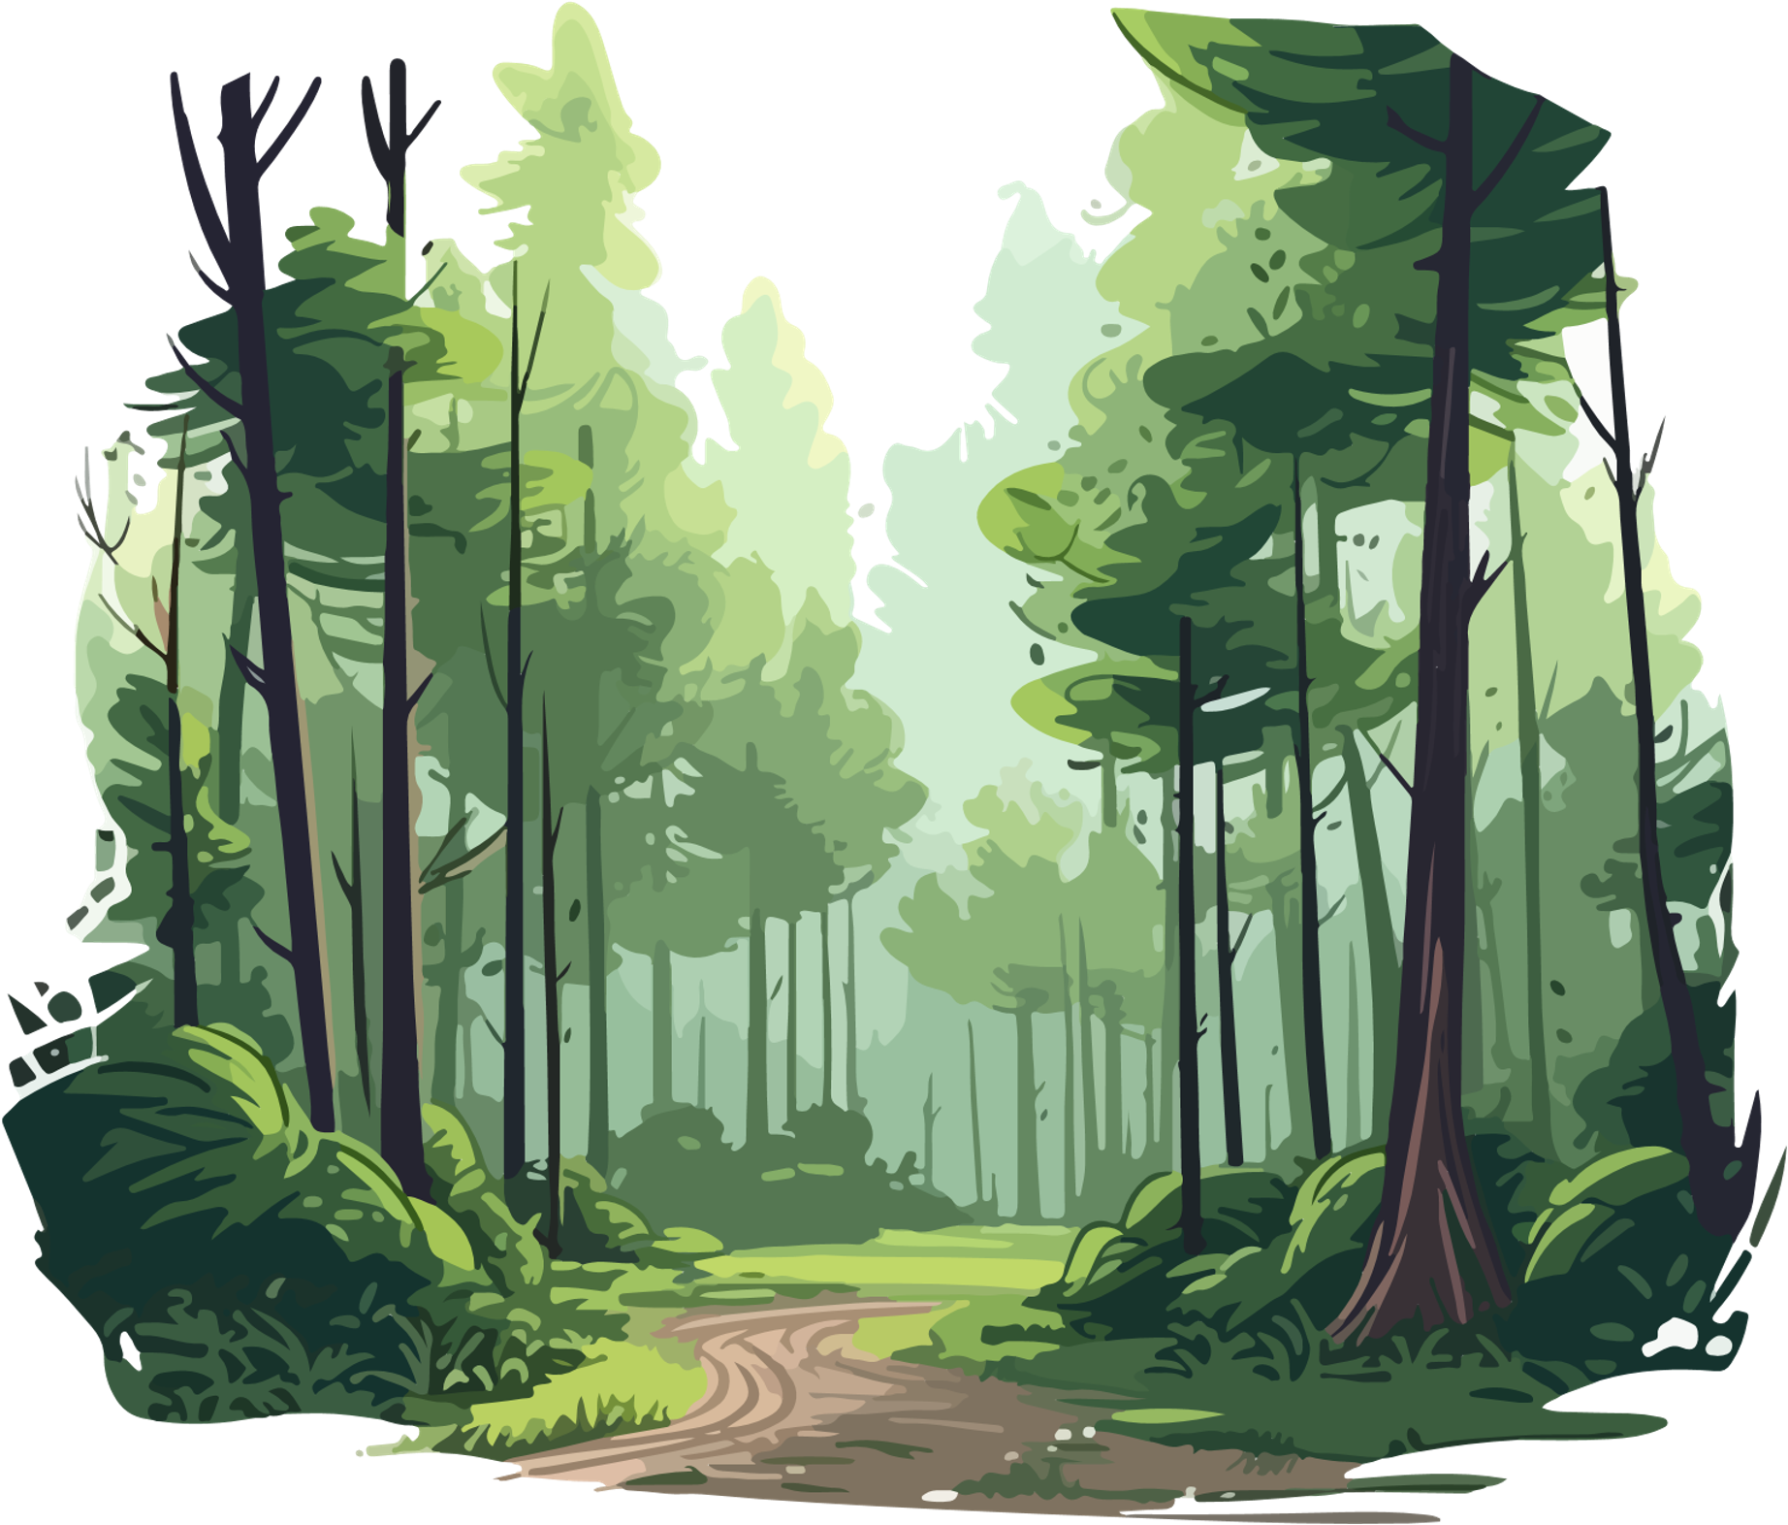

Bullying impact?
Sapling, it is no small thing
to grow
to overcome what saps your strength
bends your trunk, nibbles the fresh green
of your newly unfurled leaves
mossy weight, suffocating ivy,
frost that burns your edges.
Don’t give in to the temptation
to withdraw and wither.
We trees may be quiet,
but we speak and we share.
Reach out your young limbs
to those who offer shelter
not shade, who can show
from the vastness of their perspective
how to dig deep.
Anchor yourself in their knowledge
grow your bark hard and your leaves soft
hold firm to who you are
the gold of heartwood.
Stretch to the sky
clear and free
absorb the light
and breathe
just… breathe.
Sapling, do what trees do:
we grow.
Forests
Notes:
Section 1:
Read aloud, or invite group to reach out sections each from the poem, or show the animation in full before the discussion.

Slide 5

Section 1.
How did the poem make you feel?
Notes:
Section 1
Ask young people how the poem made them feel and what their initial thoughts are.

Slide 6

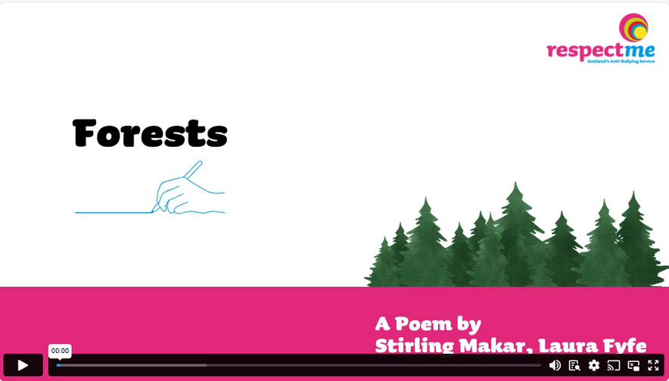

Bullying impact?
Notes:
Section 2, Step 1
Read aloud or show the animation again to the class, or group, to allow the young people to reflect further. They may wish to take notes or discuss with each other.
Introduce that the session will be led as a whole-group discussion, or that the class or group will be broken into small groups, before summarising reflections and learnings at the end.
Suggested prompts to facilitate an introduction to the group discussion are included below:
At first, ‘Forests’ might seem to be about how older trees protect younger trees (saplings)
What it’s really about is bullying. Forests are used as a metaphor in the poem for people and
Communities
Now, let’s talk about what the poem means and how it can help us learn about bullying and
how to recover from bullying
“Sapling, it is no small thing / to grow”. Sometimes growing up can be difficult! But there are
lots of places and people you can go to for help

Slide 7
Section 1.
In what way could a forest be similar to our communities and what could we learn from them?
Notes:
Section 2, Step 2
Trees in a forest help each other. They warn each other about danger and even provide water and nutrients to other trees that are struggling. They also provide shelter for each other from harsh weather.
Q: In what way could a forest be similar to our communities and what could we learn from them?
Example answers: Up to date anti-bullying policies and simple reporting pathways for children and young people to share their worries or concerns.

Slide 8
Section 2.
What kinds of bullying behaviour have you seen or heard of?
Notes:
Step 3
The second part of the poem describes some things that can harm young trees and stop them from growing. Sometimes bullying behaviourcan hurt people in different ways.
Q: What kinds of bullying behaviour have you seen or heard of?
Example answers: Being left out, belongings taken or damaged, pushed or called names. When you are bullied, it can make you feel hurt, scared, left out and afraid. Bullying behaviour happens face-to-face and online.

Slide 9
Section 2.
What are some of your most basic rights and how can being bullied affect these?
Notes:
Q:What are some of your most basic rights and how can being bullied affect these?
Example answers: Rights are basic needs for children and young people. You need to be protected from bullying behaviour so you can survive, develop and participate in a fulfilling, safe and respected life. Bullying is a breach of your rights as a child (young person).

Slide 10
Section 2.
In what ways could being bullied prevent someone from thriving?
Notes:
Q: In what ways could being bullied prevent someone from thriving?
Example answers: It can affect your mental and physical health, make you feel less confident about yourself, it can lead to you not wanting to take part in activities or go to school, feeling excluded, unsafe and disrespected.

Slide 11
Section 2.
What might put people off?
Notes:
Step 4
“we speak and we share”
Sometimes we might not want to tell people about bullying that we’ve seen or that has happened to us.
Q: What might put people off?
Example answers: If seeing bullying; fear of getting hurt if stepping in to help. If experiencing bullying; fear of the situation becoming worse or of not being taken seriously.

Slide 12
Section 2.
If you don’t feel you can go to an adult for advice, what could your parents/carers, school (or youth club or sports club, etc) do to help?
Notes:
Q: If you don’t feel you can go to an adult for advice, what could your parents/carers, school (or youth club or sports club, etc) do to help?
Example answers: Safe, confidential reporting pathways being introduced and embedded into well promoted anti-bullying policies. Grown-ups not being angry, upset or judgemental and not telling children that they will jump in fix it without discussing options.

Slide 13
Section 2.
What could staff in your school do to help protect you and your schoolmates?
Notes:
Step 5
The poem explores the idea that trees respect each other’s space and help each other grow.
Q: What could staff in your school do to help protect you and your schoolmates?
Example answers: Being taken seriously by adults when reporting bullying.

Slide 14
Section 2.
What can you do to respect others and help others thrive?
Notes:
Step 5
Q: What can you do to respect others and help others thrive?
Example answers: Being kind and respecting that everyone is not the same. Respect should be at the heart of how we treat each other. By role-modelling respectful relationships, we can all help prevent bullying. Respect can mean several things and that it can mean different things to different people. It is a combination of our behaviour towards others and how it makes them feel.
Note: You might wish to further reflect on themes of 'Respect' by downloading respectme's Anti-Bullying Week 2024 campaign resources or download similar learning resources from: Campaigns and resources | respectme

Slide 15
Section 2.
Why can it be helpful to seek advice from a trusted and responsible adult?
Notes:
Step 6
The poem describes trees as having “vast” perspectives. Adults sometimes have more information and life experiences that they’ve learned from that might help you.
Q: Why can it be helpful to seek advice from a trusted and responsible adult?
Example answers; More life experience and can offer help with bringing the bullying to an end, or offer advice on things to do to help with coping.

Slide 16
Section 2.
What types of people could you go to for support or advice and discuss what would be the advantage and disadvantages of each?
Notes:
Q: What types of people could you go to for support or advice and discuss what would be the advantage and disadvantages of each?
Example answers: Parent, carer, sibling, grandparent, teacher, youth leader.

Slide 17
Section 2.
What advice might the poem be giving you in each of these lines?
  “Reach out your young limbs / to those who offer shelter / not shade”
  “who can show … how to dig deep”
  “grow your bark hard and your leaves soft”
  “absorb the light”
  “hold firm to who you are / the gold of heartwood”
Notes:
Step 7
Q: What advice might the poem be giving you in each of these lines?
1.“Reach out your young limbs / to those who offer shelter / not shade”
2.“who can show … how to dig deep”
3.“grow your bark hard and your leaves soft”
4.“absorb the light”
5.“hold firm to who you are / the gold of heartwood”
Example answers could be: Generally looking after your own mental health and wellbeing and being kind to yourself in good and difficult times. Connect with others, create supportive communities around you. Treat others with compassion and kindness.

Slide 18
Section 2.
To help you grow – both your body and your mind - what tips could you give others to:
  look after their mental and emotional health?
  build up their confidence
  build strong, kind friendships
Notes:
Step 8
The end of the poem talks about ways a young tree can grow up strong and healthy.
Q: To help you grow – both your body and your mind - what tips could you give others to:
look after their mental and emotional health?
build up theirconfidence
build strong, kind friendships
Example answers: Join a youth or sports club to help make new friends, get outside, spend time with family and pets, keep a journal.

Slide 19
Plenary Discussions
Notes:
1.What have you learned about bullying today? For example, something about:
-the nature of bullying behaviour
-how bullying can impact us
2.What is the most important piece of advice you’ve learned today that you would give to someone who is being bullied?
3.Who would you go to for advice and support if you are bullying or being bullied

Slide 20
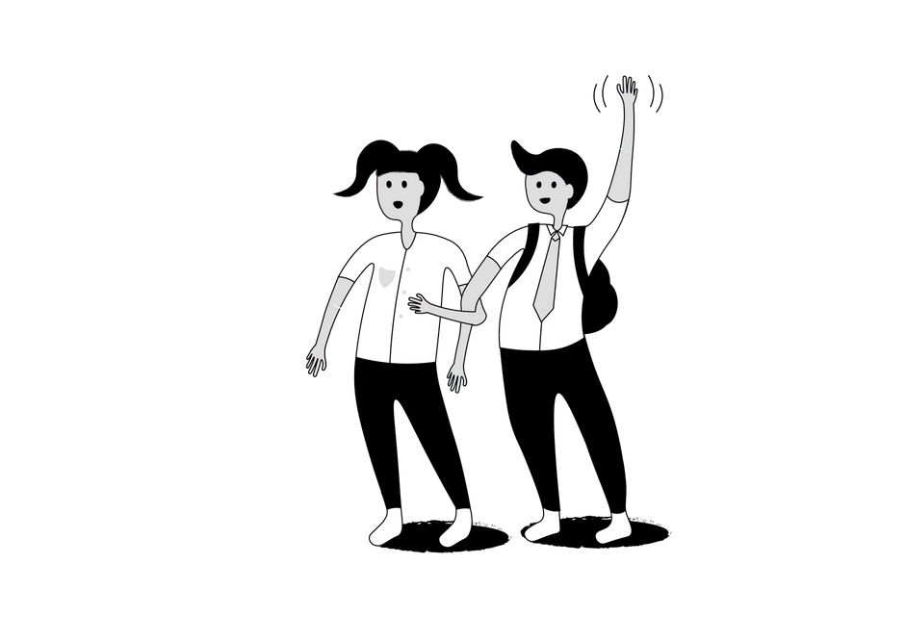

www.respectme.org.uk
Notes:
Guidance notes: This resource does not explore the full range of options for a child or young person who is experiencing
bullying. To help widen the conversation into coping strategies to help supportchildren and young people who may be experiencing bullying, use the following video and learning resource (this is optional):
Bullying: What Can I Do?
Responding to Bullying - What are my options?
Introduce the film by explaining that it is all about exploring options they could consider if they, or someone they know, is being bullied. The options outlined in the video are all examples thatchildren and young people have told us helped them to cope with bullying and to help make it stop.

