Slide 1


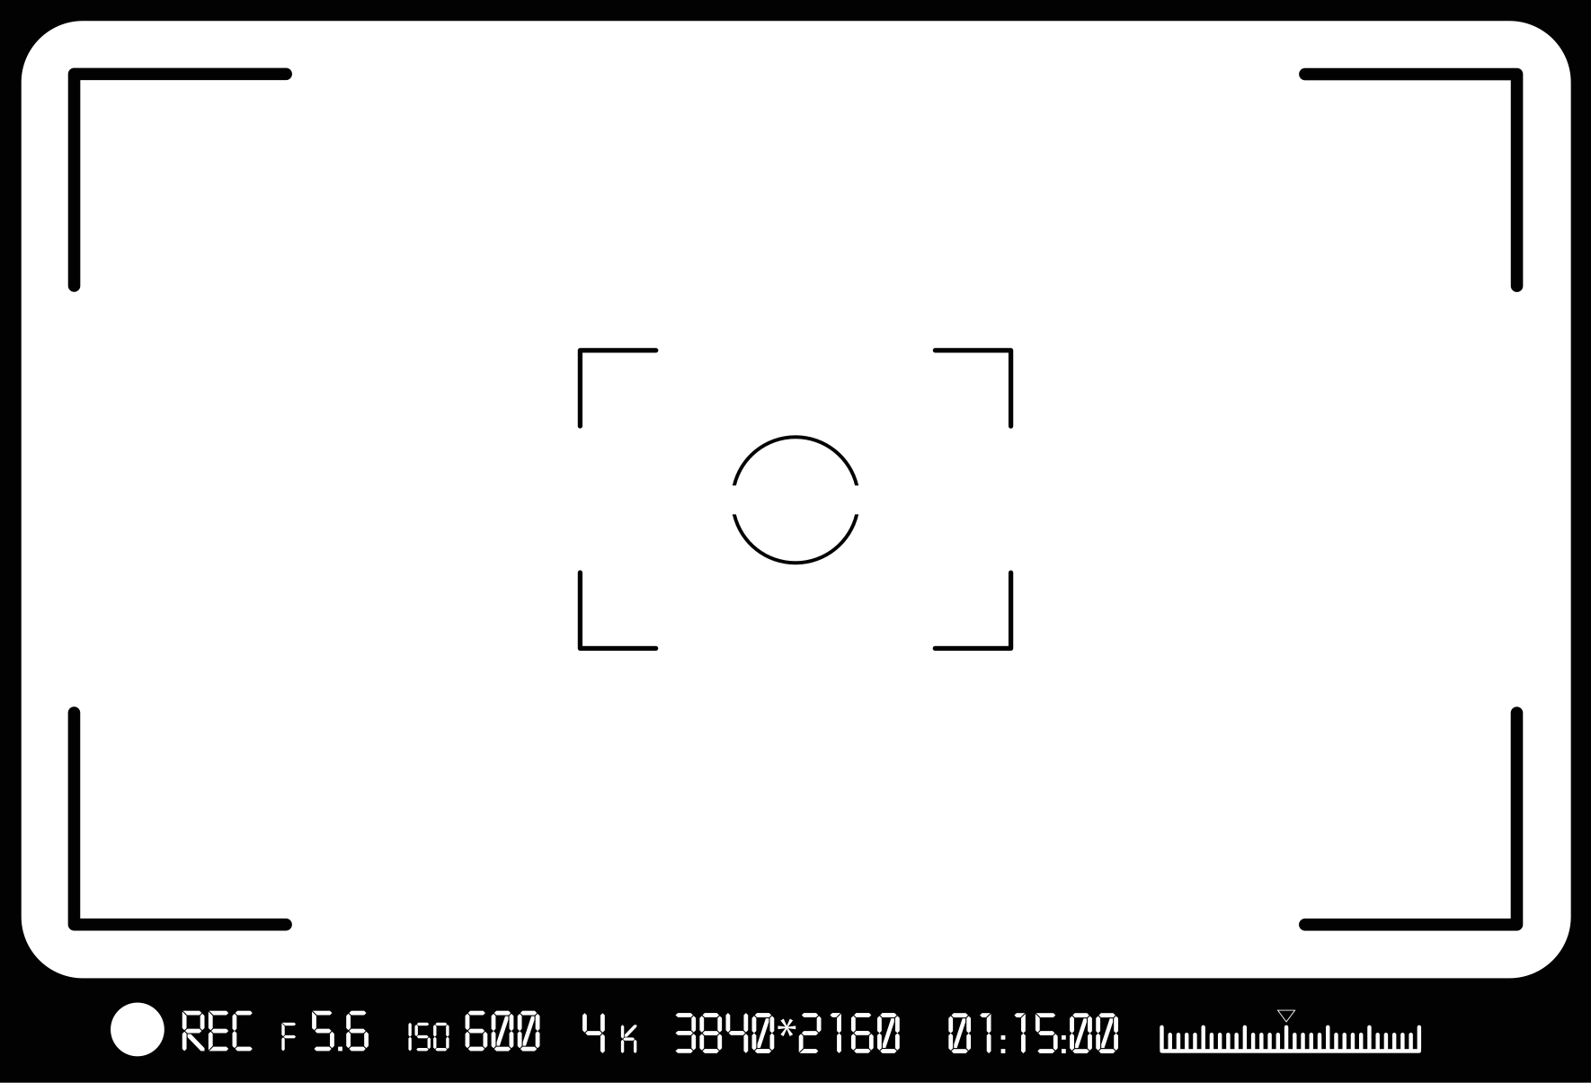
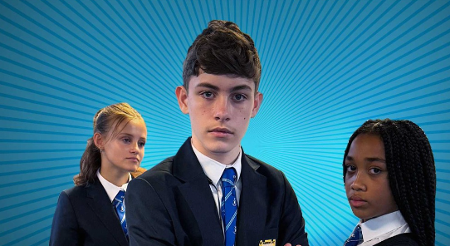

Primary Age Learning Slides (P4-P7)
Noah

Slide 2




Before you start watching the five films. Take some time to explore:
As a group - discuss the film’s title:
What do you think the film will be about?

Slide 3




Could it mean that one person will use their power for good?
It might mean that one person can help someone else if they are being bullied?
The film might show how bullying can happen and show us what we can do to get help?

Slide 4






What makes your day in school feel good or bad?
What are your rights?

Slide 5




Spending time with friends
Doing really good work in class
Hearing “well done”

Slide 6


Spending time with friends
Being left out
Doing really good work in class
Unkind words that are hurtful
Hearing
“well done”
Not being listened to

Slide 7

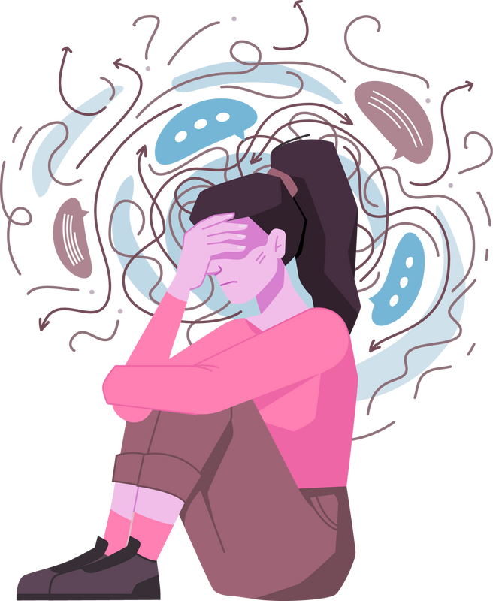
If you are someone experiencing bullying, your average day will not feel good or enjoyable.
It will feel the opposite and this is not what anyone deserves.
Bullying is never acceptable and is not a normal part of growing up. Bullying is a breach of children’s rights.

Slide 8

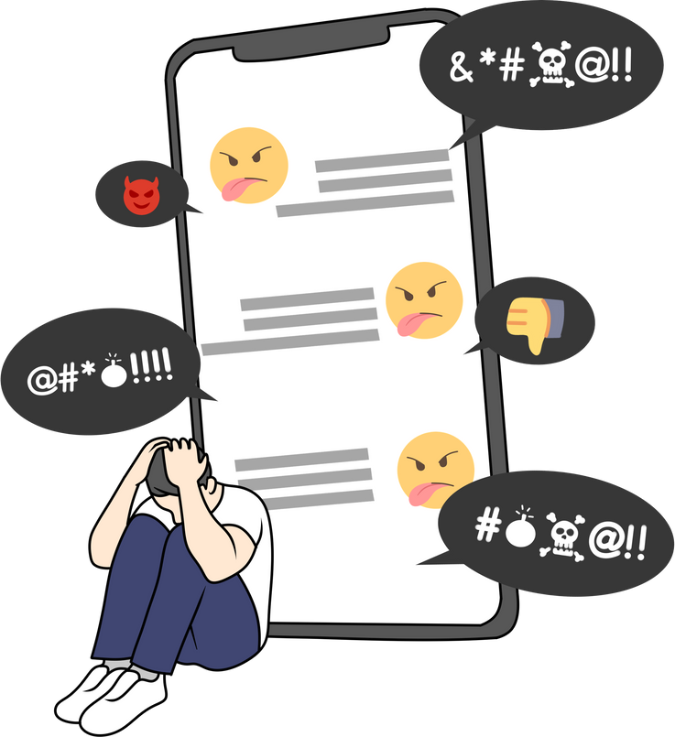


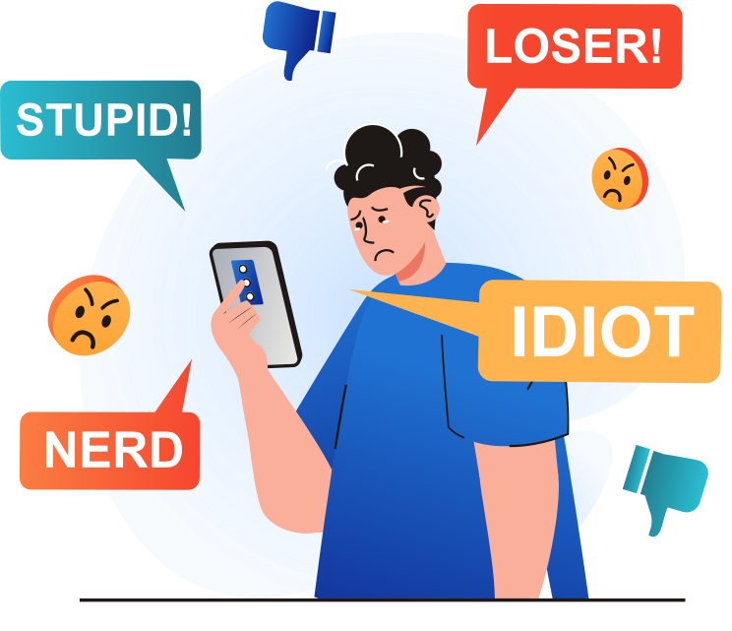
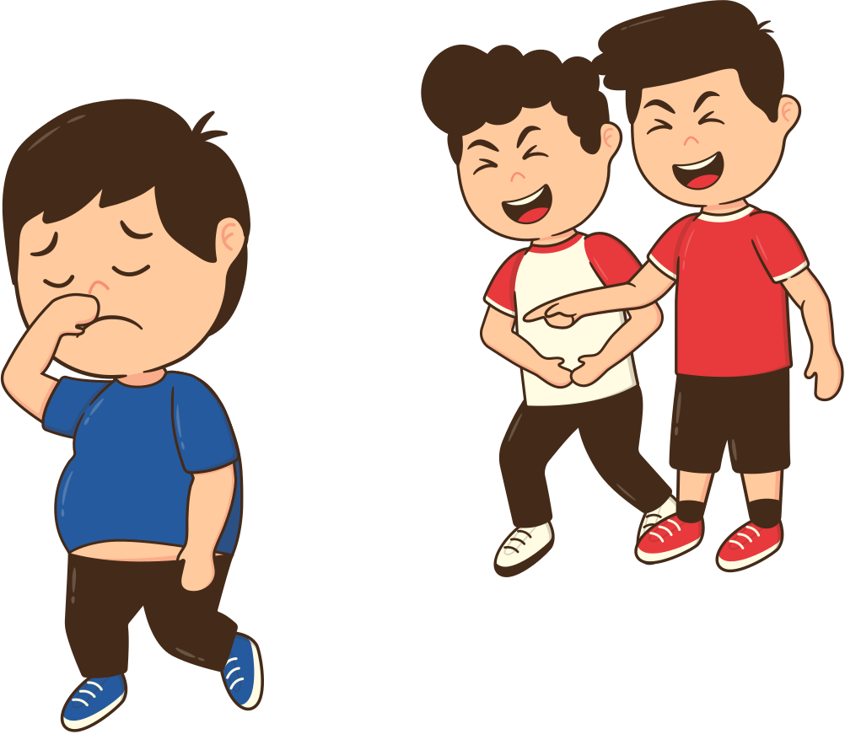

Forms of bullying
ONLINE
PHYSICAL
VERBAL
FACE TO FACE
SOCIAL

Slide 9
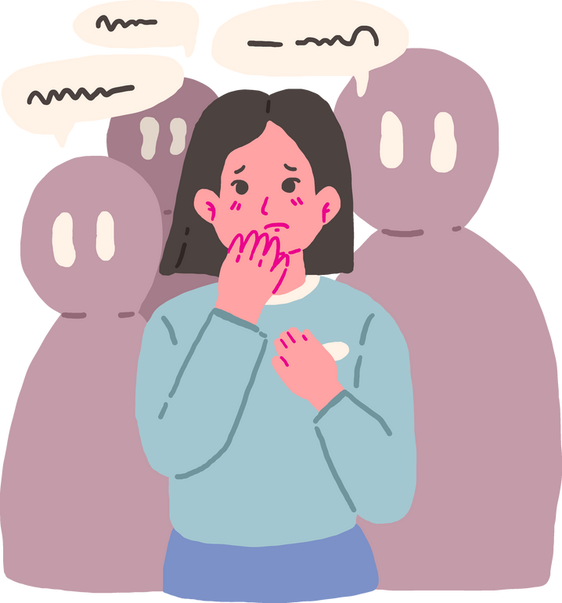
What is bullying?
c
  Behaviour which makes people feel like they are not in control of themselves or their lives
  Being targeted because of who you are or who you are perceived to be (face to face and/or online) add new one here
  Increasing the reach and impact of bullying or prejudice through the recruitment and/or involvement of a wider group
c
  Being called names, teased, put down or threatened face-to-face and/or online
  Being hit, tripped, pushed or kicked
  Having belongings taken or damaged
  Being ignored, left out or having rumours spread about you (face-to- face and/or online)
  Sending abusive messages, pictures or images on social media, online gaming platforms or phone

Slide 10

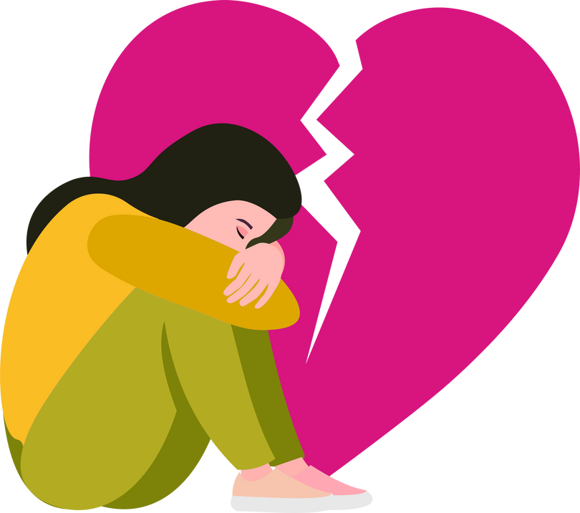
Bullying behaviour is not always intentional or deliberate.
It can be a one off or repeated.
It can be targeted and...also sometimes isn’t.
Sometimes people know what they are doing and at other times - they don’t.
It is complex.
Hurt
Threatened
Frightened
Left out

Slide 11


Bullying is never forever

Slide 12

Always remember that things can and do change!

Slide 13



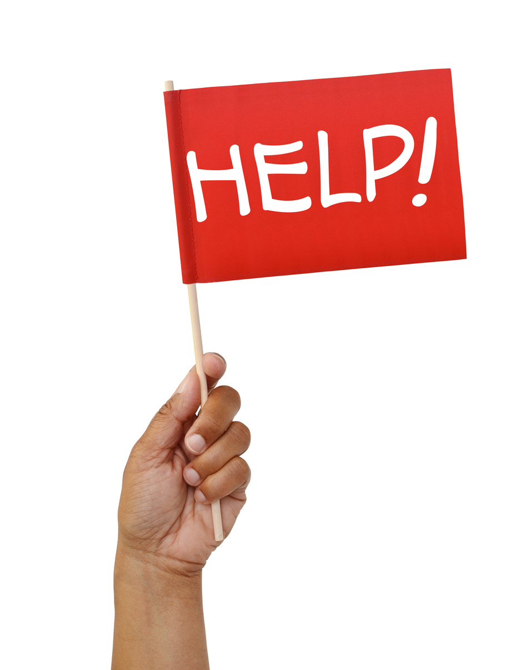
REMEMBER
Through this film series, we will be discussing bullying behaviour and examples of disrespect.
There are scenes that could cause distress
If you are experiencing bullying behaviour - please speak to your teacher, family or trusted adult.
It really can make a difference.

Slide 14
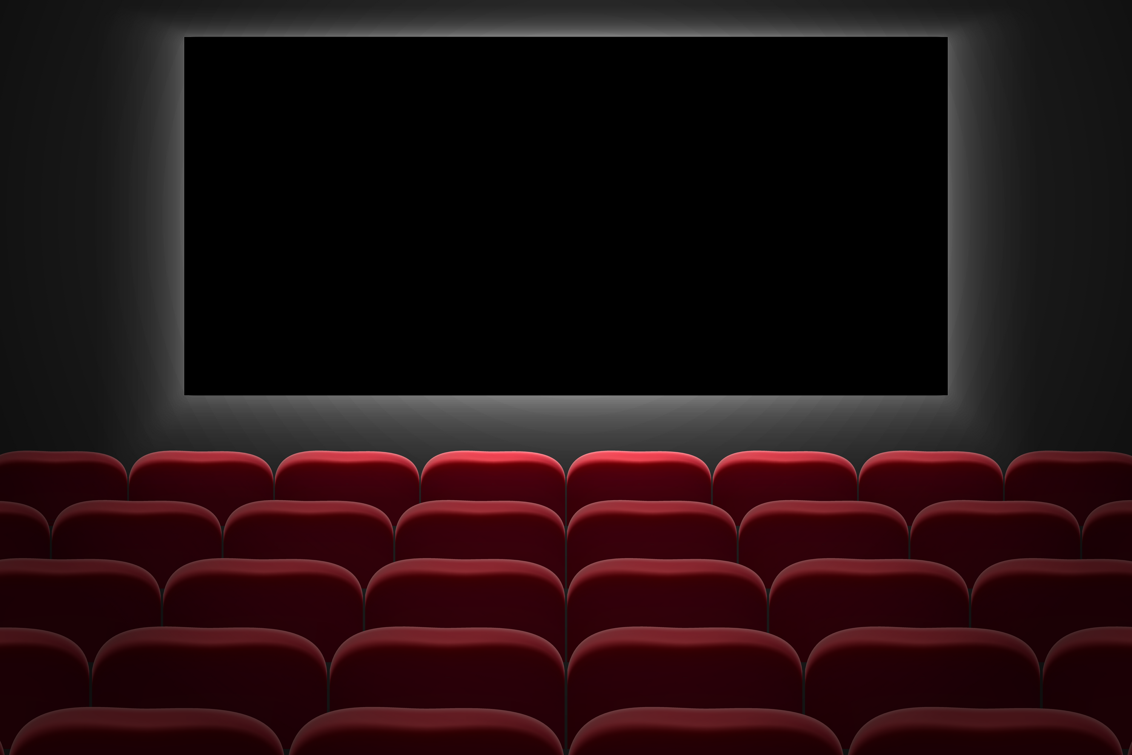






Slide 15

TIME TO WATCH FILM 1
Alternatively, watch Film 1: Noah at www.respectme.org.uk/resources-abw-25/

Slide 16




  Can you summarise what happened in Film 1 ‘Noah’?
  What words or actions show Grace is not being kind to Noah?
  What is going through Noah’s mind when he recieves a message from Grace at home?
  What do you think Ava feels about this situation. What would you do if you were her?
  What feelings does Noah have when he realises Grace is also going on the trip?

Slide 17




Script under the spotlight
Analysis task
Explore Noah’s dialogue in more detail
How is he truly feeling?
What are his inner emotions?
How is bullying behaviour impacting on his life?

Slide 18
Script under the spotlight
Noah tells the audience about Grace:
Noah:
"She was everywhere, all the time,
I didn't know where to turn to."

Slide 19


Script under the spotlight
Noah:
" She was everywhere, all the time,
I didn't know where to turn to."
What does the word “everywhere”
suggest?
How does Noah feel at this point?

Slide 20
Script under the spotlight
Noah:
"She was everywhere, all the time,
I didn't know where to turn to."
Noah feels totally helpless, alone and powerless
The word “everywhere” suggests that Noah cannot escape Grace

Slide 21
Script under the Spotlight
Ava tries to convince Noah to tell someone. Noah replies:
Noah: “NO WAY! Grace would kill me if I tell a teacher, she’ll get me outside school or at youth club. If I tell Mum or Dad they’ll tell a teacher and everything will get worse.

Slide 22
Script under the Spotlight
Noah:
“NO WAY! Grace would kill me if I tell a teacher, she’ll get me outside school or at youth club. If I tell Mum or Dad, they’ll tell a teacher and everything will get worse!"
Why do you think Noah shouts “NO WAY!” instead of just saying no?
What do the words in yellow tell us about Noah’s state of mind?

Slide 23
Script under the Spotlight
Noah:
“NO WAY! Grace would kill me if I tell a teacher, she’ll get me outside school or at youth club. If I tell Mum or Dad, they’ll tell a teacher and everything will get worse!"
Noah shouts because he has a tone of extreme panic! He is riddled with fear.
The words in yellow emphasise how helpless Noah is. He feels as if he has no control in his life!

Slide 24
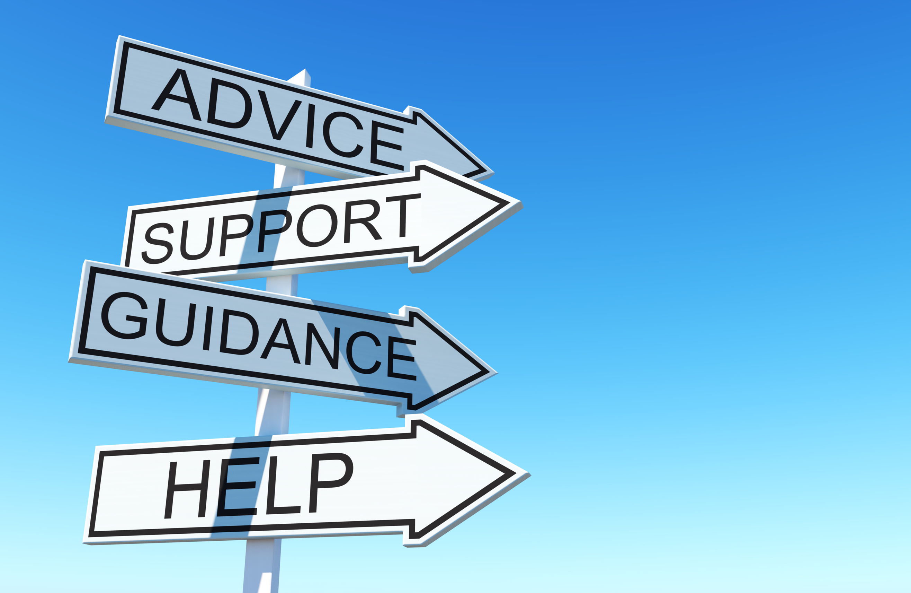




Noah is not coping well due to the bullying behaviour that he is experiencing from Grace

Slide 25
How can you support him?
What could you say to him via text or face-to-face?

Slide 26


Tell him you are there for him.
Ask if he wants to go out and do something?
Reassure him that he is not to blame.
Try and persuade Noah to tell someone.

Slide 27
Now, imagine you are Noah’s friend.
A kind, friendly message can go a long way to show someone support.
What advice would you text him at this stage?

Slide 28
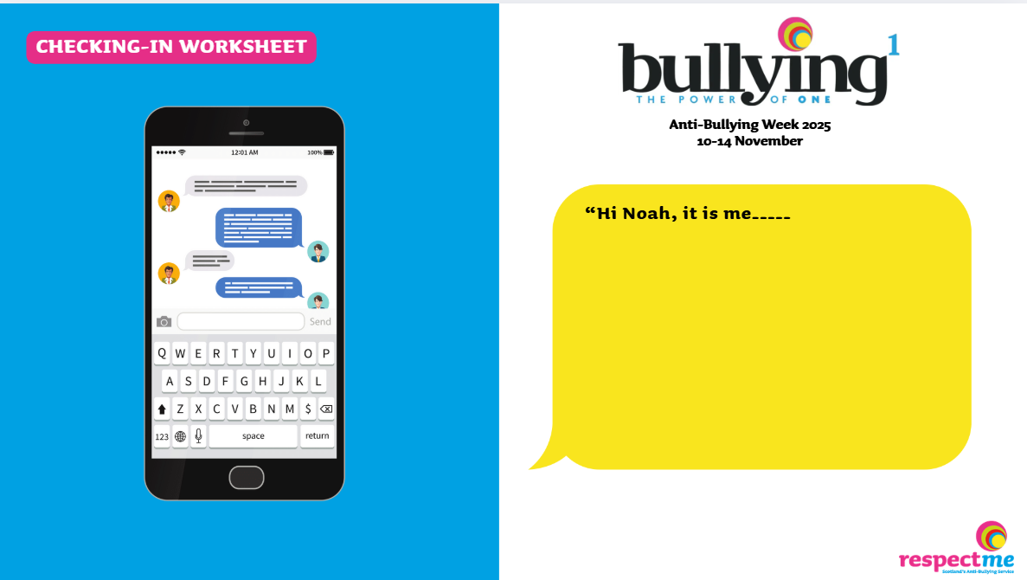


Worksheet provided

Slide 29
When anyone is going through a traumatic or uncomfortable experience - they might hide how they feel to the world.
  Noah has not told his parents or teachers what is happening. What will he be showing to them?
  Ava has not told anyone about what Grace is doing to Noah? What will she show to the wider world?
  Grace has not admitted what she is doing. How is she appearing to friends and teachers around her?

Slide 30



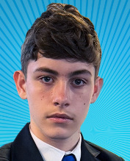
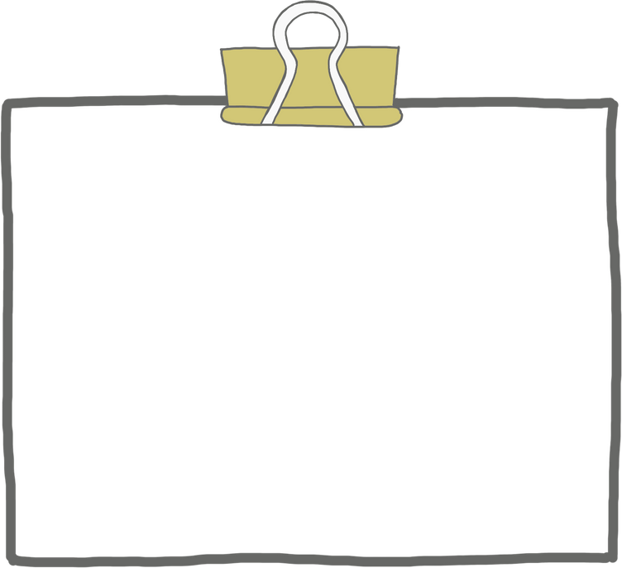

Worksheet provided
What does Noah...
Show to the outside world?
Feel inside?
Why not write or sketch up your ideas?

Slide 31
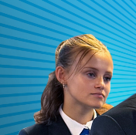
Worksheet provided
What does Grace...
Show to the outside world?
Feel inside?
Why not write or sketch up your ideas?

Slide 32
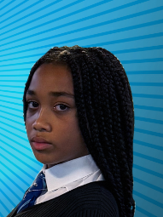
Worksheet provided
What does Ava...
Show to the outside world?
Feel inside?
Why not write or sketch up your ideas?

Slide 33



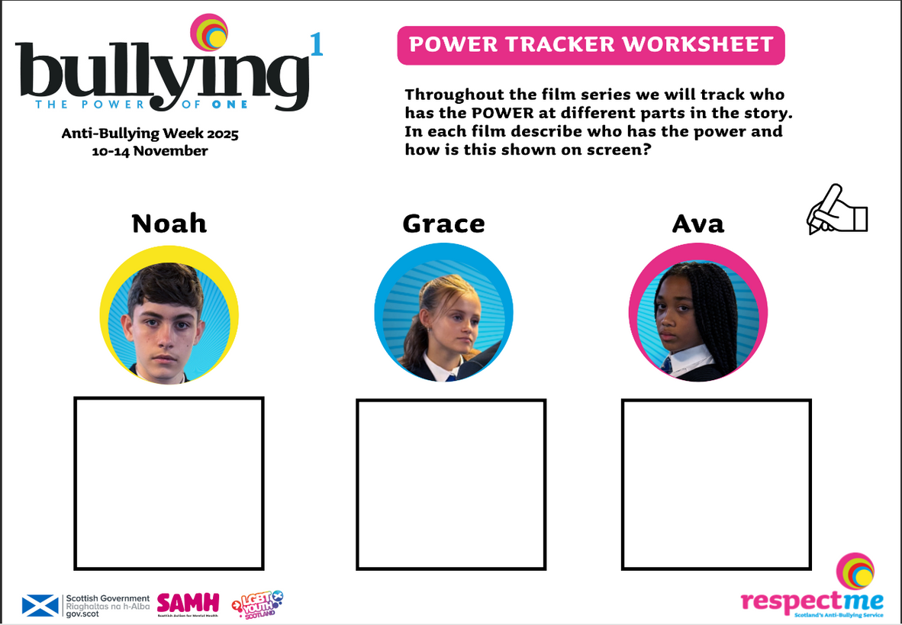
Throughout the series, we will track who has the POWER at different parts in the story.
In Film 1 - Who has the power and how is this shown?
Power Tracker Worksheet

Slide 34


Noah is feeling upset, hurt and confused. He is miserable because of the way Grace is treating him. He cannot escape her!
Imagine you are Noah and write his diary extract for this episode?
  How is he feeling?
  What is he dealing with? Think about the teasing, confrontations and messages at home on his mobile.
  Focus on Grace’s behaviour to him.
  What does Noah think his options are?
Dear Diary,

Slide 35
Primary Age Learning Slides (P4-P7)
Ava

Slide 36



Think back to Film 1
  What do you remember?
  Write down 3 things you remember, or learned
  Share with a partner

Slide 37

Noah, Ava and Grace are the main characters.
Noah is feeling down because Grace has been unkind to him
Ava is Noah’s best friend.
Bullying can happen to anyone face-to-face and online
Bullying can appear as teasing, being left out, pushed, or kicked...

Slide 38




Before you start watching Film 2- take some time to explore the following:
As a group - discuss the following:
Q: What does having power mean to you?

Slide 39


Power means having an influence over others - for either good or bad.
Power isn’t bad in itself - it depends on how you use it.
There is:
  The power to help
  The power to hurt

Slide 40

We ALL have the power to help others...
BUT do we always step in and do this?

Slide 41


Think about the power we ALL have?
If you saw someone being bullied - what power do you have to help?
Look at this next example...

Slide 42



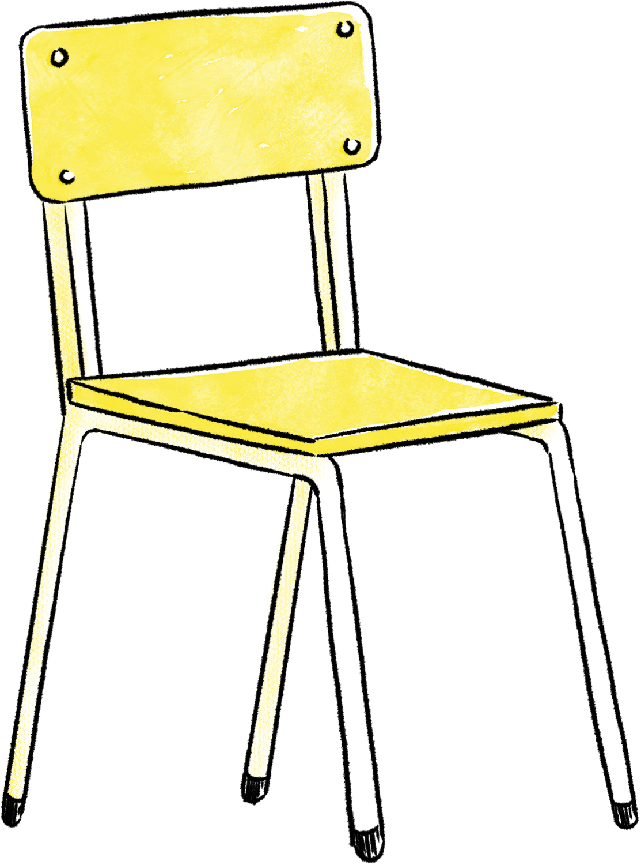
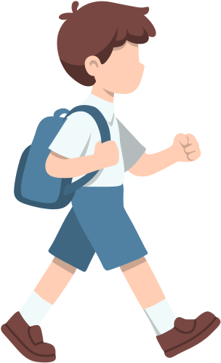
Mark was in class
Tia kept teasing him and told other people not to sit with him.
Who has the POWER here?

Slide 43
Tia has the POWER here!
She is using it to control others.

Slide 44
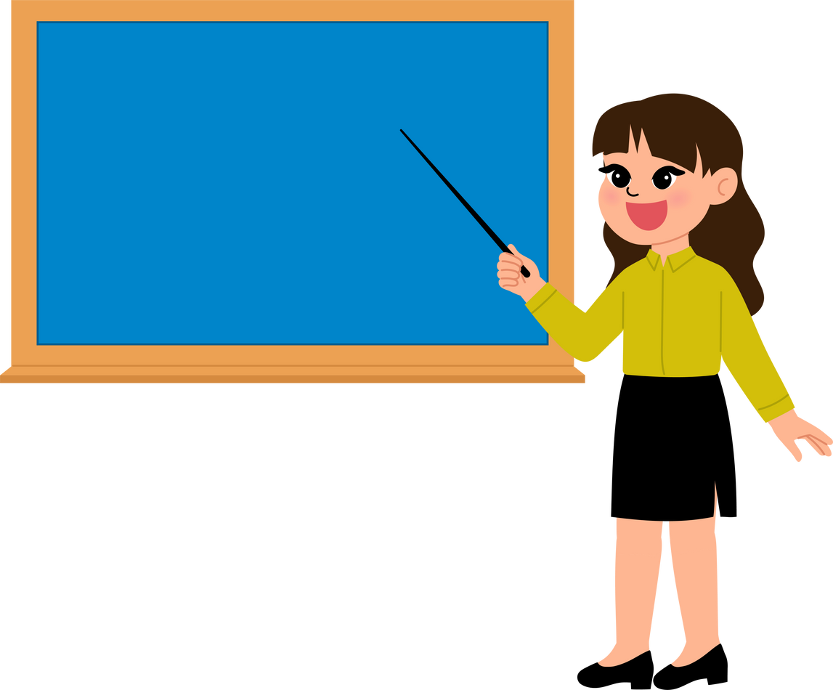


Be KIND!
The teacher hears these comments and says:
“Tia that was very unkind. In this class everyone is included”.
Tia puts her head down.
Mark’s friend messages him and says:
“Don’t listen to what Tia says. You are our friend and can sit with us.”
Mark stands up, walks over to Tia and says:
“Tia, I really don’t appreciate being treated like this. Please stop!”

Slide 45

Who has the power?

Slide 46
Everyone has used their power!
Teacher - uses power and uses it to ensure fairness/
Mark’s friend - has the power to make him feel supported and included
Mark - has the power to use his voice, be assertive and stand up for himself

Slide 47

Everyone has the power to do something!

Slide 48




We can all ask the person who is bullying to stop.
Tell a trusted adult about what is happening.
This can make a real difference.
Support others and be kind!
Include others,
speak up.

Slide 49

TIME TO WATCH FILM 2
Alternatively, watch Film 2: Ava at www.respectme.org.uk/resources-abw-25/

Slide 50
Film 2
  How do Ava and Noah know each other?
  Why are Ava and Noah no longer friends with Grace?
  Noah is receiving many upsetting text messages on his phone. How do you think he feels reading these?
  What does Ava think and feel as she watches Noah being pushed and taunted by Grace and other pupils?
  Does Ava speak to Grace in this episode? If not, Why not?

Slide 51


Script under the spotlight
Analysis task
Explore Ava’s dialogue in more detail.
How is she truly feeling?
What are her inner emotions?
How is what is happening to Noah impacting on her life?

Slide 52
Script under the spotlight
As Ava scrolls through Noah’s phone, she can see the upsetting text messages from Grace. She says:
Ava:
“She has added him to a group chat someone set up for the trip. I feel awful but I don’t know what to do about it?”

Slide 53
Script under the spotlight
Ava:
“She has added him to a group chat someone set up for the trip. I feel awful but I don’t know what to do about it?”
What does the word “awful” tell us about Ava?
If you were Ava, what choices could you make in this situation?

Slide 54
Script under the spotlight
Ava:
“She has added him to a group chat someone set up for the trip. I feel awful but I don’t know what to do about it?”
The word “awful” highlights that Ava feels upset and sad about what her friend is going through.
There are many options:
  She could tell a trusted adult
  Support Noah

Slide 55
Script under the spotlight
Ava sees what Grace is doing to Noah. And she sees Noah looking miserable and teary. She says:
Ava:
“I know I should have gone after him, but, if I’m honest...I was worried I would be next.”

Slide 56
Script under the spotlight
Ava:
"I know I should have gone after him, but, if I’m honest...I was worried I would be next.”
How could Ava be thought of as being a bystander
(someone that does nothing)?

Slide 57
Script under the spotlight
Ava:
"I know I should have gone after him, but, if I’m honest...I was worried I would be next.”
Ava thinks about herself. Whilst she is upset and feels bad for her friend - at this point - she is worried that Grace will target her.
She knows Noah is really struggling, but she chooses not to support him. She stands by watching and thinking.

Slide 58
Script under the spotlight
Ava later sees Noah sitting alone and upset. She talks with him:
Ava: “You have to tell someone, it’s getting worse”
Noah: “Leave me alone Ava! It’s nothing to do with you!”
Ava: “I decided I had to do something. I couldn’t just watch anymore.”

Slide 59

Script under the spotlight
Ava: “You have to tell someone, it’s getting worse”
Noah: “Leave me alone Ava! It’s nothing to do with you!”
Ava: “I decided I had to do something. I couldn’t just watch anymore.”
What changes for Ava?
Why could she now be called an upstander?
(someone that does something for others)

Slide 60
Script under the spotlight
Ava: “You have to tell someone, it’s getting worse”
Noah: “Leave me alone Ava! It’s nothing to do with you!”
Ava: “I decided I had to do something. I couldn’t just watch anymore.”
Ava thinks enough is enough! Noah is alone, and more isolated than ever.
She has to help him and she knows it is the right thing to do. This is a real turning point!

Slide 61

We already know that everyone has the power to do something if someone is experiencing bullying behaviour...
BUT- what if we all do nothing?
What happens? What are the consequences of doing nothing?
All behaviour has a direct impact on others.

Slide 62

If you don’t do anything
you are a:
Bystander
SOMEONE THAT SEES...BUT DOES NOT ACT
A bystander can be described as a person who does not become involved in a situation where someone else may be experiencing bullying, although they might see that the person may need help.

Slide 63

If you don’t do anything,
you are a:
Bystander
SOMEONE THAT SEES...BUT DOES NOT ACT
Being a bystander can be deeply upsetting to individuals. Even if they know they should step in, and want to, there may be reasons for not getting involved such as fear of getting hurt, getting into trouble, making the situation worse, or being bullied themselves as a consequence.

Slide 64





YOU COULD BE MORE OF AN
Bystander
Upstander
SOMEONE THAT SEES...
BUT DOES NOT ACT
SOMEONE THAT SEES...
AND THEN
ACTS!

Slide 65

Calls in others.
Speaks up for others.
Asks people to STOP being unkind and disrespectful!
Stands with the person experiencing bullying .
Asks trusted adults for help.
Shows kindness.
Is a respectful role model.
Upstander
WHAT DOES AN UPSTANDER DO?

Slide 66
Being an upstander can really help others when they are feeling alone, sad and vulnerable.
Upstanders can really spark change in society and help to make the world a better place - because they show that they care and actively do something.
Upstander
WHAT DOES AN UPSTANDER DO?

Slide 67
  Being an upstander can be a really difficult thing to do. It requires thinking, courage and knowing what to do and when.
  It is natural to worry and fear speaking up for others. It can be tricky.
  Remember that there is never a pressure for you to adopt a “superhero” role. We are all human!
  If you are in a situation like Ava, or want to be an upstander, follow these top tips:
Upstander

Slide 68

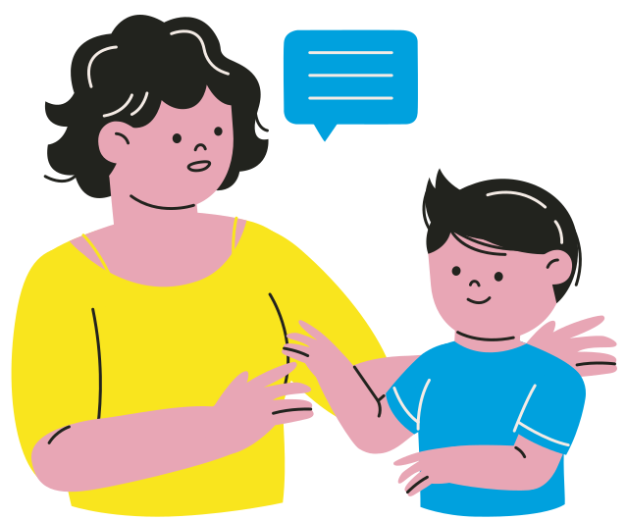


Ask yourself, is it safe to speak up?
If it is, you could say things like:
“Leave them alone!”
“That’s not kind”
“Stop doing that”
Never join in with others who are being unkind to others!
Do not copy them or encourage the bullying behaviour.
Tell a trusted adult about what’s been happening. This helps to keep others safe and the adult will know what to do.

Slide 69



At a quieter time you could show your support.
Sometimes just asking if someone is “okay” can go a long way and make them feel included.
Stand with the person, never isolate them.
Show your support by being there and showing they are not alone
Be a positive role model.
Be kind and spread kindness.
Be compassionate and show empathy.

Slide 70

If you were experiencing bullying:
  What help would you want?
  What support would you want?
  What would make you feel less scared and alone?
  What would you expect from others?

Slide 71


Ava finally gains courage to tell someone about Noah?
What might people call her if she tells his parents or the teacher?

Slide 72



grass
You are a GRASS!
Ava is reluctant to tell anyone that Noah is being bullied . Perhaps she will be called a GRASS? Could she be picked on? Found out?

Slide 73

grass
Do you agree that it is time to drop this term grass?
  It makes people feel afraid to speak up for others!
  It is a negative term that impacts on others and holds them back
  It can prevent help and support being given

Slide 74


What can we replace this word with so more people will be encouraged to use their voice and speak up?
grass

Slide 75



grass
Helper
Brave
Supporter
Courageous
Problem solver
Protector
Upstander

Slide 76





Ava can see her friend is hurting in this episode. She wants to help but is afraid.
Imagine you are Ava and write her diary extract for this episode?
How is she feeling? What is she dealing with?
What does she think her options are?

Slide 77

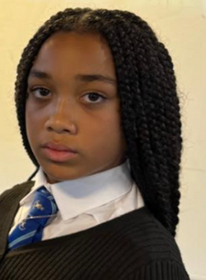
  Power Tracker Worksheet
  Character Profile Worksheet

Slide 78

Primary Age Learning Slides (P4-P7)
Mum and Dad

Slide 79





Think back to the last film...
A lot happened!
We have some statements that we need you to review and decide if they are true or false.

Slide 80
Bullying is always just
face-to-face.
Noah is overreacting and needs to deal with this.
Ava telling Noah’s mum and dad is a bad idea.
Grace has always been kind to Noah.
Noah is struggling.
This is just what it is like being a child.

Slide 81
Noah is struggling

Slide 82
Bullying is always just
face-to-face
( it can also happen online)
Noah is struggling
Noah is overreacting and needs to deal with this
(Noah is upset and is right to feel this way)
Ava telling Noah’s mum and dad is a bad idea
(It is a good idea. Tell a trusted adult)
Grace has always been kind to Noah
(Grace sadly has not always been kind)
This is just what it is like being a child
(Bullying is never acceptable)

Slide 83


TIME TO WATCH FILM 3
Alternatively, watch Film 3: Mum and Dad at www.respectme.org.uk/resources-abw-25/

Slide 84
Film 3
  What do Noah’s parents notice about him in this episode?
  What impact does bullying behaviour have on Noah’s family members?
  Why do you think Noah tells his parents that they would “not understand” when they ask him to talk about his feelings?
  How does Noah feel when his Mum tells him that Ava has told her everything?

Slide 85

Script under the spotlight
Analysis task
Explore Noah’s mum’s dialogue in more detail
How is she feeling?
What are her inner emotions?
How is Noah’s experience impacting on her?

Slide 86
Script under the spotlight
Ava reveals that Noah is being bullied
Mum:
"Ava told me everything that had been happening. About the bullying online, and at school and at youth group. How could they do that to him?”

Slide 87
Script under the spotlight
Mum:
" Ava told me everything that had been happening. About the bullying online, and at school and at youth group. How could they do that to him?...”
What does this list of places in bold show us?
Mum asks this question in yellow -how does she feel?

Slide 88
Script under the spotlight
Mum:
“Ava told me everything that had been happening. About the bullying online, and at school and at youth group. How could they do that to him?”
This list shows all the places where Noah is being bullied.
There has been no escape!
Mum feels shocked and devastated. Noah is her son and he doesn’t deserve this.

Slide 89

SIGNS OF
BULLYING
What are the signs of bullying?
Think about Noah’s parents and what they notice about him?
Make your own leaflet, or guide describing the signs and draw images to match.

Slide 90



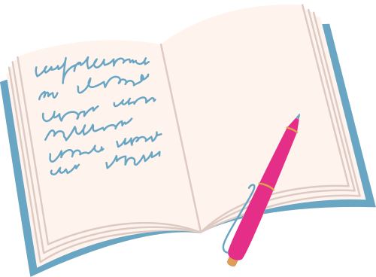
Noah’s parents are extremely worried about him in this film.
Imagine you are his Mum or Dad and writing in your diary.
How are they feeling? What are they dealing with? What do they think their options are?

Slide 91

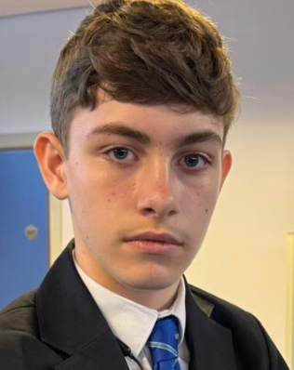
  Power Tracker Worksheet
  Character Profile Worksheet

Slide 92

Primary Age Learning Slides (P4-P7)
Grace

Slide 93


Why do people choose to show bullying behaviour to others?

Slide 94


They are unhappy
Jealousy
For attention
They have been bullied
They enjoy the POWER!
Because they can

Slide 95
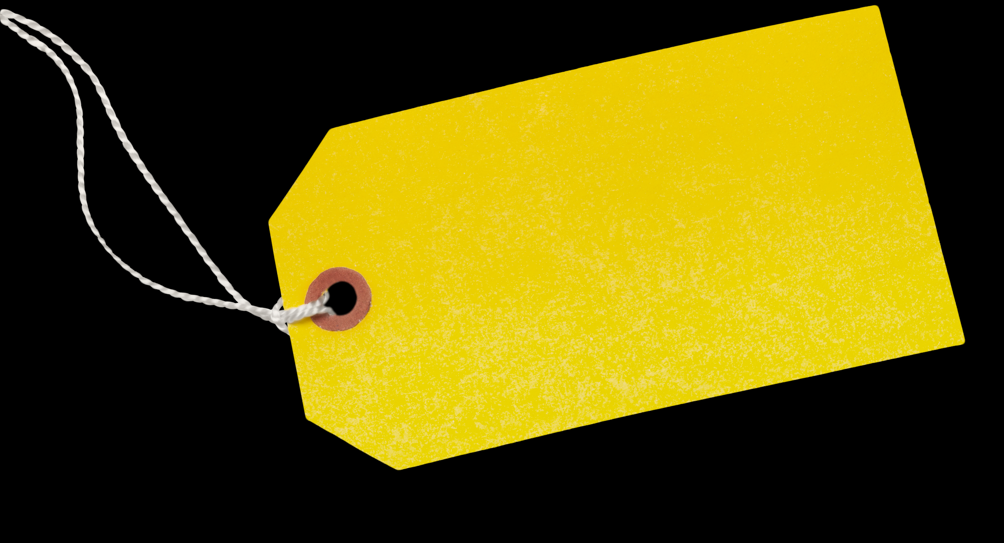

Bullying is extremely upsetting.
But we need to be careful not to give labels...as this can make people feel as if change can never happen.

Slide 96
What does ‘bully’ suggest?
Mean
Cruel
Horrible
Vile
What does ‘victim’ suggest?
Hurt
Weak
Injured
Sensitive
Labels are for things, not people.

Slide 97


People that show bullying behaviour can also be kind to others.
Bullying is never forever and. People can gain strength in time.
Nobody deserves a label. Nothing is forever!
People can make mistakes and change.

Slide 98

We use the words:
Someone is displaying
bullying behaviour
A person might experience bullying behaviour

Slide 99

TIME TO WATCH FILM 4
Alternatively, watch Film 1: Grace at www.respectme.org.uk/resources-abw-25/

Slide 100

Film 4
  What can you tell about Grace’s home life?
  What do you think the real reason is for not liking Noah?
  Do you think Grace thinks online bullying is the same as face-to-face bullying? Why / why not?
  What is your opinion of online bullying?
  Give examples of Grace enjoying bullying Noah.
  What would you say or do if you saw Grace’s behaviour?

Slide 101

Script under the spotlight
Analysis task
Explore what Grace says in more detail
How is she truly feeling?
What are her emotions?
How are her choices affecting her?

Slide 102
Script under the spotlight
Grace tells the audience one of her reasons for picking on Noah
Grace:
“He was just an easy target. Never fought back or anything.”

Slide 103
Script under the spotlight
Grace:
“He was just an easy target. Never fought back or anything.”
What do these words reveal about Grace?

Slide 104
Script under the spotlight
Grace:
“He was just an easy target. Never fought back or anything.”
Grace loves POWER.
Noah doesn’t fight back and she knows this. So, Grace has all the power to do what she wants! She views him as weak and enjoys him being upset.

Slide 105
Script under the spotlight
Grace later reveals more about herself. She tells us:
Grace:
“It just kept going, the more I did it, the more my friends thought it was funny. Having this power over him was great. At least he has people who care about him.”

Slide 106
Script under the spotlight
Grace:
“It just kept going, the more I did it, the more my friends thought it was funny. Having this power over him was great. At least he has people who care about him.”
Why is having ‘power’ so important to Grace?
What does she mean “people who care”?

Slide 107
Script under the spotlight
Grace:
“It just kept going, the more I did it, the more my friends thought it was funny. Having this power over him was great. At least he has people who care about him.”
She is trying to excuse her behaviour. She is ignored at home and knows Noah has a supportive family life. This is not an excuse. She has to know that her actions are wrong.
Power makes Grace feel big and important. She gets attention.
She enjoys making Noah feel small.

Slide 108

Script under the spotlight
Grace sees Noah upset and crying in the stairwell-alone
Grace:
“I hadn’t really thought about what happens to him when he’s alone. It was just a laugh, I didn’t mean to take it as far as this.”

Slide 109

Script under the spotlight
Grace:
“I hadn’t really thought about what happens to him when he’s alone. It was just a laugh, I didn’t mean to take it as far as this.”
Why are Grace’s thoughts, actions and behaviour so dangerous?

Slide 110
Script under the spotlight
Grace:
“I hadn’t really thought about what happens to him when he’s alone. It was just a laugh, I didn’t mean to take it as far as this.”
Grace never once stops to think about the impact on Noah. She is the one causing upset and pain, nobody else. She has forgotten that Noah is a human with feellings.

Slide 111




Who is in the hot seat?
Your time to interview Grace
  What would you ask her?
  What would her reply be?

Slide 112

Who is in the Hot Seat?
What other characters could you interview?

Slide 113

It would be false to say that everyone always likes one another and gets on.
How could you treat others that you perhaps do not like, or get on with?
Make a list of the ways we could treat others better.
hOW WE TREAT OTHERS?

Slide 114




hOW WE TREAT OTHERS?
Respect
Kindness
Empathy

Slide 115
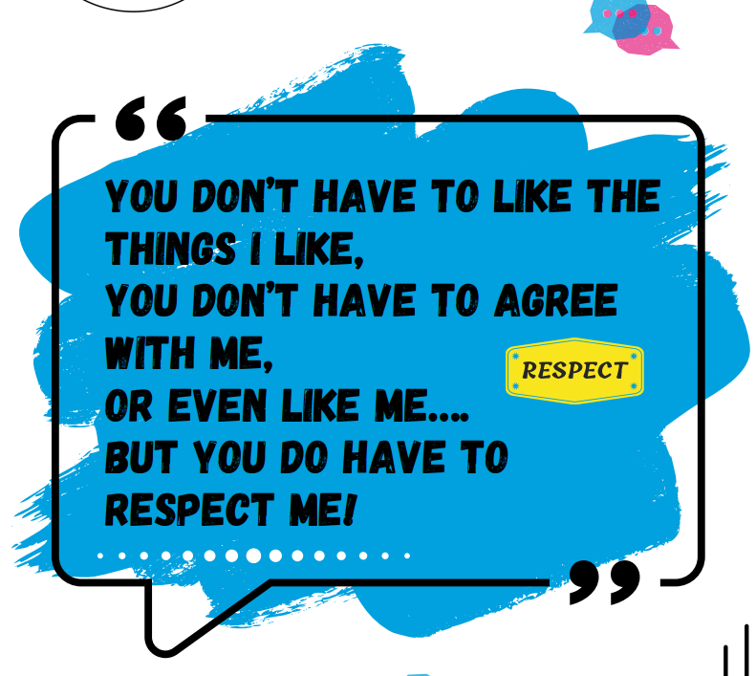


Slide 116

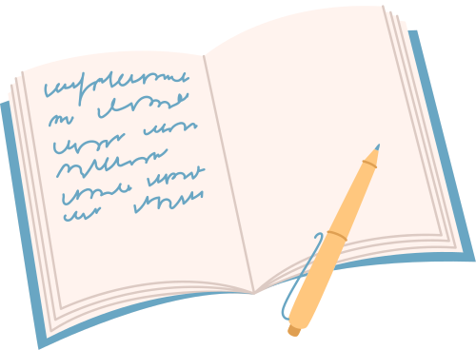
We find out lots about Grace in this film.
Imagine you are Grace and write in your diary.
How are you feeling? What are you dealing with? Why are you thinking about Noah? What do you think your options are?

Slide 117

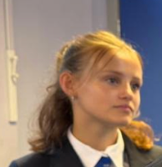
  Power Tracker Worksheet
  Character Profile Worksheets

Slide 118

Primary Age Learning Slides (P4-P7)
The Power of All

Slide 119


  So far, Noah is struggling, his mum and dad can see this and Grace really dislikes Noah.
  Ava decides she could no longer be a bystander seeing her friend Noah being bullied.
  She decides to; Use her words, Find her voice and Own her power - by telling trusted adults (Noah’s parents), so that he can gain help and support.

Slide 120
If you feel bullying behaviour is wrong - then you are someone who is Against bullying.
If you feel bullying behaviour is wrong and you want to do something about it - you are someone who promotes Anti-Bullying. You want to use your POWER to stop it!
Explore the examples on the next slide and write down if they are against bullying or anti-bullying.

Slide 121


Kira felt so sad when she heard her friend being called nasty names. She could not stop thinking about it.
Ahmed could see James being tripped up every day and teased about his trainers. He told the teacher about this as he was so worried.
Reena was fed up with so many pupils being unkind to each other. She asked the teacher if they could create an anti-bullying group in school to help create a safer school.
Dylan was at his youth club. He watched as another group of boys and girls left out Max from the games. He felt really guilty and just went home.

Slide 122
Kira felt so sad when she heard her friend being called nasty names. She could not stop thinking about it.
Ahmed could see James being tripped up every day and teased about his trainers. He told the teacher about this as he was so worried.
Against
Reena was fed up with so many pupils being unkind to each other. She asked the teacher if they could create an anti-bullying group to help create a safer school.
Dylan was at youth club. He watched as another group of boys and girls left out Max from the games. He felt really guilty and just went home.

Slide 123
Kira felt so sad when she heard her friend being called nasty names. She could not stop thinking about it.
Ahmed could see James being tripped up every day and teased about his trainers. He told the teacher about this as he was so worried.
Against
ANTI
Reena was fed up with so many pupils being unkind to each other. She asked the teacher if they could create an anti-bullying group anti-bullying group to help create a safer school.
Dylan was at youth club. He watched as another group of boys and girls left out Max from the games. He felt really guilty and just went home.

Slide 124
Kira felt so sad when she heard her friend being called nasty names. She could not stop thinking about it.
Ahmed could see James being tripped up every day and teased about his trainers. He told the teacher about this as he was so worried.
Against
ANTI
Reena was fed up with so many pupils being unkind to each other. She asked the teacher if they could create an anti-bullying group to help create a safer school.
Dylan was at youth club. He watched as another group of boys and girls left out Max from the games. He felt really guilty and just went home.
ANTI

Slide 125
Kira felt so sad when she heard her friend being called nasty names. She could not stop thinking about it.
Ahmed could see James being tripped up every day and teased about his trainers. He told the teacher about this as he was so worried.
Against
ANTI
Reena was fed up with so many pupils being unkind to each other. She asked the teacher if they could create an anti-bullying group to help create a safer school.
Dylan was at youth club. He watched as another group of boys and girls left out Max from the games. He felt really guilty and just went home.
ANTI
Against

Slide 126
TIME TO WATCH FILM 5
Alternatively, watch Film 5: The Power of All at www.respectme.org.uk/resources-abw-25/

Slide 127
Film 5
  What does Ava tell Noah’s parents?
  How do you think his parents feel when they hear Ava’s words?
  What is Ava afraid of in this film?
  Noah is angry at Ava and says: “She doesn’t even stand up for me! She has left me to deal with this by myself.” Is Noah correct? Why / Why not?
  Why is it important for the teacher to speak with everyone?
  How do you think Noah feels after the teacher finds out the truth?
  What do you predict the future holds? What could happen next?

Slide 128

Script under the spotlight
Analysis task
Explore what Noah says in more detail
How is he truly feeling?
What are his inner emotions?
How is bullying behaviour impacting on his life?

Slide 129

Script under the spotlight
Near the end of the film, Noah says:
Noah:
“It wasn’t forever? I thought it was, but things got better...I was angry...at Grace obviously but also at Ava and Mum and Dad for trying to get involved, but it took everyone to fix this. I’m glad they were there for me. It’s great to have my life back.”

Slide 130
Script under the Spotlight
Noah:
“It wasn’t forever?
I thought it was, but things got better...I was angry...at Grace obviously but also at Ava and Mum and Dad for trying to get involved, but it took everyone to fix this. I’m glad they were there for me. It’s great to have my life back.”
What does Noah mean by “It took everyone to fix this?”

Slide 131
Script under the spotlight
Noah:
“It wasn’t forever?
I thought it was, but things got better...I was angry...at Grace obviously but also at Ava and Mum and Dad for trying to get involved, but it took everyone to fix this. I’m glad they were there for me. It’s great to have my life back.”
It took the power of everyone stop the bullying behaviour. The power of one means that everyone can do something to spark change - never underestimate your impact!

Slide 132




You can uplift others and support them.
You can show you are anti-bullying!
When you are bullied - it drains you mentally, physically and emotionally
Complete the task on the next page

Slide 133

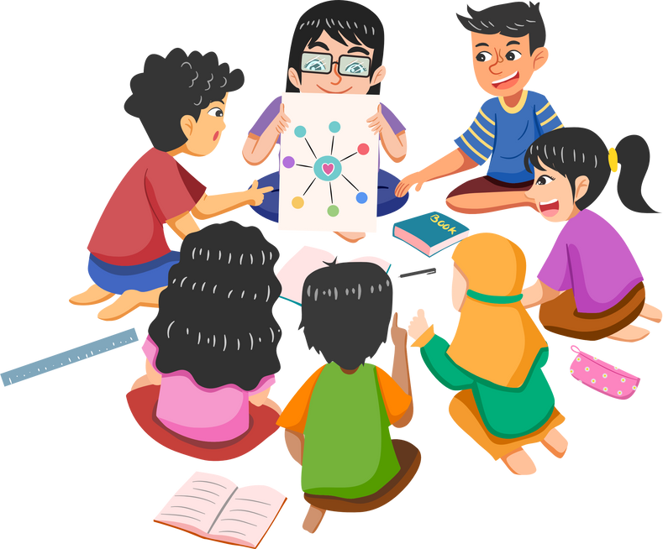
We can now bring all of our learning together!
How can you be an upstander and promote Anti-Bullying across your school community?
You can now share your learning and help others.
You can do this!

Slide 134



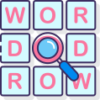
Own your Power
Find your Voice
Who will you speak to?
How will you convince others?
Use your Words
How will you educate others?
Prevent bullying?
Promote Anti-bullying
What will you say to others?
How will you include and support?

Slide 135
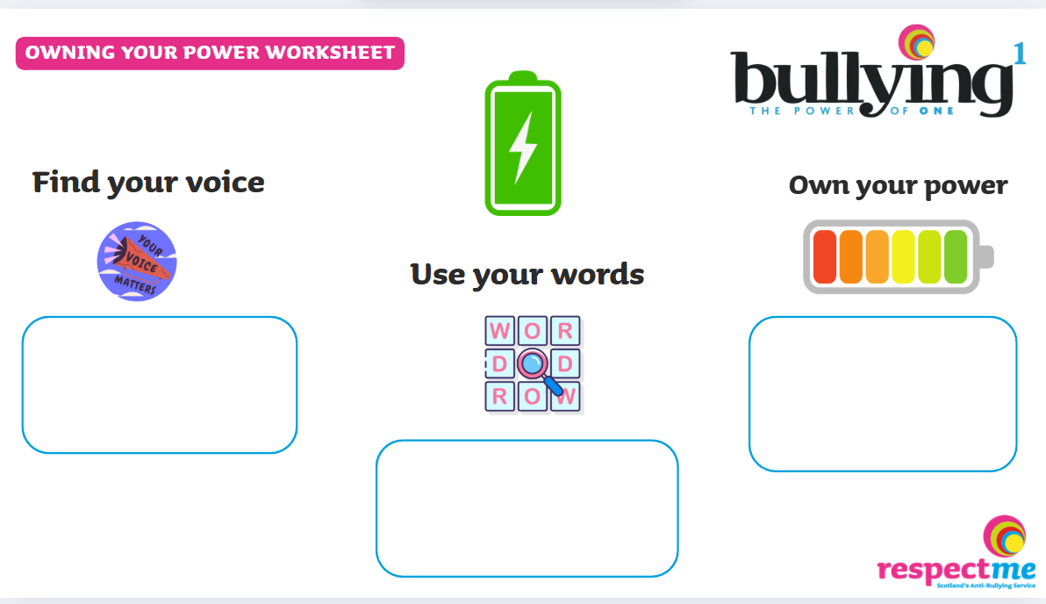
Worksheet available

Slide 136

Find your Voice
Own your Power
Don’t do this! STOP!
Miss/Sir - Can I talk with you?
Create posters and guides.
We can do this together.
Use your Words
Start your youth activist group.
Ask others to join in
Hold assemblies.
Promote respect.
Be kind.
“Well done”
“That’s great”
You are not alone. Come join us.

Slide 137

  Power Tracker Worksheet
  Character Profile Worksheets

Slide 138

REFLECTION TIME
What have you learned from watching the film series and completing the lessons?
  About power?
  The power of others?
  The power of everyone?
  How we treat each other?
  Words we use?

Slide 139

Worksheet available

