Slide 1


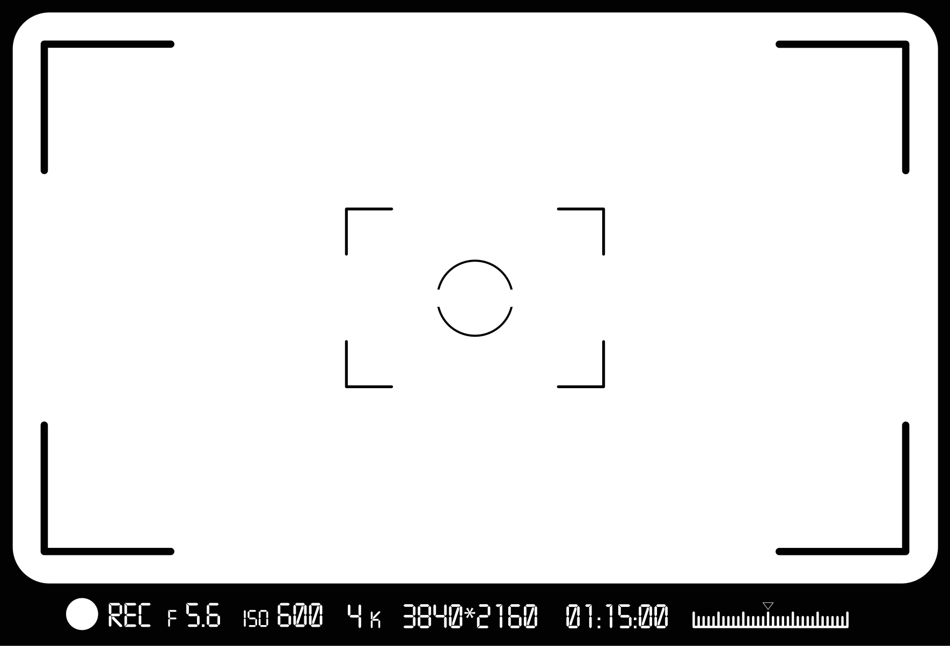
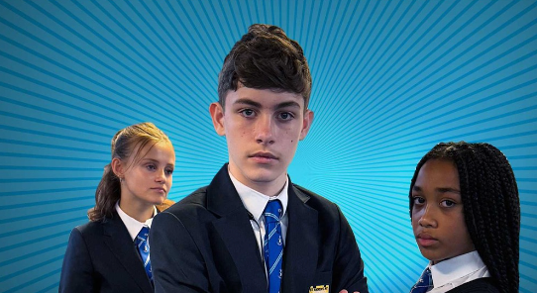

Secondary Age Learning Slides
Noah

Slide 2




Before you start watching the five films. Take some time to explore:
What do you think the film will be about?

Slide 3


It might mean that one person can help someone else if they are being bullied?
The film might show how bullying can happen and show us what we can do to help?
Could it mean that one person will use their power to hurt others?

Slide 4




Bullying behaviour can impact on your daily thoughts, feelings and overall mental health.
Thinking of the UNCRC - what rights are taken away if you experience bullying?

Slide 5


Explore the list of rights on the next slide
Which ones are impacted by bullying behaviour and in what way?

Slide 6

Right to be safe
Right to a name and nationality
Right to education
Right to be healthy
Right to be heard and taken seriously
Right not to be discriminated against

Slide 7

Right to be safe
Bullying makes children feel unsafe at school, online and in their community
Right to a name and nationality
Right to education
Right to be heard and taken seriously
Right not to be discriminated against
Right to be healthy

Slide 8

Right to be safe
Bullying makes young people feel unsafe at school, online and in their community
Right to a name and nationality
Bullying does not change this right
Right to education
Right to be healthy
Right to be heard and taken seriously
Right not to be discriminated against

Slide 9
Right to be safe
Bullying makes children feel unsafe at school, online and in their community
Right to a name and nationality
Bullying does not change this right
Right to education
Bullying can make young people scared to attend school
Right to be heard and taken seriously
Right not to be discriminated against
Right to be healthy

Slide 10
Right to be safe
Bullying makes children feel unsafe at school, online and in their community
Right to a name and nationality
Bullying does not change this right
Right to education
Bullying can make children scared to attend school
Right to be healthy
Bullying can make you feel stressed, unwell and impact on mental health
Right to be heard and taken seriously
Right not to be discriminated against

Slide 11
Right to be safe
Bullying makes children feel unsafe at school, online and in their community
Right to a name and nationality
Bullying does not change this right
Right to education
Bullying can make children scared to attend school
Right to be healthy
Bullying can make you feel stressed, unwell and impact on mental health
Right to be heard and taken seriously
Bullying can silence people and take away their sense of control
Right not to be discriminated against

Slide 12
Right to be safe
Bullying makes children feel unsafe at school, online and in their community
Right to a name and nationality
Bullying does not change this right
Right to education
Bullying can make children scared to attend school
Right to be healthy
Bullying can make you feel stressed, unwell and impact on mental health
Right to be heard and taken seriously
Bullying can silence people and take away their sense of control
Right not to be discriminated against
Bullying often targets people for their race, gender, beliefs or being them

Slide 13

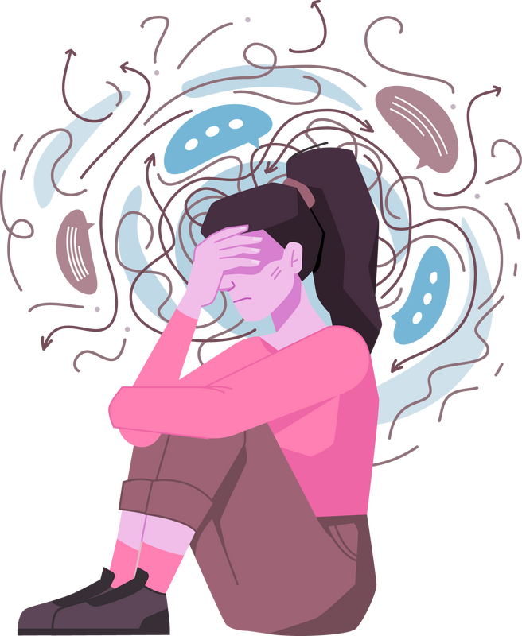
If you are experiencing bullying, your average day will not feel good, or enjoyable.
It will feel the opposite and this is not what anyone deserves.
Bullying is never acceptable and is not a normal part of growing up. Bullying is a breach of children’s rights.

Slide 14

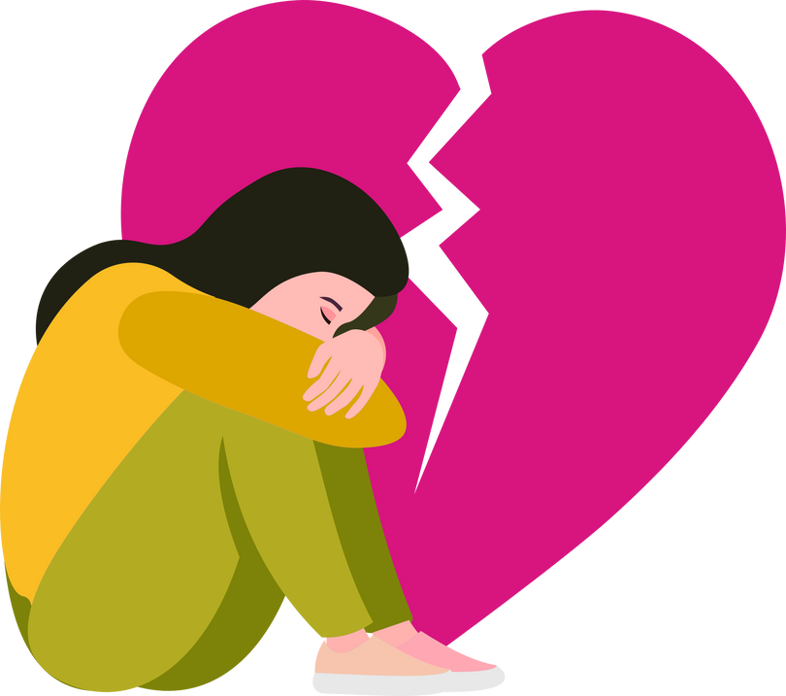
Bullying behaviour is not always intentional or deliberate.
It can be a one off or repeated.
It can be targeted and...sometimes it isn’t.
Sometimes people know what they are doing and at other times - they don’t.
It is complex.
Hurt
Threatened
Frightened
Left out

Slide 15


Bullying is never forever

Slide 16
Always remember that things can and do change!

Slide 17



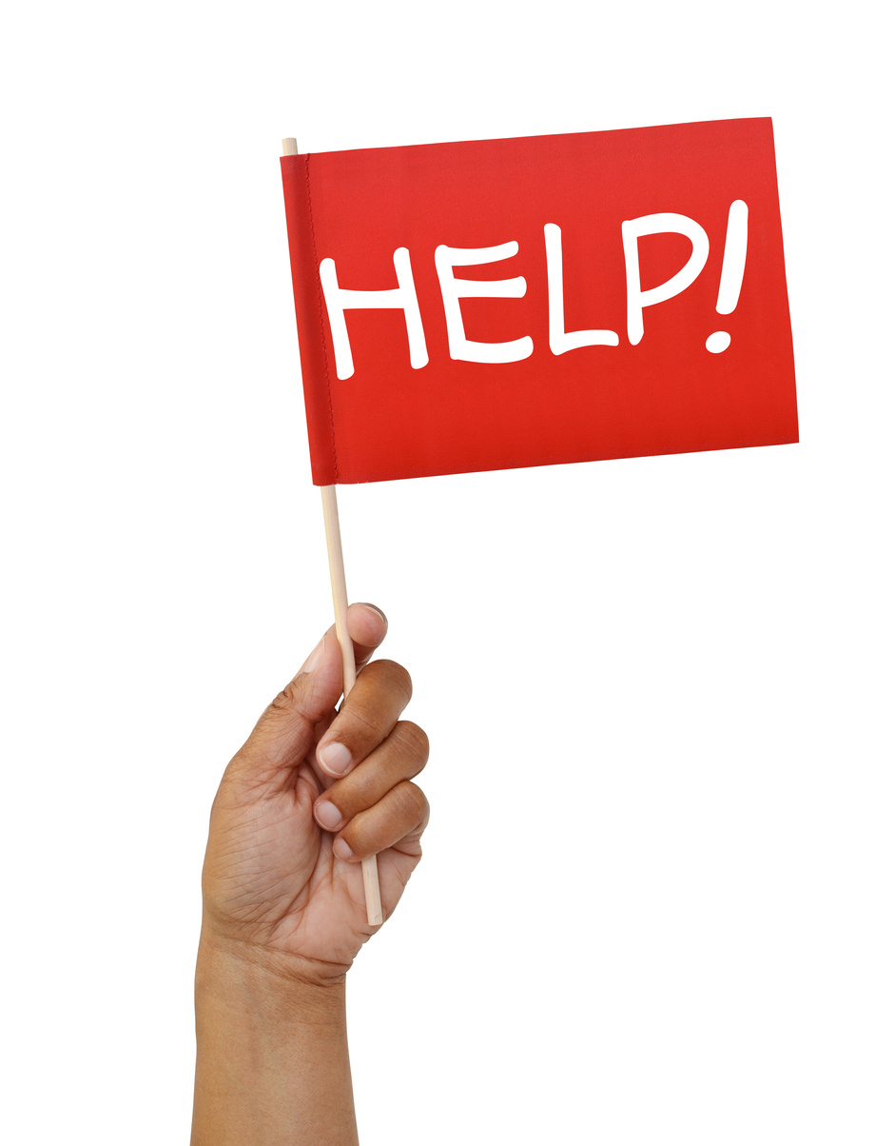
REMEMBER
Through this film series, we will be discussing bullying behaviour and examples of disrespect.
There are scenes that could cause distress.
If you are experiencing bullying - please speak to your teacher, family or trusted adult.
It really can make a difference.

Slide 18





TIME TO WATCH FILM 1

Slide 19

TIME TO WATCH FILM 1
Alternatively, watch Film 1: Noah at www.respectme.org.uk/resources-abw-25/

Slide 20

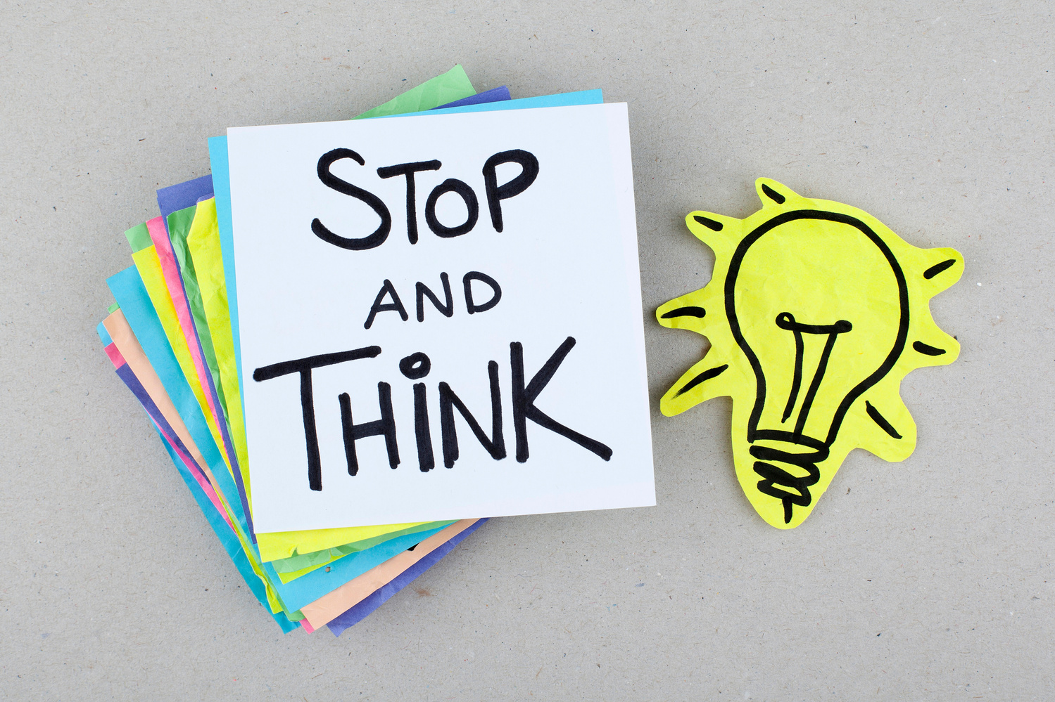

In pairs, take time to answer the questions for Film 1.
Think carefully about the character’s thoughts, feelings and actions.

Slide 21


1. Noah gives an overview of his day. It seems normal until he repeatedly mentions “Grace”. Why is this?
4. What are the different ways that Grace is showing bullying behaviour towards Noah?
2. Noah says “This is when everything changed.” What does he mean?
5. How does Ava want to deal with the situation and why is Noah against this?
3. What do you think is going through Noah and Ava’s minds when Grace turns up at the Youth Club?
6. How do you think Noah and Ava feel after dealing with Grace all day and find out about her going the trip?

Slide 22

1. Noah gives an overview of his day. It seems normal until he repeatedly mentions “Grace”. Why is this?
Noah’s day is filled with Grace mocking him, shouting at him and threatening him. She causes him to feel upset and sad and powerless. This is not normal!
2. Noah says “This is when everything changed”. What does he mean?
Grace has access to him at HOME through his mobile! She is texting him in his own personal space and he can’t escape her now. This is overwhelming.
3. What do you think is going through Noah and Ava’s minds when Grace turns up at the Youth Club?
They feel shocked! Youth Club is their safe space - their happy place where they can just be themselves. She is now disrupting their enjoyment and daily life. It is unbearable!

Slide 23
4. What are the different ways that Grace is showing bullying behaviour towards Noah?
She is teasing him, mocking him, physically pushing him, taunting him, being aggressive and intimidating him- all in one day!
Ava really wants to tell someone and get help...but Noah is terrified. He thinks that Grace will “kill him” and that everything will get worse!
5. How does Ava want to deal with the situation and why is Noah against this?
6. How do you think Noah and Ava feel after dealing with Grace all day and find out about going the trip?
They will feel completely drained, scared, alone and helpless. They cannot get away from Grace, she is relentless!

Slide 24



Film 1
  What words or phrases show that Noah did not want this attention?
  What emotion is Grace filled with?
  Why do you think this is?
“It just got worse and worse. I tried to avoid her, she found me.
I tried to be nice to her, that just made her angry.
I tried to block her...that REALLY made her angry.”

Slide 25





Script under the spotlight
Analysis task
Explore Noah’s dialogue in more detail
How is he truly feeling?
What are his inner emotions?
How is the bullying impacting on his life?

Slide 26
Script under the spotlight
Noah tells the audience about Grace:
Noah:
"She was everywhere, all the time,
I didn't know where to turn to."

Slide 27


Script under the Spotlight
Noah:
" She was everywhere, all the time,
I didn't know where to turn to."
What does the word “everywhere”
suggest?
How does Noah feel at this point?

Slide 28
Script under the Spotlight
Noah:
"She was everywhere, all the time,
I didn't know where to turn to."
The word “everywhere” suggests that Noah cannot escape Grace
Noah feels totally helpless, alone and powerless

Slide 29
Script under the spotlight
Ava tries to convince Noah to tell someone. Noah replies:
Noah:
“NO WAY! Grace would kill me if I tell a teacher, she’ll get me outside school or at youth club. If I tell Mum or Dad they’ll tell a teacher and everything will get worse.”

Slide 30
Script under the spotlight
Noah:
“NO WAY! Grace would kill me if I tell a teacher, she’ll get me outside school or at youth club. If I tell Mum or Dad, they’ll tell a teacher and everything will get worse!”
Why do you think Noah shouts “NO WAY!” instead of just saying no?
What do the words in yellow tell us about Noah’s state of mind?

Slide 31
Script under the spotlight
Noah:
“NO WAY! Grace would kill me if I tell a teacher, she’ll get me outside school or at youth club. If I tell Mum or Dad, they’ll tell a teacher and everything will get worse!”
The words in yellow emphasise how helpless Noah is. He feels as if he has no control in his life!
Noah shouts because he has a tone of extreme panic! He is riddled with fear.

Slide 32


Noah is not coping due to the bullying behaviour he is experiencing from Grace.

Slide 33



What advice could Ava be giving Noah?
Have a look at these example text messages and explain if they have good or bad advice?

Slide 34



Does this text message have good or bad advice?
Explain why!
Hi Noah, ...
Hi Noah, I can’t believe that Grace is behaving like this and being so mean to you! Maybe we should just skip school and youth club over the next few weeks so she can’t get to you...or me?!

Slide 35


Bad advice. This is allowing Grace to have power. If Noah skips school and youth club...then he is missing out on learning and things he enjoys!
Hi Noah, ...
Hi Noah, I can’t believe that Grace is behaving like this and being so mean to you! Maybe we should just skip school and youth club over the next few weeks so she can’t get to you...or me?!

Slide 36

Does this text message have good or bad advice?
Explain why!
Hi Noah, ...
Hi Noah, I can’t believe Grace is acting like this. She is out of order! It is not okay!
I really think you need to tell a teacher or the youth club leader. They can help you!

Slide 37


Good advice. Ava is right to try and persuade Noah to tell a trusted adult. Speaking to someone can help and the situation can turn around.
Hi Noah, ...
Hi Noah, I can’t believe Grace is acting like this. She is out of order! It is not okay!
I really think you need to tell a teacher or youth club member. They can help you!

Slide 38
Does this text message have good or bad advice?
Explain why!
Hi Noah, ...
Hi Noah, Grace was just horrible to you today. I was thinking maybe you could try and change yourself when she is around? Like don’t talk about school and act a bit more cool.

Slide 39

Bad advice. Nobody should ever change who they are to stop being bullied or to “fit in”. Changing yourself for others only leads to sadness and unhappiness.
Hi Noah, ...
Hi Noah, Grace was just horrible to you today. I was thinking maybe you try and change yourself when she is around? Like don’t talk about school and act a bit more cool.

Slide 40
Does this text message have good or bad advice?
Explain why!
Hi Noah, ...
Hi Noah, Grace is in the wrong - not YOU!
I’ll back you up. You are not on your own at all. Let’s go talk to someone together.

Slide 41
Good advice. This is great to see Ava offering so much help and support. She explains to Noah that he is not alone and this is a really important thing to hear. It can give him strength.
Hi Noah, ...
Hi Noah, Grace is in the wrong - not YOU!
I’ll back you up. You are not on your own at all. Let’s go talk to someone together.

Slide 42

Now, imagine you are Noah’s friend.
A kind, friendly message can go a long way in showing someone support.
What advice would you text him at this stage?

Slide 43
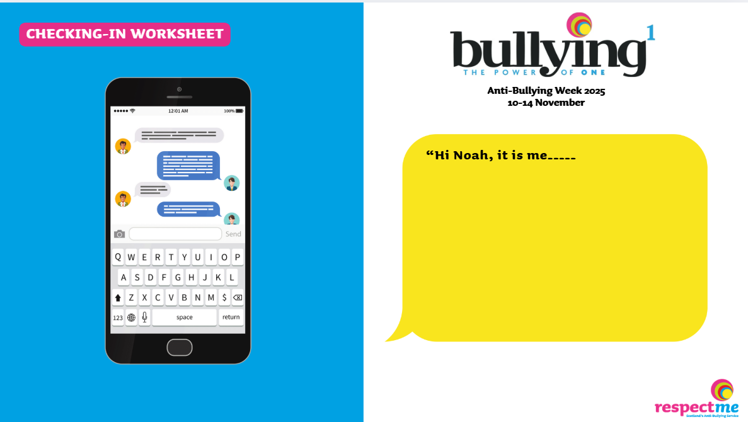

Worksheet available

Slide 44
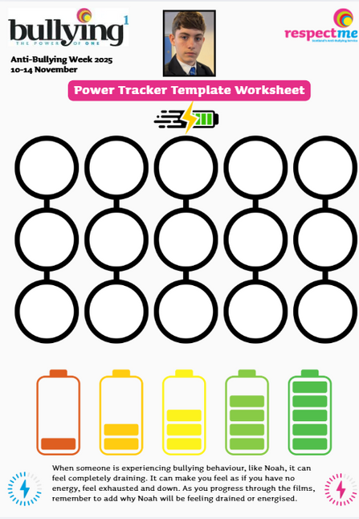
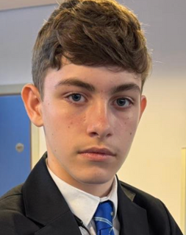

When someone is experiencing bullying - like Noah - it can feel completely draining. It can make you feel as if you have no energy, exhausted and down. As you progress through the film, remember to label when and why Noah will be feeling drained or energised.
Worksheet available

Slide 45



Noah receives an abusive text when he is home. He has no escape!
Grace hurts Noah-she pushes him
Grace follows Noah
Grace laughs at Noah

Slide 46
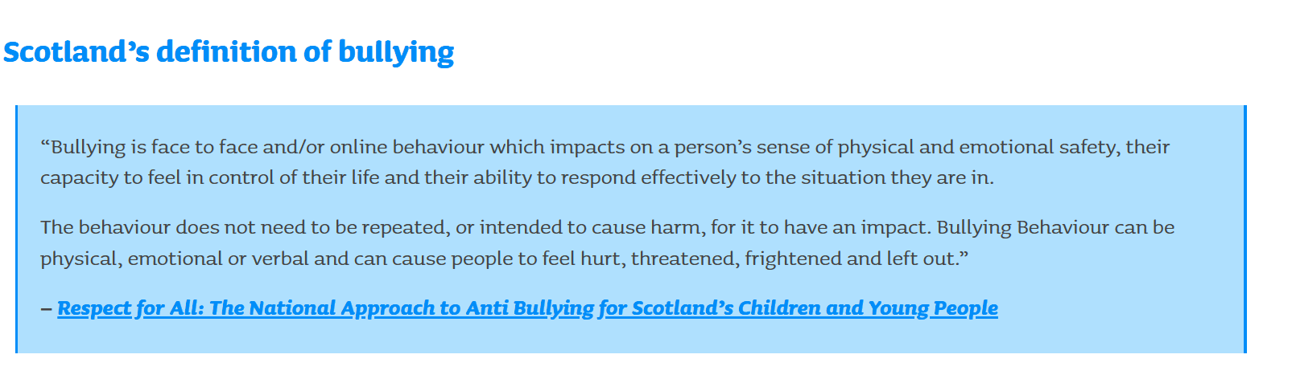

Slide 47




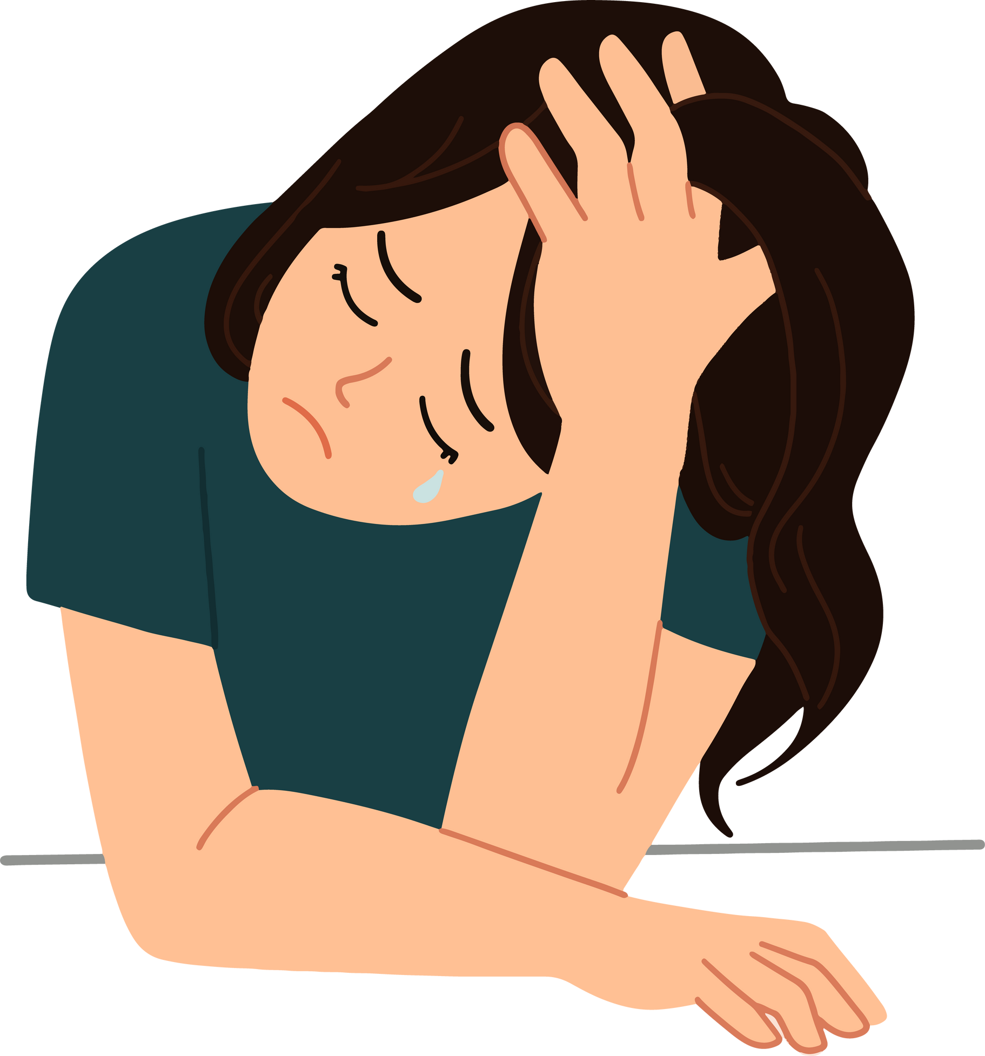
Bullying
It can make you feel trapped
It can make you feel afraid and very alone
Mental and emotional health can be affected
Our thoughts and actions can be consumed by what is happening

Slide 48




Noah is feeling upset, hurt and confused. He is miserable because of the way Grace is treating him. He cannot escape her!
Imagine you are Noah and write his diary extract for this episode?
  How is he feeling?
  What is he dealing with? Think about the teasing, the confrontations and text messages at home on his mobile.
  Focus on Grace’s behaviour to him.
  What does Noah think his options are?
Dear Diary,

Slide 49
Secondary Age Learning Slides
Ava

Slide 50



Think back to Film 1
  What do you remember?
  Write down 3 things you remember, or learned
  Share with a partner

Slide 51

Noah, Ava and Grace are the main characters.
Noah is feeling down because Grace has been bullying him.
Ava is Noah’s best friend.
Bullying can happen to anyone face-to-face and online
Bullying can appear as teasing, being left out, pushed, or kicked...

Slide 52



Before you start watching Film 2 - take some time to explore the following:
As a group, discuss:
  What is power? How is it used?
  Is having power always fixed? (does the same person always have power?)

Slide 53



Power means having an influence over others - for either good or bad.
Power isn’t bad in itself - it depends on how you use it.
There is:
  The power to help
  The power to hurt

Slide 54


Power is not fixed.
It changes in different situations.

Slide 55

Think about the power we all have. If you see someone being bullied - what power do you have to help?
Look at this next example.

Slide 56
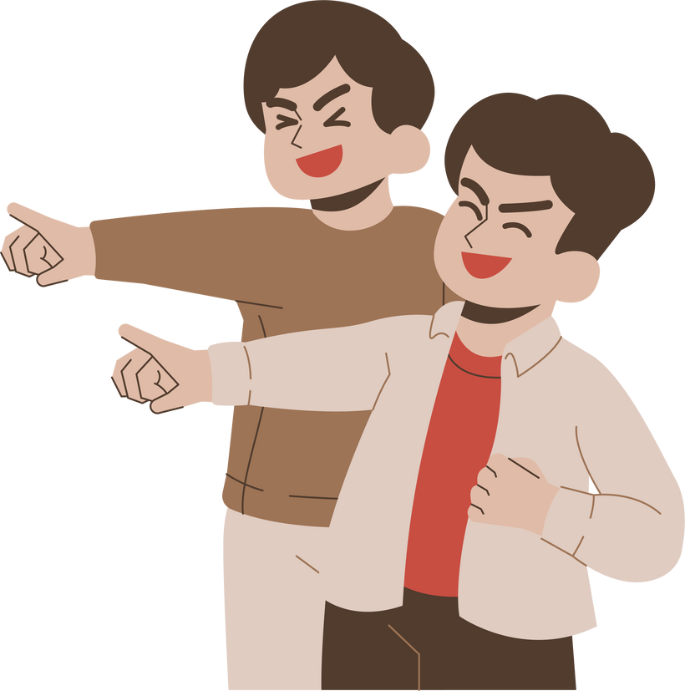

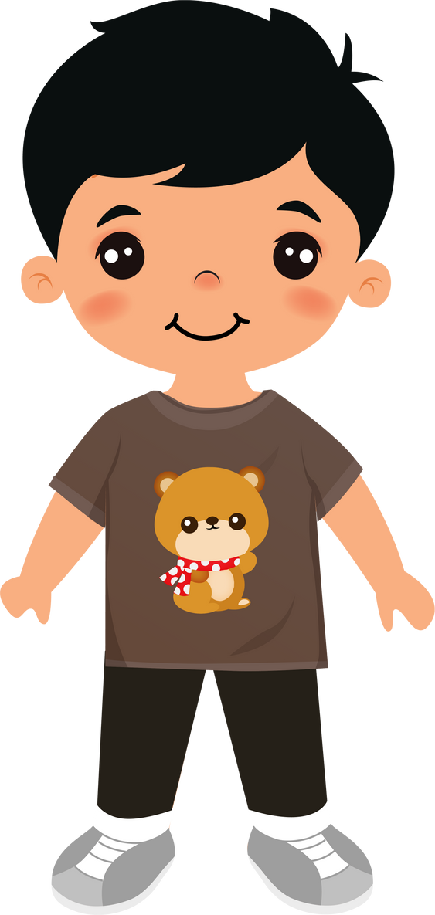



Craig has just started S1 and wants to impress the older pupils.
Craig blocks the door way each morning, laughs at others, make comments on people’s shoes and tries to trip them up. Other pupils laugh nervously and join in.

Slide 57

Craig has just started S1 and wants to impress the older pupils.
Craig blocks the door way each morning, laughs at others, make comments on people’s shoes and tries to trip them up. Other pupils laugh nervously and join in.
Who has the POWER here?

Slide 58
Craig has the POWER here!
He is using it to control and intimidate others.

Slide 59
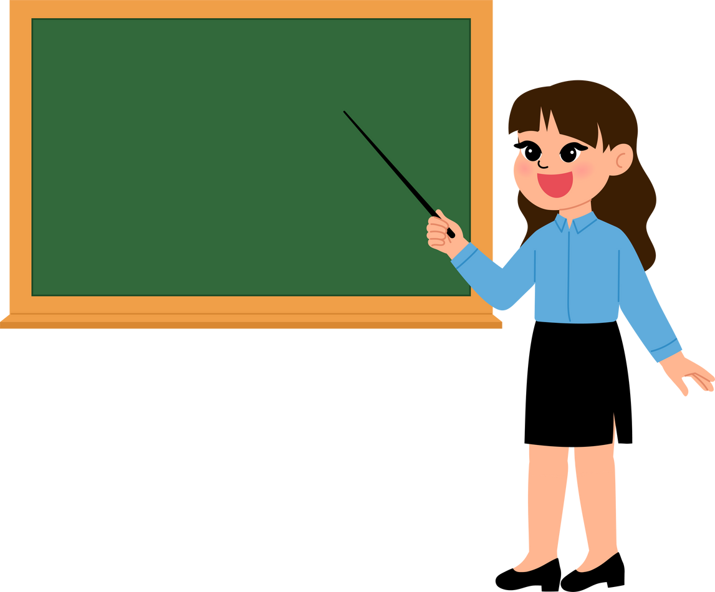
Be KIND!
One day, a teacher noticed this constant behaviour. She did not ignore it. She approached Craig and told him:
“Craig this is extremely unkind, mean and dangerous. This is bullying behaviour!”
She reminded him of the school values and asked him to stop.
Everyone deserves to feel safe in school.
Aisha and Peter decided enough was enough and instead of rushing past Craig and feeling fear - they told him firmly:
“Stop this now and move away! Everyone should be allowed to walk by safely.”

Slide 60
Who has the power here?

Slide 61
Everyone has used their power!
Teacher - uses power to ensure fairness and inclusion
Pupils - use their power to stand up to Craig. They use their voice and ask him to stop behaving this way. It is not cool! It is not fun! It is bullying behaviour.

Slide 62




Everyone has the POWER to do something

Slide 63
We can all ask the person who is bullying to stop.
Tell a trusted adult about what is happening.
This can make a real difference.
Support others and be kind!
Include others,
speak up.

Slide 64


TIME TO WATCH FILM 2
Alternatively, watch Film 2: Ava at www.respectme.org.uk/resources-abw-25/

Slide 65
1. How do Ava and Noah know each other?
4. When Noah is physically hurt and ridiculed, Ava decides not to go after him. Why is this?
2. Why are Ava, Noah and Grace no longer friends?
5. How do you feel about Ava not following Noah, after he was being pushed around by Grace?
3. Ava scrolls through Noah’s phone and can see the many abusive messages from Grace.
How do you think she feels?
6. Does Ava speak with Grace in this film? Why?

Slide 66
1. How do Ava and Noah know each other?
Ava and Noah went to Nursery with each other. They go way back!
2. Why are Ava, Noah and Grace no longer friends?
Grace spread really nasty rumours about Noah...so they now keep their distance.
3. Ava scrolls through Noah’s phone and can see the many abusive messages from Grace. How do you think she feels?
She will likely feel terrified and full of fear for her friend. She will also be worried about herself being at risk from these types of messages.

Slide 67
4. When Noah is physically hurt and ridicluled, Ava refuses go after him. Why is this?
Ava is riddled with fear. She is terror stricken and assumes she will be next to be attacked by Grace. She can see Noah’s tears, but worries about herself.
5. How do you feel about Ava not following Noah to help him after his altercation with Grace?
This is understandable...but Ava could have followed him or quickly messaged him to let him know she was there for him. He thinks he is alone now and has no one.
6. Does Ava speak with Grace in this film? Why? Why not?
Ava does not speak with Grace as she is simply too scared. She can see the relentless bullying Noah suffers and she doesn’t want to go through the same experience.

Slide 68


Script under the spotlight
Analysis task
Explore what Ava says in more detail.
How is she truly feeling?
What are her inner emotions?
How is Noah’s experience impacting on Ava’s life?

Slide 69
Script under the spotlight
As Ava scrolls through Noah’s phone, she can see the upsetting text messages from Grace. She says:
Ava:
“She has added him to a group chat someone set up for the trip. I feel awful but I don’t know what to do about it?”

Slide 70
Script under the spotlight
Ava:
“She has added him to a group chat someone set up for the trip. I feel awful but I don’t know what to do about it?”
What does the word “awful” tells us about Ava?
If you were Ava, what choices could you make in this situation?

Slide 71
Script under the spotlight
Ava:
“She has added him to a group chat someone set up for the trip. I feel awful but I don’t know what to do about it?”
The word “awful” highlights that Ava feels upset and sad about what her friend is going through.
There are options:
  She could tell a trusted adult
  Support Noah

Slide 72
Script under the spotlight
Ava sees what Grace is doing to Noah. And she sees Noah looking miserable and teary. She says:
Ava:
“I know I should have gone after him, but, if I’m honest...I was worried I would be next.”

Slide 73
Script under the spotlight
Ava:
"I know I should have gone after him, but, if I’m honest...I was worried I would be next”.
How could Ava be thought of as being a bystander
(someone that does nothing)?

Slide 74
Script under the spotlight
Ava:
"I know I should have gone after him, but, if I’m honest...I was worried I would be next”.
Ava thinks about herself. Whilst she is upset and feels bad for her friend - at this point - she is worried that Grace will target her.
She knows Noah is really struggling, but she chooses not to support him. She stands by watching and thinking.

Slide 75
Script under the spotlight
Ava later sees Noah sitting alone and upset. She talks with him:
Ava: “You have to tell someone, it’s getting worse”
Noah: “Leave me alone Ava! It’s nothing to do with you!”
Ava: I decided I had to do something. I couldn’t just watch anymore.”

Slide 76

Script under the spotlight
Ava: “You have to tell someone, it’s getting worse”
Noah: “Leave me alone Ava! It’s nothing to do with you!”
Ava: I decided I had to do something. I couldn’t just watch anymore.”
What changes for Ava?
Why could she now be called an upstander?
(someone that does something for others)

Slide 77
Script under the spotlight
Ava: “You have to tell someone, it’s getting worse”
Noah: “Leave me alone Ava! It’s nothing to do with you!”
Ava: I decided I had to do something. I couldn’t just watch anymore.”
Ava thinks enough is enough! Noah is alone, and more isolated than ever.
She has to help him and she knows it is the right thing to do. This is a real turning point!

Slide 78



We already know that everyone has the power to do something if someone is experiencing bullying...
BUT- what if we all do nothing?
What happens? What are the consequences of doing nothing?
All behaviour has a direct impact on others.

Slide 79

What is the impact of this?
  Ava witnesses Grace being unkind to Noah - but says or does nothing.
  Ava can see the abusive messages that Noah is receiving- but says or does nothing.
  Ava can see the upset and turmoil that Noah feels...and yet does not follow him to make sure he is okay. She worries that she will be next on Grace’s list.

Slide 80
What is the impact of this?
  Ava witnesses Grace being unkind to Noah - but says or does nothing.
  Ava can see the abusive messages that Noah is receiving - but says or does nothing.
  Ava can see the upset and turmoil that Noah feels...and yet does not follow him to make sure he is okay. She worries that she will be next!
Noah continues to feel scared, alone and targeted.

Slide 81
What is the impact of this?
  Ava witnesses Grace being unkind to Noah - but says or does nothing.
  Ava can see the abusive messages that Noah is receiving- but says or does nothing.
  Ava can see the upset and turmoil that Noah feels...and yet does not follow him to make sure he is okay. She worries that she will be next!
Noah continues to feel scared, alone and targeted.
Grace continues to hold power over Noah and Ava. The misery and cruel behaviour continues. Noah feels more alone than ever!

Slide 82
What is the impact of this?
  Ava witnesses Grace being unkind to Noah - but says or does nothing.
  Ava can see the abusive messages that Noah is receiving - but says or does nothing.
  Ava can see the upset and turmoil that Noah feels...and yet does not follow him to make sure he is okay. She worries that she will be next!
Noah continues to feel scared, alone and targeted.
Grace continues to hold power of Noah and Ava. The misery and cruel behaviour continues. Noah feels more alone than ever!
Noah feels completely alone and thinks things will never change. Terror and fear linger for everyone...Grace continues this behaviour.

Slide 83

If you don’t do anything
you are a:
Bystander
SOMEONE THAT SEES...BUT DOES NOT ACT
A bystander can be described as a person who does not become involved in a situation where someone else may be experiencing bullying, although they might see that the person may need help.

Slide 84
If you don’t do anything,
you are a:
Bystander
SOMEONE THAT SEES...BUT DOES NOT ACT
Being a bystander can be deeply upsetting to individuals. Even if they know they should step in, and want to, there may be reasons for not getting involved such as fear of getting hurt, getting into trouble, making the situation worse, or being bullied themselves as a consequence.

Slide 85




YOU COULD BE MORE OF AN
Bystander
Upstander
SOMEONE THAT SEES...
BUT DOES NOT ACT
SOMEONE THAT SEES...
AND THEN
ACTS!

Slide 86

Calls in others.
Speaks up for others.
Asks people to STOP being unkind and disrespectful!
Stands with the person experiencing bullying.
Asks trusted adults for help.
Shows kindness.
Is a respectful role model.
Upstander
WHAT DOES AN UPSTANDER DO?

Slide 87
Being an upstander can really help others when they are feeling alone, sad and vulnerable.
Upstanders can really spark change in society and help to make the world a better place - because they show that they care and actively do something.
Upstander
WHAT DOES AN UPSTANDER DO?

Slide 88
  Being an upstander can be a really difficult thing to do. It requires thinking, courage and knowing what to do and when.
  It is natural to worry and fear speaking up for others. It can be tricky.
  Remember that there is never a pressure for you to adopt a “superhero” role. We are all human!
  If you are in a situation like Ava, or want to be an upstander, follow these top tips:
Upstander

Slide 89




Ask yourself, is it safe to speak up?
If it is, you could say things like:
“Leave them alone!”
“That’s not kind”
“Stop doing that”
Never join in with others who are being unkind to others!
Do not copy them or encourage the bullying behaviour.
Tell a trusted adult about what’s been happening.
This helps to keep others safe and the adult will know what to do.

Slide 90



At a quieter time you could show your support.
Sometimes just asking if someone is “okay” can go a long way and make them feel included.
Stand with the person, never isolate them.
Show your support by being there and showing they are not alone.
Be a positive role model.
Be kind and spread kindness. Be compassionate and show empathy.

Slide 91

If you were experiencing bullying:
  What help would you want?
  What support would you want?
  What would make you feel less scared and alone?
  What would you expect from others?

Slide 92



Ava finally gains courage to tell someone about Noah?
What might people call her if she tells his parents or the teacher?

Slide 93



grass
We have all had heard this word being used towards people -especially when they tell their teacher or trusted adult about something that has happened in school or at youth group/ dancing/ football...etc.
You are a GRASS!

Slide 94

grass
Ava is reluctant to tell anyone that Noah is being bullied . Perhaps she will be called a GRASS? Could she be picked on? Found out?
You are a GRASS!

Slide 95


grass
Why do people say this? | Why is speaking out important?

Slide 96
grass
Why do people say this? | Why is speaking out important?
To frighten others | Keeping quiet can make problems worse
To protect others/ to sound cool | It keeps others safe, happy and respected
To make people feel guilty | It is the right thing to do!

Slide 97

grass
Do you agree that it is time to drop the word ‘grass’?
  It makes people feel afraid to speak up for others!
  It is a negative term that impacts on others and holds them back
  It can prevent help and support being given

Slide 98



What can we replace this word with so more people will be encouraged to use their voice and speak up?
grass

Slide 99


grass
Helper
Brave
Supporter
Courageous
Problem solver
Protector
Upstander

Slide 100


Power Tracker Worksheet

Slide 101
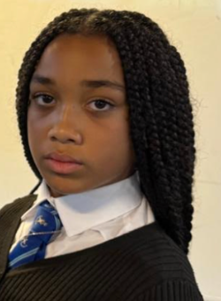


Ask the expert!
Ava can see her friend is hurting in this film, she wants to help and yet is also afraid for her own safety.
Imagine you are Ava and need advice:
  You see an online message board that offers advice on bullying.
  Write a post from Ava’s point of view - describe what’s happening and why you know it’s wrong.
  How is she feeling? What is she dealing with?
  What does she think her options are?
And then:
  Write a reply to Ava offering advice from the message board admin. Think about what being a ‘bystander’ means. How can she help Noah and also feel safe in doing so? Give her some expert advice!

Slide 102

Secondary Age Learning Slides
Mum and Dad

Slide 103




Think back to the last film...
A lot happened!
We have some statements that we would like you to review and decide if they are true or false.

Slide 104
Bullying is always just face-to-face
Noah is overreacting and needs to deal with this
Ava telling Noah’s mum and dad is a bad idea
Grace has always been kind to Noah
Noah is struggling
This is just what it is like being a young person

Slide 105
Noah is struggling

Slide 106

Bullying is always just
face-to-face
(It can also happen online)
Noah is struggling
Noah is overreacting and needs to deal with this
(Noah is upset and is right to feel this way)
Ava telling Noah’s mum and dad is a bad idea
(It is a good idea to speak to a trusted adult)
Grace has always been kind to Noah
(Grace sadly has not always been kind)
This is just what it is like being a young person
(Bullying is never acceptable)

Slide 107

TIME TO WATCH FILM 3
Alternatively, watch Film 3: Mum and Dad at www.respectme.org.uk/resources-abw-25/

Slide 108


1.Why are Noah’s parents so concerned about him?
4. How are Noah’s parents affected at home?
5. How does Noah feel when his Mum tells him that Ava has told her everything?
2. How is Noah feeling at the start of this film?
3. Why do you think Noah tells his parents that they would “not understand’ when they ask him to discuss his feelings?
6. Does knowing the truth about Grace automatically mean the bullying will stop?

Slide 109
  Why are Noah’s parents so concerned about him?
Noah is extremely distant, withdrawn and not his normal self. He is angry and refusing to communicate.
Noah is now at a really low point. He is scared, helpless and thinks his friend doesn’t really care. He feels powerless.
2. How is Noah feeling at the start of this film?
3. Why do you think Noah tells his parents that they would “not understand’ when they ask him to discuss his feelings?
He might feel that they don’t understand how another person could be doing this to him. He feels embarrassed and full of shame. He perhaps feels his parents can't relate to his experience.

Slide 110
4. How are Noah’s parents affected at home?
Noah’s parents are feeling distress for their son. They are trying everything to get him to open up.
5. How does Noah feel when his Mum tells him that Ava has revealed everything?
He will have mixed feelings. He will have relief his secret is out and no longer a secret burden on his shoulders. He could be angry at Ava for involving herself.
6. Does knowing the truth about Grace automatically mean the bullying behaviour will stop?
Sadly, no. Noah’s parents knowing does not mean it will stop right away. However, it is a step in the right direction. They can now speak with the school and teachers. The power of everyone is needed!

Slide 111


Script under the spotlight
Analysis task
Explore Noah’s mum’s dialogue in more detail
How is she feeling?
What are her inner emotions?
How is Noah’s experience impacting on her?

Slide 112
Script under the spotlight
Noah’s mum explains that Ava has revealed that Noah is being bullied
Mum:
“Ava told me everything that had been happening. About the bullying online, and at school and at youth group. How could they do that to him?...”

Slide 113
Script under the spotlight
Mum:
“Ava told me everything that had been happening. About the bullying online, and at school and at youth group. How could they do that to him?...”
This list shows all the places where Noah is being bullied.
There has been no escape!
Mum asks this question in yellow-how does she feel?

Slide 114
Script under the spotlight
Mum:
“Ava told me everything that had been happening. About the bullying online, and at school and at youth group. How could they do that to him?...”
This list outlines the ways and the places Noah is being bullied.
There has been no escape!
Mum feels shocked and devastated. Noah is her child and he doesn’t deserve this.

Slide 115



SIGNS OF
BULLYING
Think about Noah’s parents and what they notice about his behaviour at home.
They don’t recognise their son at all and just know something is very wrong.
Do you know the signs of someone experiencing bullying behaviour?

Slide 116
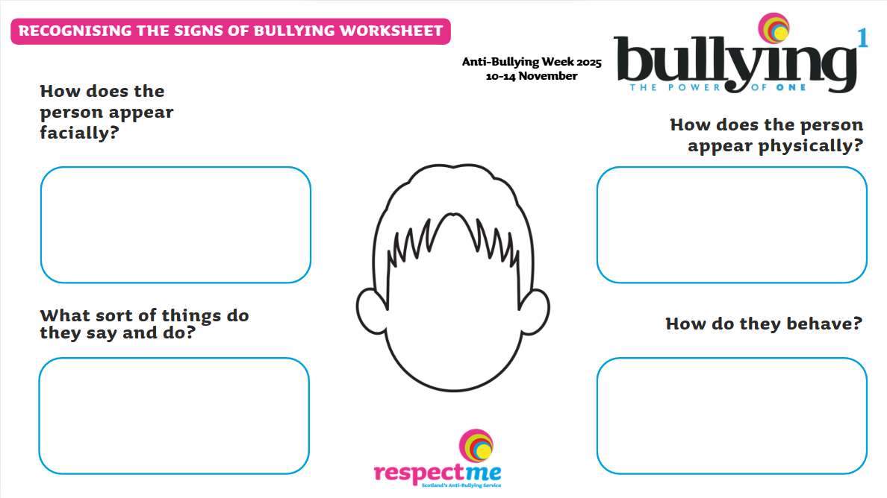
Worksheet available

Slide 117

SIGNS OF
BULLYING
How does the person appear facially?
  They can seem sad and teary
  Look worried or nervous
  Look like something else is on their mind
  Looking down or deep in thought
How does the
person appear physically?
  Tired, due to lack of sleep
  Tight shoulders - they have a burden on them
  Unwell, headaches and feeling sick
  Tense and on edge as though they are on alert

Slide 118
SIGNS OF
BULLYING
What sort of things do they say and do?
  They can be very quiet and withdrawn
  Prefer to be alone
  Not wanting to go to school
  Avoid going out and to certain places
  They might say: “Leave me alone! Nobody likes me!”
How do they behave?
  Can be quick to get upset
  Can be quick to get angry
  They might shout and lash out!
  Change their eating and sleeping habits
  Ignore others

Slide 119

SIGNS OF
BULLYING
Of course...all of these signs might be nothing to do with bullying....but it is always wise to keep your eye out, check in on people and be an upstander!

Slide 120

SIGNS OF
BULLYING
Why not make a guide or poster to help other learners and adults look out for the signs of bullying?

Slide 121

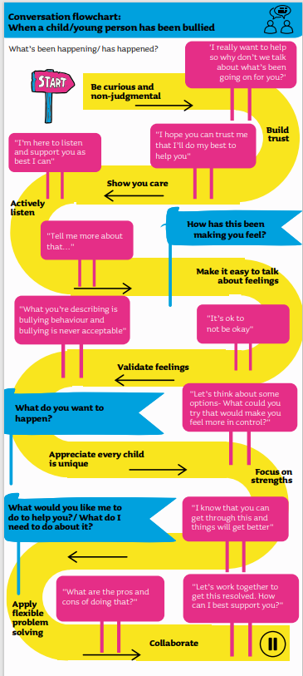


Now it is time to look at this conversation guide from respectme.
This helps adults to understand what to say to a child who may be experiencing bullying.
  Imagine you are Noah’s parents and script a conversation with him
  Ask him what is wrong?
  Let him know that you are there for him.
  Use the respectme conversation guide for some ideas on what to say.
  Why don’t you take a character role and and act this out in class?
Teachers will provide a copy of the guide

Slide 122

Power Tracker Worksheet

Slide 123

Secondary Age Learning Slides
Grace

Slide 124


Why do people choose to show bullying behaviour to others?

Slide 125
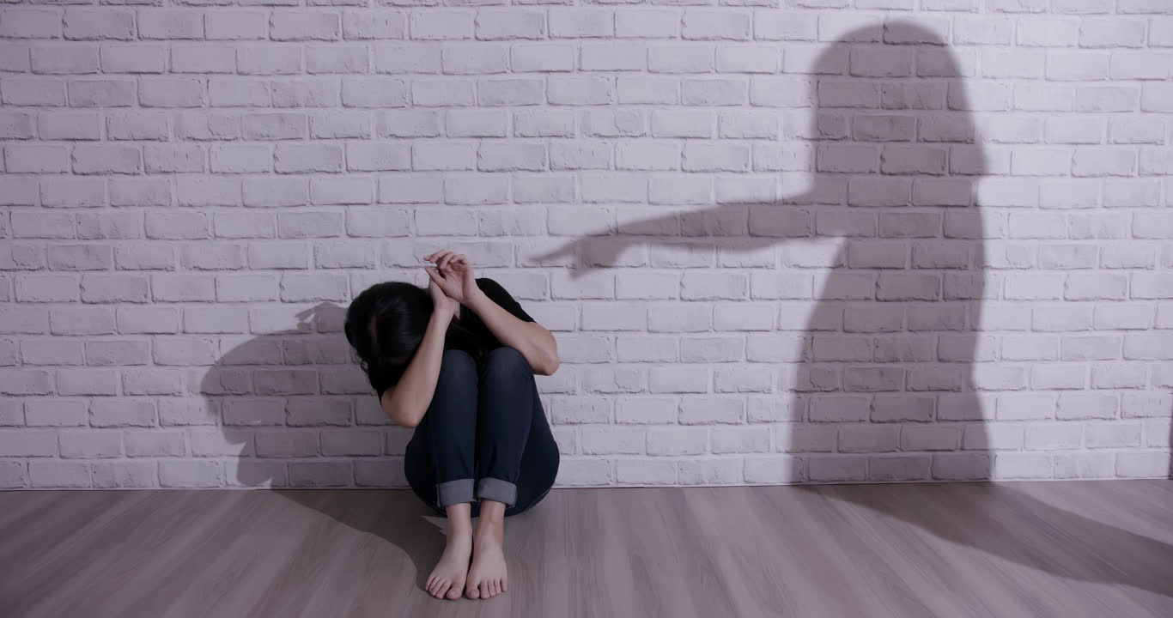
BECAUSE THEY CAN
It’s fun for them!
Power
Low self-esteem
Anger
Jealousy!

Slide 126


Bullying is extremely upsetting.
But we need to be careful not to give labels...as this can make people feel as if change can never happen.

Slide 127
What does ‘bully’ suggest?
Mean
Cruel
Horrible
Vile
What does ‘victim’ suggest?
Hurt
Weak
Injured
Sensitive
Labels are for things, not people.

Slide 128

People that show bullying behaviour can also be kind to others.
Bullying is never forever and. People can gain strength in time.
People can make mistakes and change.
Nobody deserves a label. Nothing is forever!

Slide 129

We use the words:
Someone is displaying
bullying behaviour.
A person might experience bullying behaviour.

Slide 130
TIME TO WATCH FILM 4
Alternatively, watch Film 4: Grace at www.respectme.org.uk/resources-abw-25/

Slide 131

3. Is there ever an excuse for acting out bullying behaviour to others? Why? Why not?
1. What can you tell about Grace’s home life?
“In primary school he would always show up with his mum or dad. I hated that. Why does he get to have his parents running around after him? It makes me sick. I’ve been looking after myself for years. I haven’t even seen dad in forever.”
4. Grace comments that her behaviour “is just a laugh”. Why is this not the case?
2. Explore the words above from Grace. What does this reveal about Grace and the reasons for her bullying behaviour?
5. What would you do if you saw all of this behaviour from Grace?

Slide 132
Grace’s mum does not seem to take too much notice of her. She seems to ignore her and prefers her to be out at the youth group. This is extremely sad.
1. What can you tell about Grace’s home life?
“In primary school he would always show up with his mum or dad. I hated that. Why does he get to have his parents running around after him? It makes me sick. I’ve been looking after myself for years. I haven’t even seen dad in forever.”
2. Explore the words from Grace. What does this reveal about Grace and her reasons for the bullying behaviour?
Grace’s tone sounds angry and sad.
She is angry about taking care of herself. Her words reveal her inner jealousy for Noah and his seemingly happy, perfect life. She wants what he has!

Slide 133
3. Is there ever an excuse for acting out bullying behaviour to others? Why? Why not?
No, there is never an excuse. Bullying makes people feel down, hurt and takes away all sense of control. It is not excusable.
4. Grace comments that her behaviour “is just a laugh”- why is this not the case?
It is not “a laugh” as only Grace finds it funny. Noah is subjected to face-to-face and online bullying. He also experiences hitting and pushing!
5. What would you do if you witnessed all of this behaviour from Grace?
I would reassure Noah that he is not alone. I would also tell my teacher as I know they can help bring this to a stop!

Slide 134

Script under the spotlight
Analysis task
Explore what Grace says in more detail
How is she truly feeling?
What are her inner emotions?
How are her choices impacting on her?

Slide 135
Script under the spotlight
Grace tells the audience one of her reasons for picking on Noah
Grace:“He was just an easy target. Never fought back or anything.”

Slide 136
Script under the spotlight
Grace:“He was just an easy target. Never fought back or anything.”
What do these words reveal about Grace?

Slide 137
Script under the spotlight
Grace:“He was just an easy target. Never fought back or anything.”
Grace loves POWER.
Noah doesn’t fight back and she knows this. So, Grace has all the power to do what she wants! She views him as weak and enjoys causing upset.

Slide 138
Script under the spotlight
Grace later reveals more about herself. She tells us:
Grace: “It just kept going, the more I did it, the more my friends thought it was funny. Having this power over him was great. At least he has people who care about him.”

Slide 139

Script under the spotlight
Grace: “It just kept going, the more I did it, the more my friends thought it was funny. Having this power over him was great. At least he has people who care about him.”
Why is having “power” so important to Grace?
What does she mean “people who care”?

Slide 140
Script under the spotlight
Grace: “It just kept going, the more I did it, the more my friends thought it was funny. Having this power over him was great. At least he has people who care about him.”
Power makes Grace feel big and important. She gets attention. She enjoys making Noah feel inferior and small.
She is trying to explain her behaviour. She is seems neglected at home and knows Noah has a good family life. This is not an excuse, she has to be accountable.

Slide 141
Script under the spotlight
Grace sees Noah upset and crying in the stairwell - alone
Grace: I hadn’t really thought about what happens to him when he’s alone. It was just a laugh, I didn’t mean to take it as far as this.”

Slide 142

Script under the spotlight
Grace: “I hadn’t really thought about what happens to him when he’s alone. It was just a laugh, I didn’t mean to take it as far as this.”
Why are Grace’s thoughts, actions and behaviour so dangerous?

Slide 143
Script under the spotlight
Grace: I hadn’t really thought about what happens to him when he’s alone. It was just a laugh, I didn’t mean to take it as far as this.”
Grace never once stops to think about the impact on Noah. She is the one causing pain and misery, nobody else. She has forgotten that Noah is a human with feelings.

Slide 144


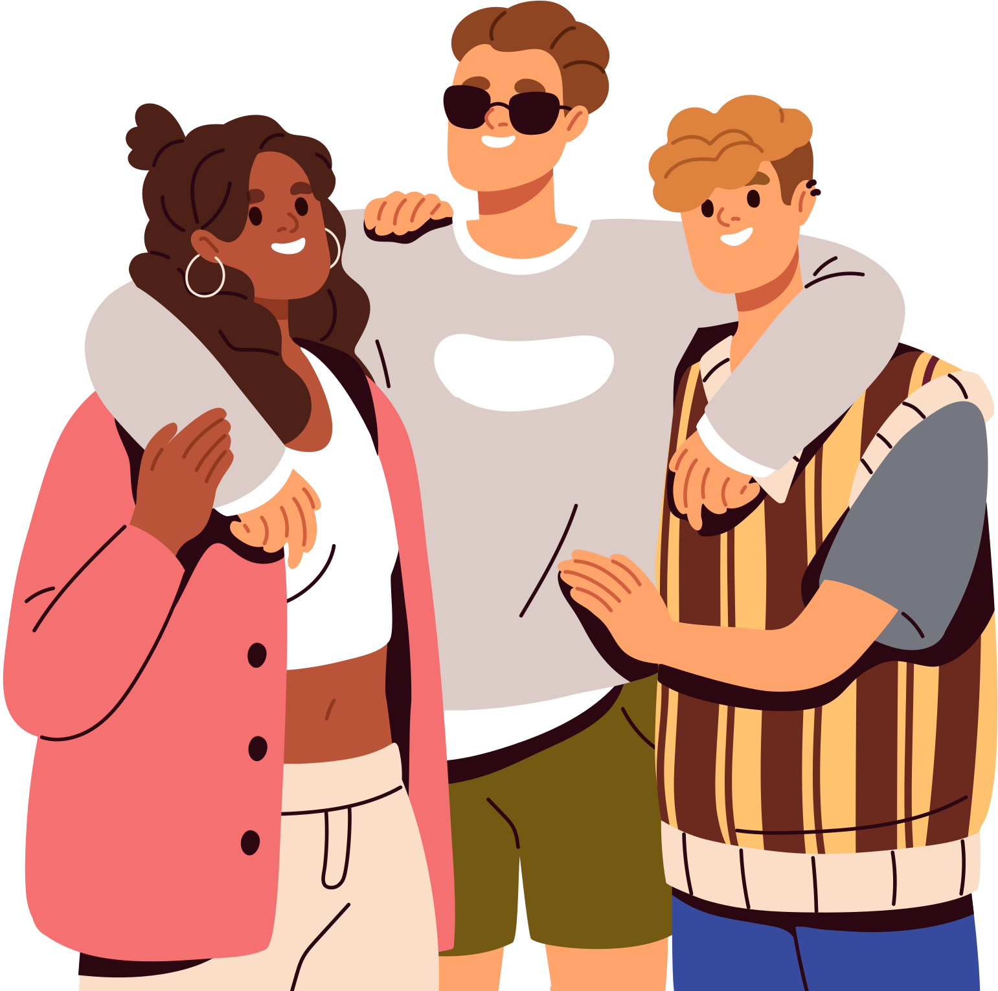
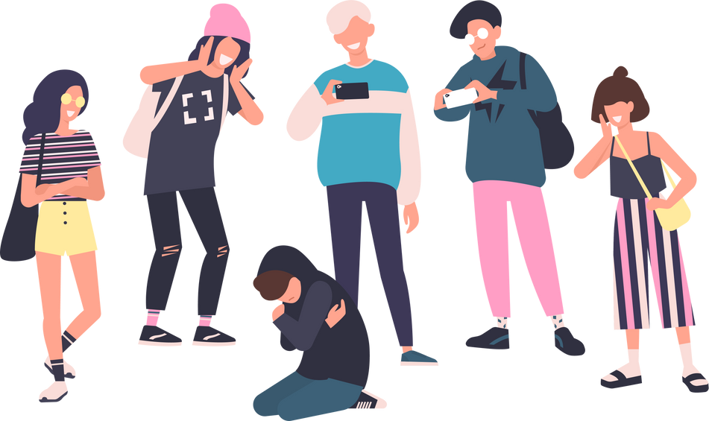

BULLYING OR BANTER?
Grace says that her behaviour towards Noah is “just a laugh” but it isn’t!
He is hurt, attacked, and feels an impact.
What is the difference between Bullying and banter?
Bullying causes upset and great pain to people. People are picked on and singled out due to their appearance, beliefs, or for simply being them.
Banter means everyone finds something funny and nobody is picked on or targeted!

Slide 145
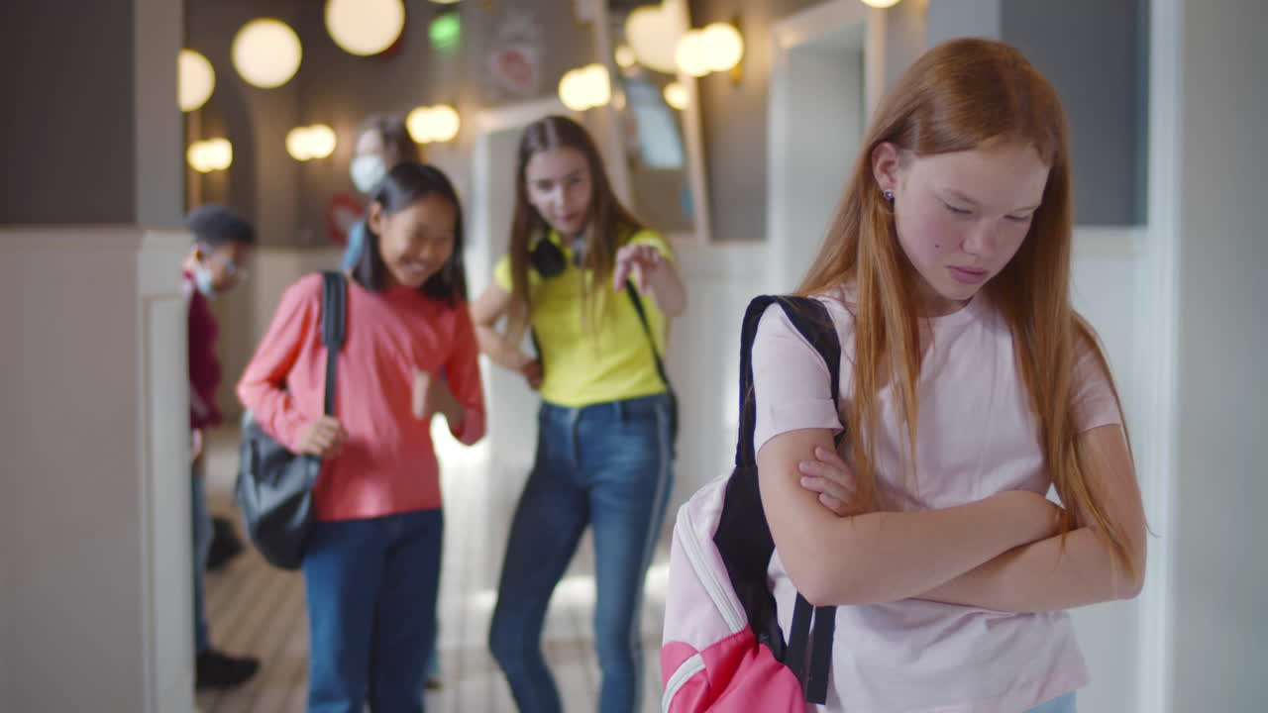
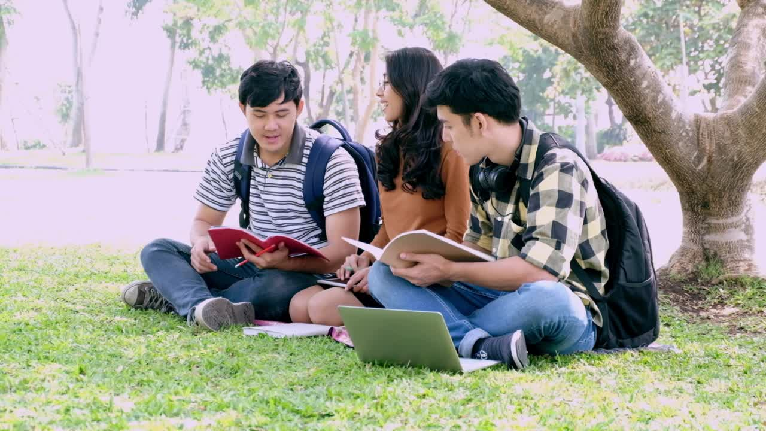
Each day, Ellie calls Mia mean
names during break.
OR
BULLYING
BANTER

Slide 146
Each day, Ellie calls Mia means
names during break.
Ellie is being mean to Mia for no reason at all.
Imagine how hurt Mia would feel?
It is never acceptable to do this to someone!
BULLYING

Slide 147
Gemma and Ben joke that each other’s football team is rubbish, and they both laugh.
OR
BULLYING
BANTER

Slide 148
Gemma and Ben joke that each other’s football team is rubbish, and they both laugh.
This is banter because both Gemma and Ben see the funny side of this joke. They are both involved and find it funny.
It is a friendly joke.
BANTER

Slide 149
Someone makes a joke about Jordan’s weight, and he looks upset, but they say “It’s just a joke!”
OR
BULLYING
BANTER

Slide 150
Someone makes a joke about Jordan’s weight, and he looks upset, but they say “it’s just a joke”
Jordan does not find this funny at all.
Making negative comments about someone’s appearance is mean, cruel and not something anyone should put up with.
BULLYING

Slide 151
Liam laughs at Zara’s new haircut and tells others not to sit with her.
OR
OR
BULLYING
BANTER

Slide 152
Liam laughs at Zara’s new haircut and tells
others not to sit with her.
Poor Zara! She does not deserve to be treated like this. Liam is being unkind and trying to leave her out.
What would you do if you saw this?
BULLYING

Slide 153


It would be false to say that everyone always likes one another and gets on?
How could you treat others that you perhaps do not like, or get on with?
Make a list of the ways we could treat others better.
hOW WE TREAT OTHERS?

Slide 154




hOW WE TREAT OTHERS?
Respect
Kindness
Empathy

Slide 155
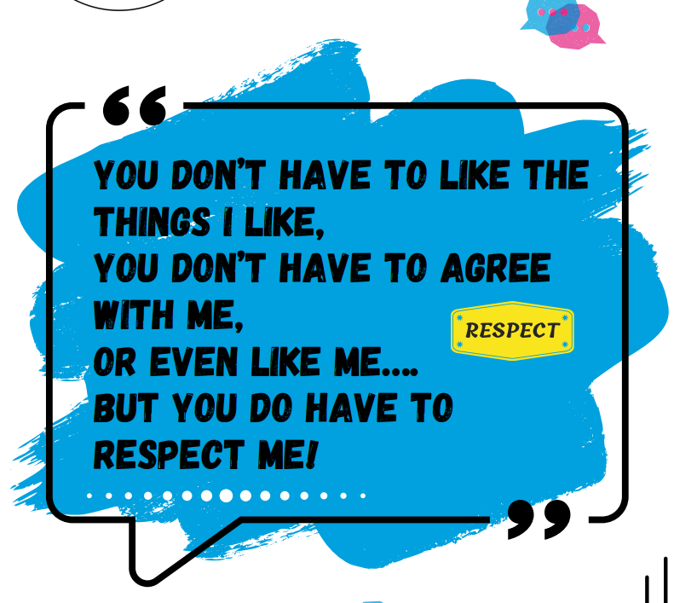


Slide 156


Every action we carry out has an an impact and consequence on others.
Explore these examples:

Slide 157
Behaviour | Impact - how could the person feel?
Being called names and put down
Someone smiles at someone else
Being hit, tripped, pushed or kicked
Someone sits beside the person that has been left out
Being ignored, left out or having rumours spread about you (face to face and/or online) | Isolated, alone, hurt

Slide 158
Behaviour | Impact-how could the person feel?
Being called names and put down | Unhappy, upset and loss of confidence
Someone smiles at someone else | Person feels happy and included
Being hit, tripped, pushed or kicked | Injured, in pain, hurt, upset or hospital trip!
Someone sits beside the person that has been left out | Person feels safe and not alone
Being ignored, left out or having rumours spread about you (face to face and/or online) | Isolated, alone, hurt

Slide 159

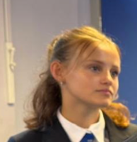
Grace is cruel and unkind to Noah and it is important that she she understands the consequence of her behaviour.
However - she also needs help and support to change. She does not need to behave this way forever. Everyone has this potential.

Slide 160


We find out lots about Grace in this film. She has a great deal of anger and upset within her.
Imagine you are Grace.
Create a mood board that represents how Grace thinks and feels.
Compile a collage of images, colours and words that represent Grace’s emotions/likes/dislikes.

Slide 161

Secondary Age Learning Slides
The Power of All

Slide 162


  So far, Noah is struggling, his mum and dad can see this and Grace dislikes Noah.
  Ava decides she could no longer be a bystander seeing her friend being bullied.
  She decides to: Use her words, Find her voice. Own her power - by telling trusted adults (Noah’s parents), so that he can gain help and support.

Slide 163
If you feel bullying behaviour is wrong - then you are someone who is against bullying.
If you feel bullying behaviour is wrong and you want to do something about it - you are someone who promotes Anti-Bullying. You want to use your POWER to stop it!
Explore the examples on the next slide and write down if they are against bullying or anti-bullying.

Slide 164


Kira felt so sad when she heard her friend being called nasty names. She could not stop thinking about it.
Ahmed could see James being tripped up every day and teased about his trainers. He told the teacher about this as he was so worried.
Reena was fed up with so many pupils being unkind to each other. She asked the teacher if they could create an anti-bullying group in school to teach others.
Dylan was at youth club. He watched as another group of boys and girls left out Max from the games. He felt really guilty and just went home.

Slide 165
Kira felt so sad when she heard her friend being called nasty names. She could not stop thinking about it.
Ahmed could see James being tripped up every day and teased about his trainers. He told the teacher about this as he was so worried.
Against
Reena was fed up with so many pupils being unkind to each other. She asked the teacher if they could create an anti-bullying group in school to teach others.
Dylan was at youth club. He watched as another group of boys and girls left out Max from the games. He felt really guilty and just went home.

Slide 166
Kira felt so sad when she heard her friend being called nasty names. She could not stop thinking about it.
Ahmed could see James being tripped up every day and teased about his trainers. He told the teacher about this as he was so worried.
Against
ANTI
Dylan was at youth club. He watched as another group of boys and girls left out Max from the games. He felt really guilty and just went home.
Reena was fed up with so many pupils being unkind to each other. She asked the teacher if they could create an anti-bullying group in school to teach others.

Slide 167
Kira felt so sad when she heard her friend being called nasty names. She could not stop thinking about it.
Ahmed could see James being tripped up every day and teased about his trainers. He told the teacher about this as he was so worried.
Against
ANTI
Dylan was at youth club. He watched as another group of boys and girls left out Max from the games. He felt really guilty and just went home.
Reena was fed up with so many pupils being unkind to each other. She asked the teacher if they could create an anti-bullying group in school to teach others.
ANTI

Slide 168
Kira felt so sad when she heard her friend being called nasty names. She could not stop thinking about it.
Ahmed could see James being tripped up every day and teased about his trainers. He told the teacher about this as he was so worried.
Against
ANTI
Reena was fed up with so many pupils being unkind to each other. She asked the teacher if they could create an anti-bullying group in school to teach others.
Dylan was at youth club. He watched as another group of boys and girls left out Max from the games. He felt really guilty and just went home.
ANTI
Against

Slide 169

Kira felt so sad when she heard her friend being called nasty names. She could not stop thinking about it.
How could Dylan become Anti?
Against
Dylan was at youth club. He watched as another group of boys and girls left out Max from the games. He felt really guilty and just went home.
How could Kira become Anti?
Against

Slide 170

Kira felt so sad when she heard her friend being called nasty names. She could not stop thinking about it.
Dylan could tell the Youth leader.
If safe-he could ask the others to include Max
Against
Kira could tell a trusted adult.
She could ask her friend if she is ok?
Dylan was at youth club. He watched as another group of boys and girls left out Max from the games. He felt really guilty and just went home.
Against

Slide 171
TIME TO WATCH FILM 5
Alternatively, watch Film 5: The Power of All at www.respectme.org.uk/resources-abw-25/

Slide 172

1. When Ava tells Noah’s parents all about Grace - his mum thanks her and says this is the right thing. Why is it the right thing to do?
4. Why is it important that the school become involved?
2. Why is Ava still not fully convinced that telling the parents is the right thing to do?
5. What would be the best way to reach a resolution?
3. Do you think Noah has felt supported by Ava? Why? Why not?
6. Who had the most power to get Noah help?

Slide 173
1. When Ava tells Noah’s parents all about Grace, his mum thanks her and says this is the right thing. Why is it the right thing to do?
Telling trusted adults - like Noah’s parents -
is vital. Ava alone cannot stop Grace, but together with his parents and school - they can all use their collective power to help him.
2. Why is Ava still not fully convinced that telling the parents is the right thing to do?
She might feel as if she is betraying Noah’s trust. She took quite a while to involve herself...but eventually stood up for him.
3. Do you think Noah has felt supported by Ava? Why? Why not?
This could be yes and no.
She initially stood by him... but allowed her own fears to take over when she did not follow him.

Slide 174

4. Why is it important that the school become involved?
The school and staff can really ensure that Grace learns there are consequences from her behaviour. They can also help protect Noah.
5. What would be the best way to reach a resolution?
Everyone will have a different opinion on this.
An genuine apology could be a step in the right direction.
6. Who had the most power to get Noah help?
Nobody has the most power!
Everyone was needed and valued!
Ava, Noah’s Parents and his teacher all contributed to helping him.

Slide 175
Script under the spotlight
Analysis task
Explore what Noah’s says in more detail
How is he truly feeling?
What are his inner emotions?
How is bullying behaviour impacting on his life?

Slide 176
Script under the spotlight
Near the end of the film, Noah says:
Noah:
“Home and bed...it wasn’t forever?
I thought it was, but things got better...I was angry...at Grace obviously, but also at Ava and Mum and Dad for trying to get involved, but it took everyone to fix this, I’m glad they were there for me. It’s great to have my life back.”

Slide 177
Script under the spotlight
Noah: “Home and bed...it wasn’t forever?
I thought it was, but things got better...I was angry...at Grace obviously but also at Ava and Mum and Dad for trying to get involved but it took everyone to fix this, I’m glad they were there for me. It’s great to have my life back.”
What does Noah mean by “it took everyone to fix this”?

Slide 178
Script under the spotlight
Noah: “Home and bed...it wasn’t forever?
I thought it was, but things got better...I was angry...at Grace obviously but also at Ava and Mum and Dad for trying to get involved but it took everyone to fix this, I’m glad they were there for me. It’s great to have my life back.”
Noah means that it took the power of each and every person to take back control and stop the bullying behaviour from Grace. The power of one means that everyone can do something to spark change - never underestimate impact YOU can make!

Slide 179



What do you predict the future holds?
What could happen now?
Discuss...

Slide 180


You can uplift others and support them.
You can show you are anti-bullying!
When you are bullied - it drains you mentally, physically and emotionally
Complete the task on the next page

Slide 181
We can now bring all of our learning together!
How can you be an upstander and promote Anti-Bullying across your school community?
You now have the opportunity to share your learnings and help others so that nobody has to experience bullying like Noah.
You can do this!

Slide 182



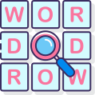
Own your power
Find your voice
Who will you speak to?
How will you convince others?
How will you educate others?
Prevent bullying?
Promote anti-bullying?
Use your words
What will you say to others?
How will you include and support?

Slide 183
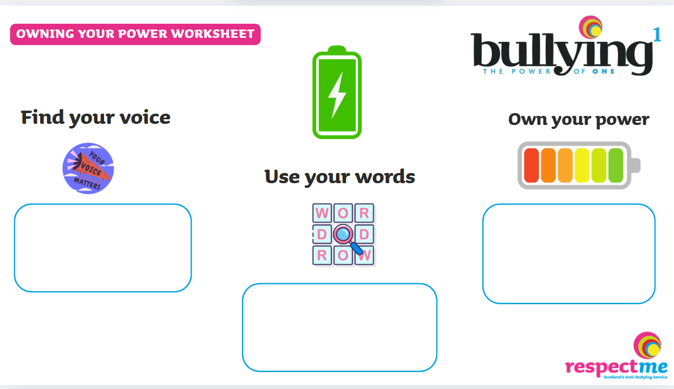

Worksheet available

Slide 184

Find your Voice
Own your Power
Don’t do this! STOP!
Miss/Sir - Can I talk with you?
Create posters and guides.
We can do this together.
Use your Words
Start your youth activist group.
inform others.
Hold assemblies.
Promote respect.
Be kind.
“Well done”
“That’s great”
You are not alone. Come join us.

Slide 185


What have you learned from watching the film series and completing the lessons?
  About power?
  The power of others?
  The power of everyone?
  How we treat others?
  Words we use?
REFLECTION TIME

Slide 186


Worksheet available

Slide 187


  Power Tracker Worksheet
  Character Profile Worksheets

