Slide 1



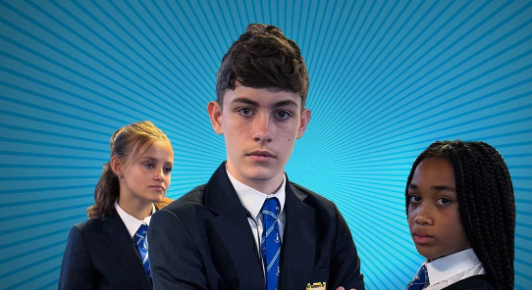

Learning Resource: Suitable for P5-S2
Safer Internet Day
2026

Slide 2

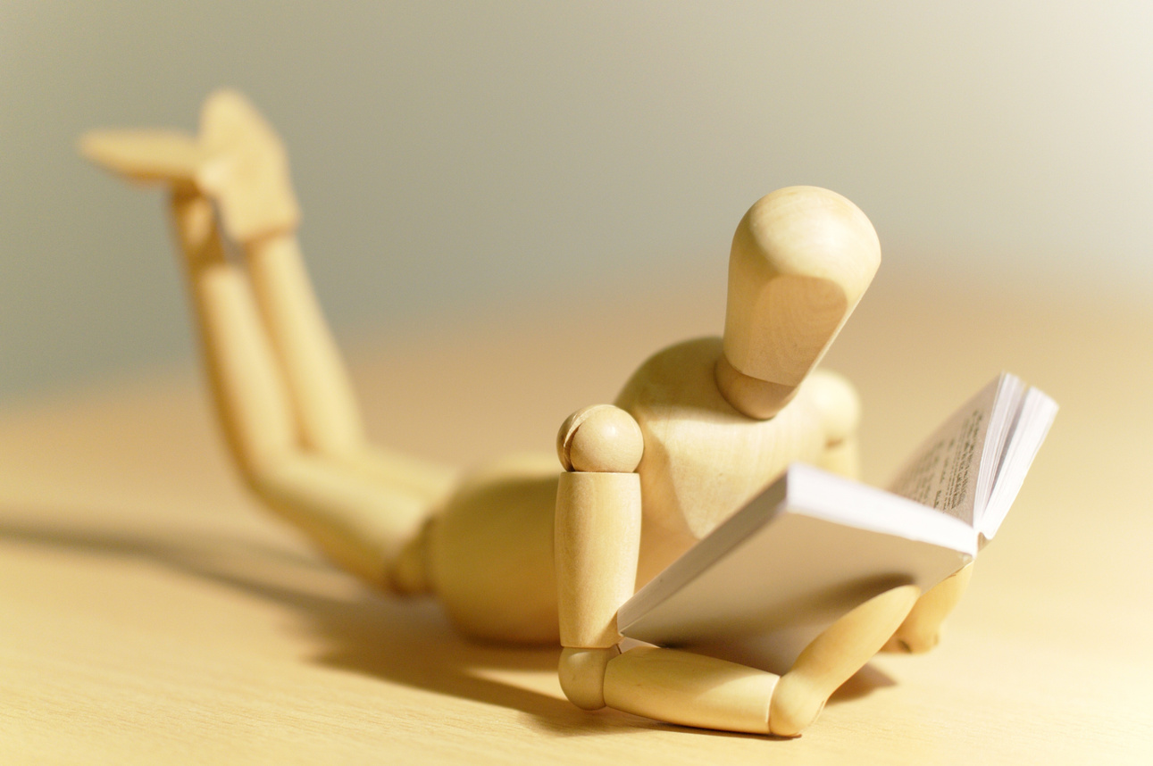
Learning intentions
To be able to:
  Understand how to stay safe online.

Slide 3

Success Criteria
  I can explain how to keep myself and others safe online.

Slide 4


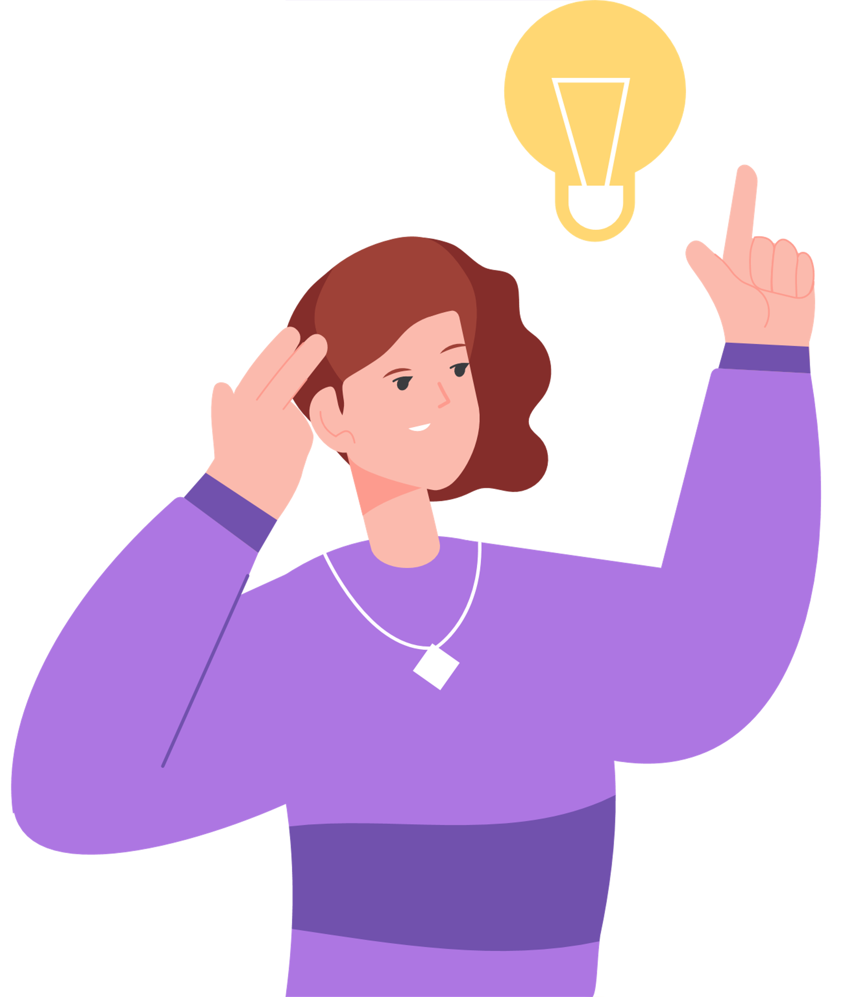
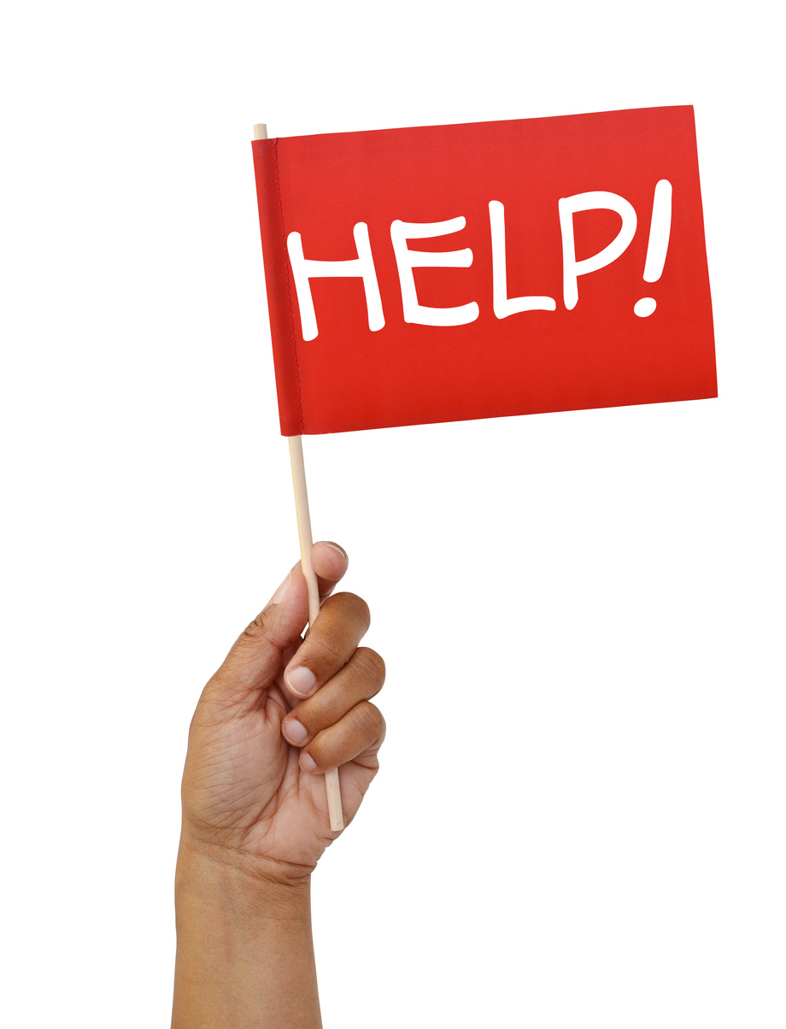
REMEMBER
Through this film series, we will be discussing bullying behaviour and examples of disrespect.
There are scenes that could cause distress
If you are experiencing bullying behaviour - please speak to your teacher, family or trusted adult.
It really can make a difference.

Slide 5


Bullying is never forever

Slide 6

Always remember that things can and do change!

Slide 7



Slide 8




Take time to watch our film:
Bullying: The Power of One
Whilst watching, think about:
  What happens to each character?
  How do you feel about what is happening?
  What would you do if you were in their position?

Slide 9


In pairs, discuss what ways Noah is facing online bullying?

Slide 10




Noah is added to chats that he doesn't want to be part of.
Grace repeatedly messages Noah at home.
Grace even joins chats when Noah is gaming.
Images and chats about Noah are circulated without his permission.

Slide 11


Noah is added to chats that he didn't want to be part of.
Grace repeatedly messages Noah at home.
What is the impact of this behaviour?
Grace even joins chats when Noah is gaming.
Images and chats about Noah are circulated without his permission.

Slide 12
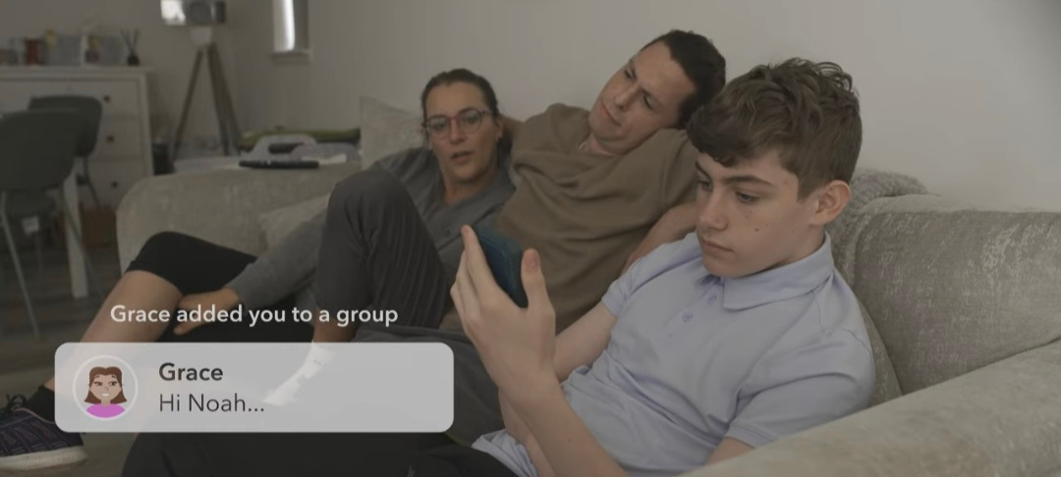
Impact
  Noah cannot escape Grace - his personal space is invaded.
  Noah feels pressurised, sad and overwhelmed.
  Noah feels mocked and humiliated when images and comments are shared.

Slide 13




1. Why does Noah block Grace?
2. Why does Grace react the way she does?

Slide 14

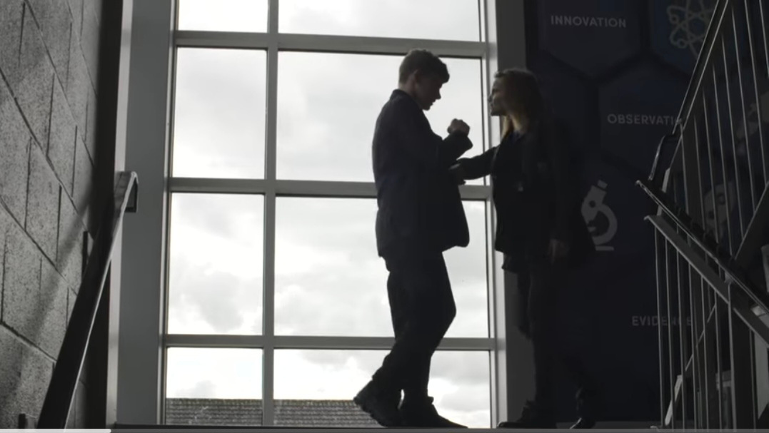
Noah is trying to regain his power.
By blocking Grace; he is able to protect himself and stop her having the freedom to contact him at home - his safe space.
Grace is furious at being blocked. She likes to be in control and hold the power over Noah.

Slide 15
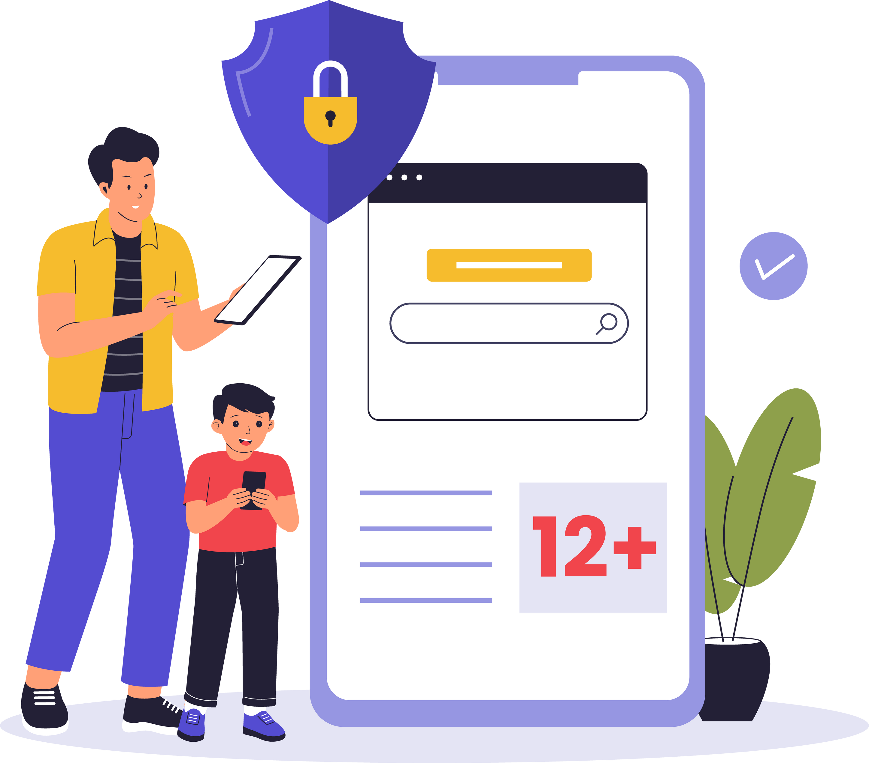



Discuss: What could Noah have done to protect himself further online?

Slide 16

1. Set a digital boundary
If you feel unhappy or uncomfortable with messages that someone sends you can - block that person.
This means they cannot:
  Contact you
  You won't see any messages from them
Staying safe online

Slide 17


2. Change settings
Did you know that you can actually change settings so that only selected people can add you to chats?
Take time to:
  Change settings
  Select who can add you to chats
  Click here for help with changing settings
Staying safe online

Slide 18
2b. Change settings
Make sure that your privacy settings are completely set to Private
  Make sure profiles are locked.
  Keep your details completely private.
  Do not allow strangers or non-friends to explore your profile or chat with you.
Staying safe online

Slide 19

3. Screenshot
It is really important to try and collect and gain evidence. If someone sends messages that are cruel and uncomfortable - take a screenshot. This helps you to collate the information and share your story when you report it.
You can protect yourself and regain power by using your screenshots to report the person sending the information.
Staying safe online

Slide 20
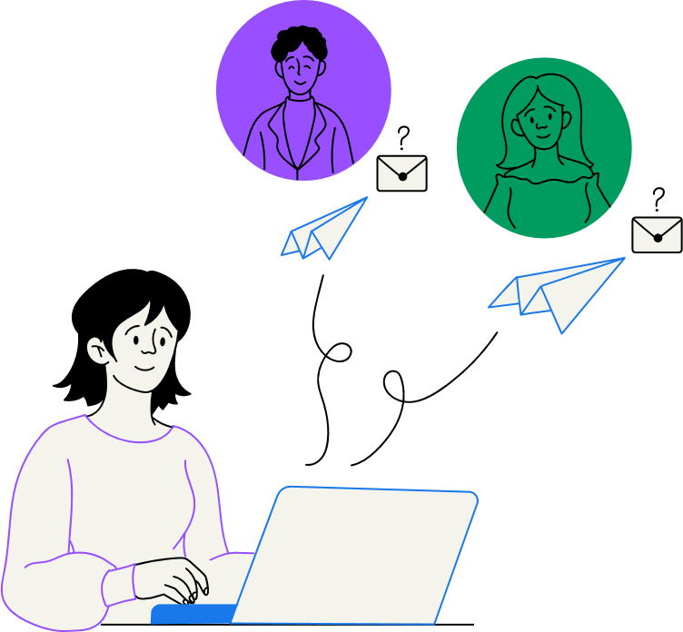

4 .Do not reply
Never reply or engage in negative conversation or comments. The person choosing to bullying you online wants you to do this.
Instead - do not reply so that YOU can reclaim the power in the situation. Silence is still a response. No matter how upset or angry you are - you can choose not to reply.
Staying safe online

Slide 21

5. Tell a trusted adult
All forms of bullying are cruel and unkind. It can make a person feel upset, alone, humiliated and traumatised.
Telling a trusted adult; a family member, teacher or youth leader- can really help and make a massive difference. They can take the right action.
Nobody should have to deal with the worry and burden of bullying behaviour.
Staying safe online

Slide 22

6. Report
You have the right to feel safe online. If something is worrying you and just doesn't feel right, like Noah, most apps have a reporting area/link.
  Reporting means that app owners can investigate and ban whoever is sending malicious messages or creating unkind content.
  This can give you power and control to enjoy the app again
  It can prevent others from also experiencing online bullying or seeing inappropriate content
Staying safe online

Slide 23

7. Never join in
If you see someone being bullied online, make sure that you never join in:
  Do not like cruel comments
  Do not share or re-post mean images and comments
  Avoid commenting in chats where other people are gossiping and criticising others
  Do not write unkind comments to anyone, nobody deserves this
  Help others by reporting bullying behaviour
Staying safe online

Slide 24


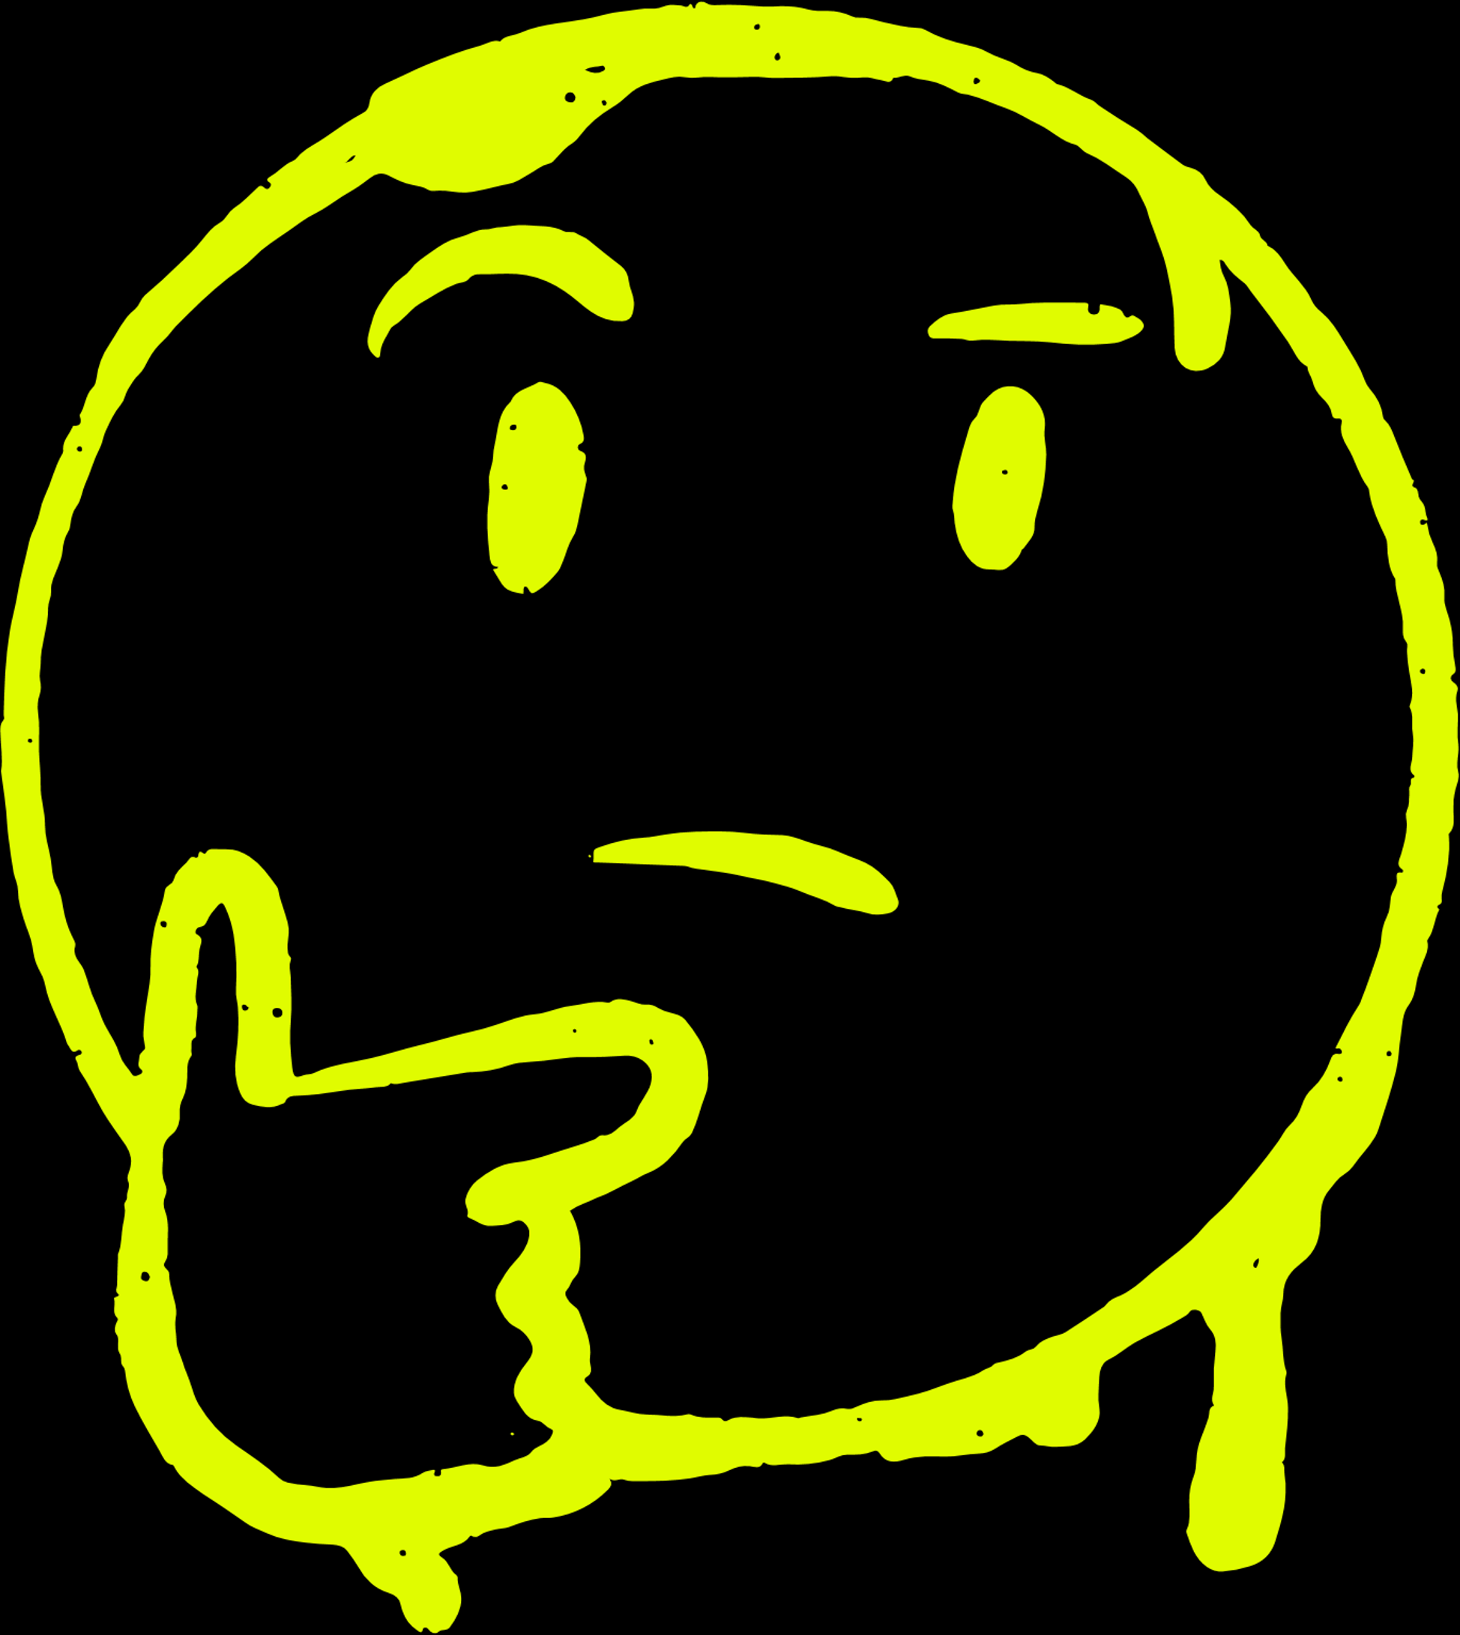
Explore these scenarios!
What should each person do to be safe online?

Slide 25
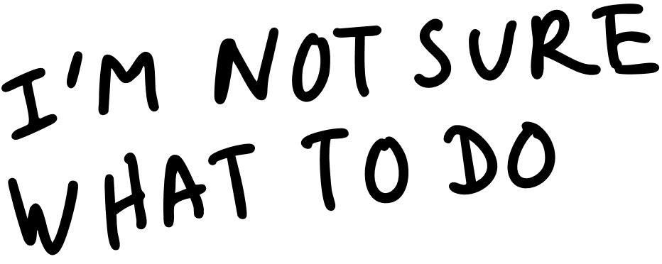
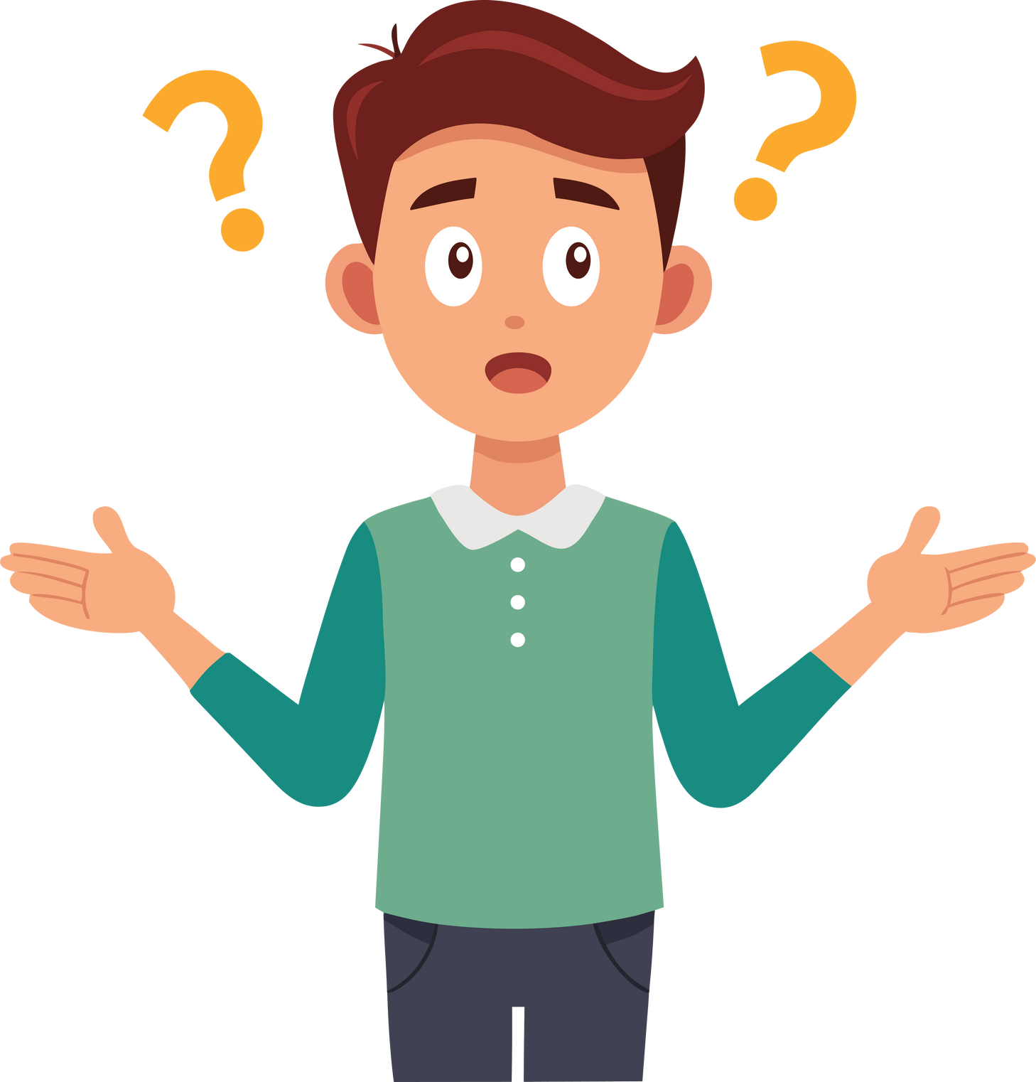

James was completing his homework when he received a notification. He had been added to a chat by someone he didn't know.
What advice would you give James

Slide 26
Melissa posted photos of her dance competition win online. She recieved many likes but also noticed someone had posted mean comments about her appearance.
What advice would you give Melissa?

Slide 27

A whatsApp chat
for the football club was set up for everyone to chat about ideas.
Amir’s friends told him that he had not been added to the group. He also heard that people were making fun of him and making memes of him.
What advice would you give Amir?
What could Amir’s friend do?

Slide 28
You are not alone. Telling a trusted adult can help you bring about change.
Remember! Whether bullying is online or face-to-face, the impact is the same. It is hurtful, upsetting and not right.
  It is never something you should accept or expect.
  It is also against your children’s rights to be bullied.

Slide 29



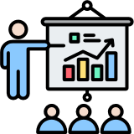



How can you now help educate others on Internet Safety and Online Bullying? Share your learning.
  You could create your own presentation
  Present at assembly
  Make your own leaflet or digital guide
  Write a poem or song
  Create your own film

Slide 30
Safer Internet Day
2026

